Slide 1
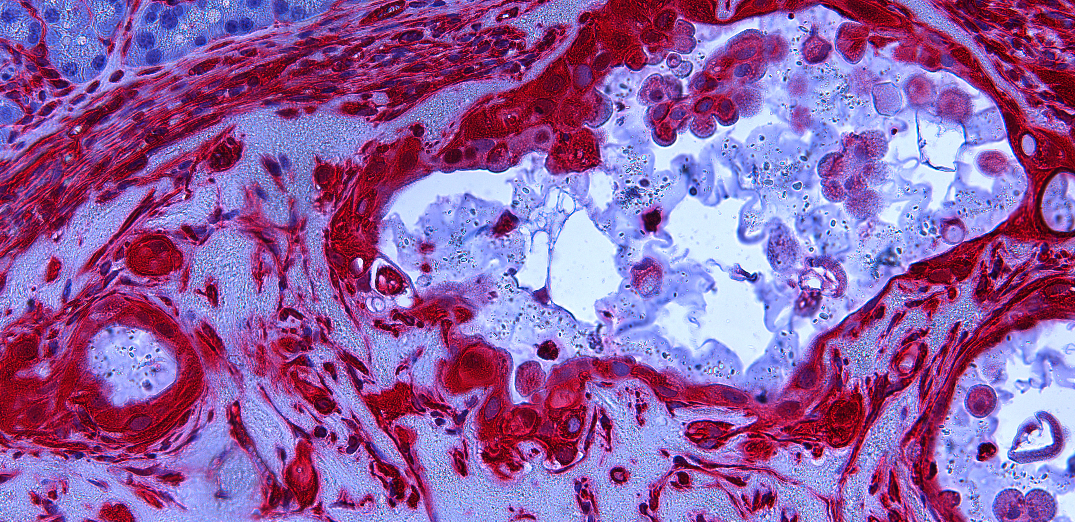
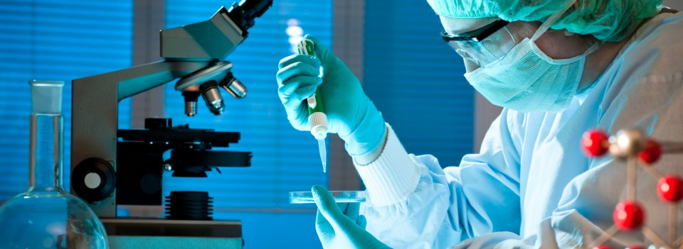
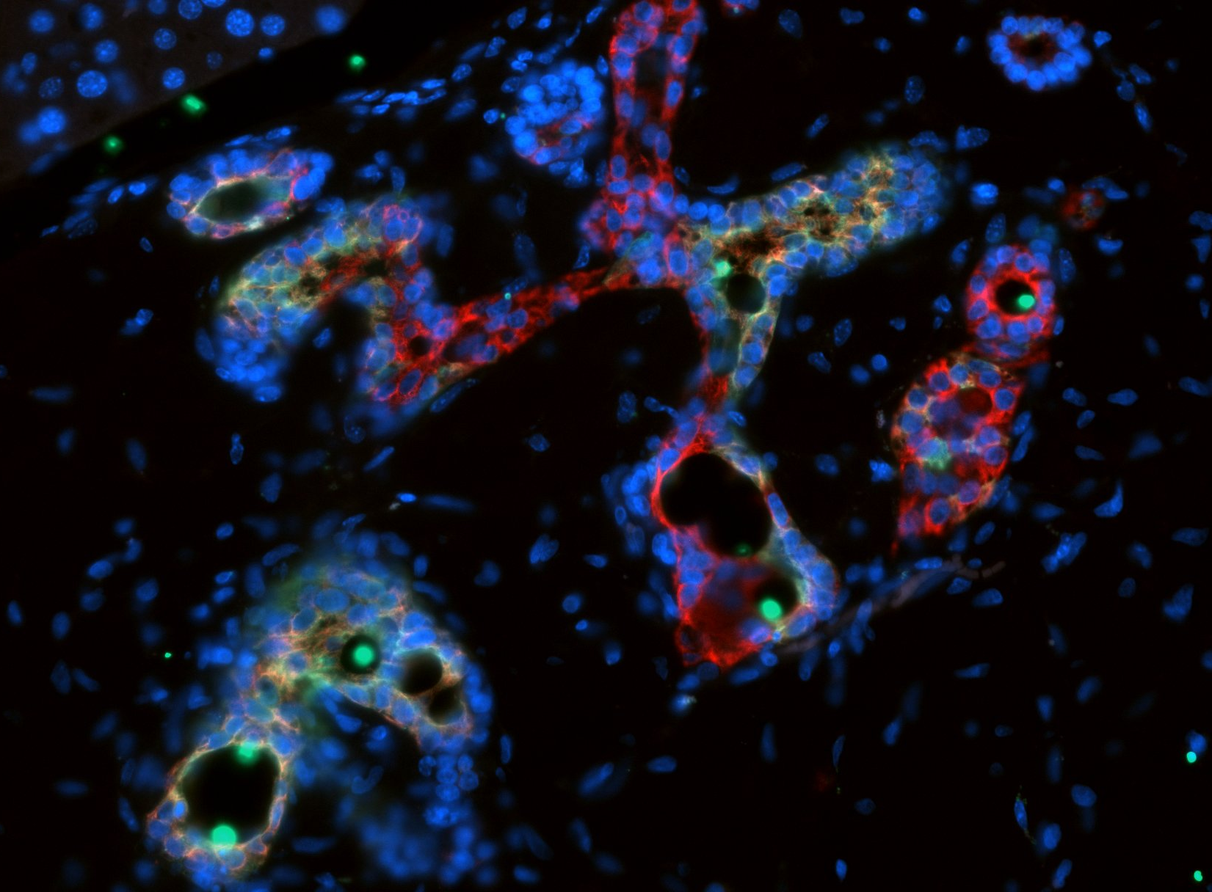
Call for PhD student (f/m/d) Start from October 2023
PhD project:
A successful applicant will investigate druggable cell-intrinsic mechanisms in modulating an immune cell response in pancreatic cancer. The applicant will employ complex 3D co-culture model systems, genetically engineered mouse models as well as human organoid models to perform shRNA and CRISPR library-based screening approaches and study biochemical and biophysical aspects of tumour-niche interactions for entering clinical translation.
What we offer:
Potential for meaningful research and high-impact publications
Opportunity for further projects to guarantee a successful PhD
A strong base for a successful (scientific) career
National and international collaborations
Multifarious work including sophisticated 3D co-culture model system and patient-derived organoid models
Excellent technical support and well-established methods
Tight supervision, while allowing autonomy and giving responsibility
Young and dedicated team with familial team-spirit
Flat hierarchies
What we expect:
Very high intrinsic motivation and dedication to the project
Collaborative, proactive, and ambitious spirit
Structuredness and reliability
Excellent M.Sc. in Life Sciences, Bioinformatics or related discipline
A successful candidate will be closely supervised by Dr. Yuanna Lin.
Dr. Lin is a Clinician Scientist and junior group leader. She has previously worked at the University Hospital Hamburg-Eppendorf and was a postdoc at Georgetown University in Washington DC.
Dr. Yuanna Lin, PhD and Prof. Dr. Alexander Kleger
Ulm, University; Albert-Einstein-Alle 23, 89081 Ulm
Department of Internal Medicine I
Institute for Molecular Oncology and Stem Cell Biology (IMOS)
Mail: yuanna.lin@uni-ulm.de

