Slide 1
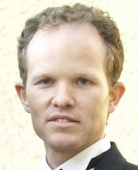




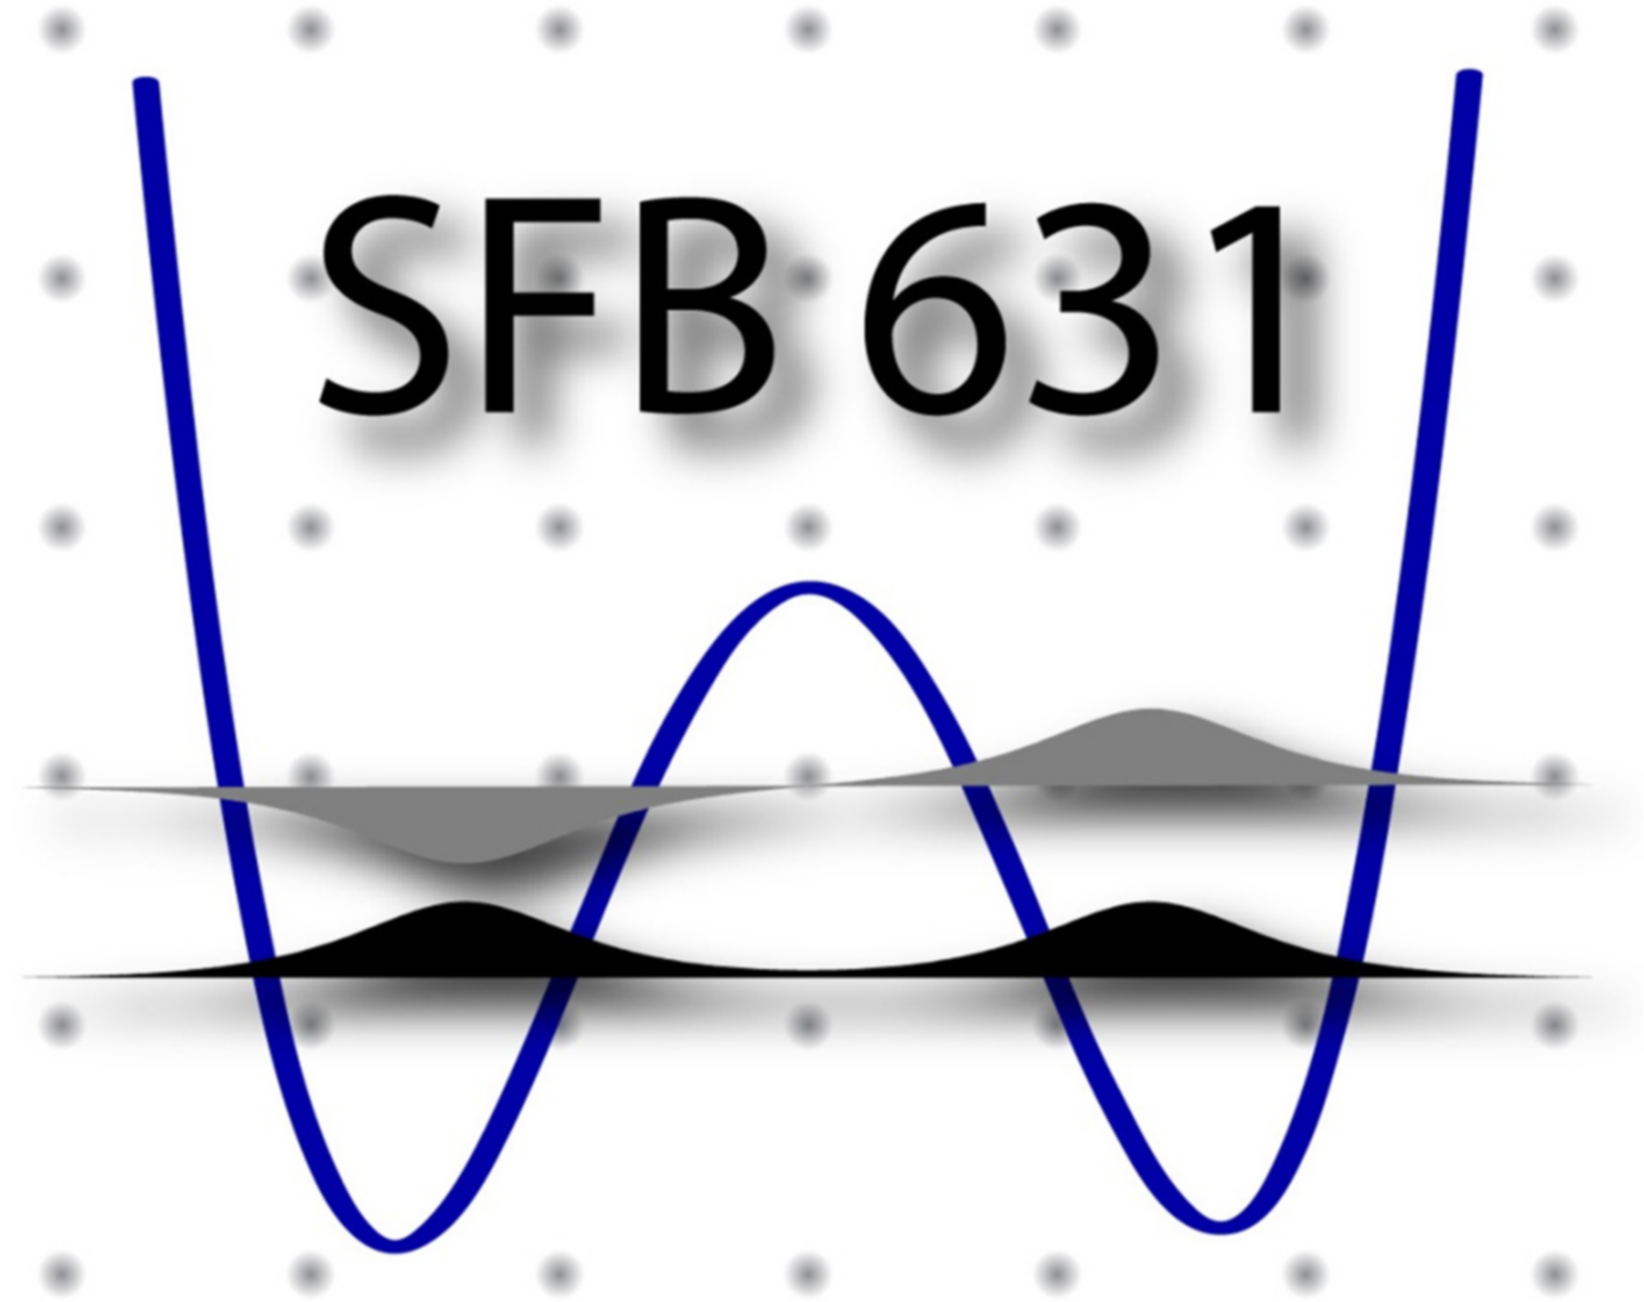



Nonequilibrium steady-state transport through quantum impurity models – a hybrid NRG-DMRG treatment
arXiv:1604.02050
Frauke Schwarz, Andreas Weichselbaum, Jan von Delft

Slide 2

Quantum Impurity Models
discrete quantum system + continuum
Magnetic atom
in metal
(Kondo effect)
STM-studies of
adatoms on surfaces
Transport
through
quantum dot(s)
Phase-coherent transport
Aharonov-Bohm rings
Time-dependent
driving
Nonequilibrium
steady-state transport
eV
V_{g}(t)
Dynamical mean
field theory
(maps lattice model to self-consistent impurity model)
Qubits
(driving + dissipation)

Slide 3


Our method of choice: NRG-DMRG
numerics inside
Numerical renormalization group (NRG)
[Wilson, ’75]
Quantum impurity models
Density matrix renormalization group
(DMRG) [White, ’92]
Quantum chain models
How does NRG work?
How does DMRG work?
Relation between NRG and DMRG
Nonequilibrium steady-state transport
matrix product states

Slide 4
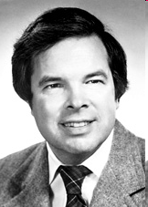
Numerical renormalization group (NRG)
Wilson, RMP 1975; Bulla, Costi, Pruschke, RMP 2008
Crossover from high to low T requires
nonperturbative method: Wilson’s NRG
Logarithmic discretization of conduction band
Map to Wilson chain model with exponentially
decreasing hoppings
Iteratively diagonalize Wilson chain
Method is very flexible, can treat
general impurity models
Wilson
+1
Λ
-1
Λ
-2
0
-Λ
-2
-Λ
-1
-1
1
2
3
4
5
Use recent developments:
- complete basis set [Anders, Schiller, PRL ‘05];
- matrix product state formulation of NRG
[Weichselbaum et al, cond-mat/0504305]
- full density matrix [Peters, Pruschke, Anders, PRB ’06, Weichselbaum, von Delft, PRL ’07]
0
1
2
3
4
5
1
2
3
4
5

Slide 5
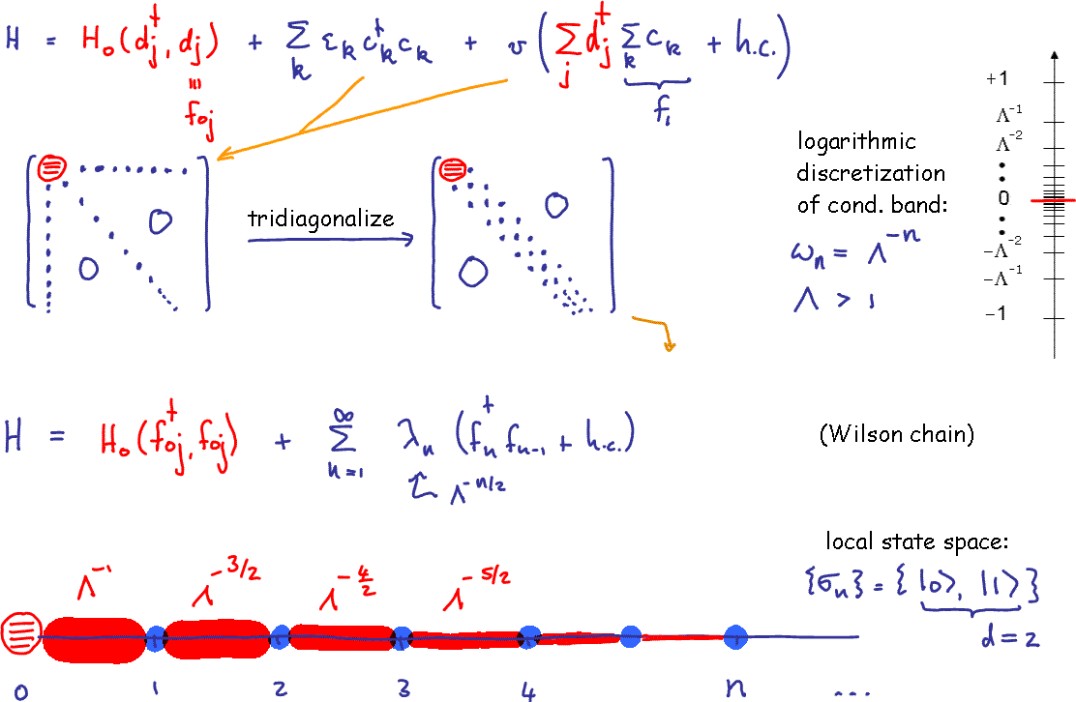
How does NRG work?
Diagonalize chain iteratively, discard high-energy states

Slide 6
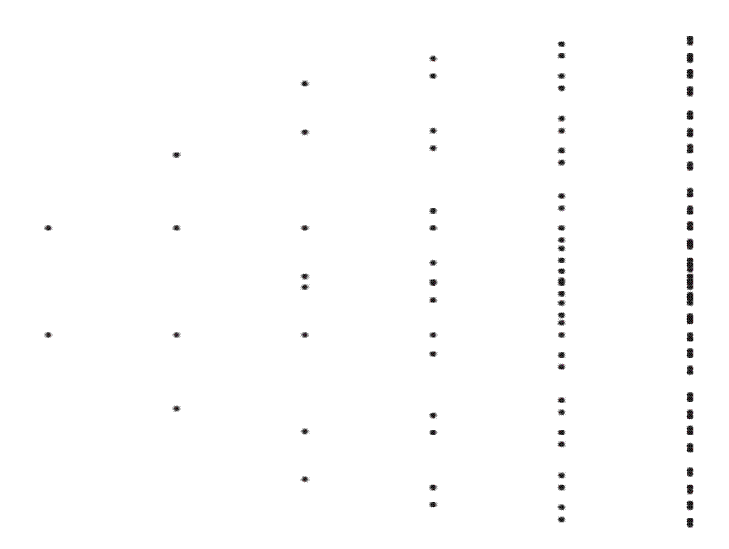
Diagonalize Hamiltonian iteratively
[Wilson, 1975]
complete basis
of exact
many-body
eigenstates of H
Dimension of
Hilbert space
grows as 2^{n}
Truncation
criterion
needed!
s
2

Slide 7
Energy truncation, complete many-body basis
[Wilson, 1975]
[Anders, Schiller, 2005]
build complete many-body basis from discarded states, keeping track of degeneracies
complete basis of (approximate)
many-body eigenstates of H
X 2
X 2
X 2
X 2
X 2
X 2

Slide 8
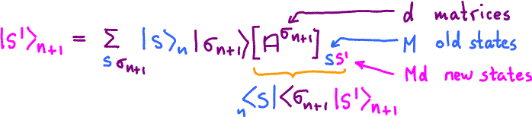
NRG yields Matrix Product States (MPS)
[Weichselbaum,
Verstraete,
Schollwoeck, Cirac,
von Delft, 2005]
iterate:
“matrix product state” (MPS)

Slide 9
NRG yields Matrix Product States (MPS)
[Weichselbaum,
Verstraete,
Schollwoeck, Cirac,
von Delft, 2005]
iterate:
Wilson truncation of high-energy states:
“matrix product state” (MPS)

Slide 10

DMRG truncation strategy
Fix size of matrices:
Variationally optimize ground state
in space of matrix product states:
singular-value decomposition
reshape
0
0
0
retain only largest M singular values
(for given M this maximizes entanglement )
reshape
0
0

Slide 11


Advantages of MPS formulation
For quantum impurity problems:
- First truly "clean" algorithm for spectral functions [Peters, Pruschke, Anders, PRB ‘06]
at finite temperatures (full multi-shell DM) [Weichselbaum, von Delft, PRL 2007]
- Memory reduction by optimizing size of A-matrices
- Logarithmic discretization no longer needed
[Weichselbaum et al, PRB 2009, Guo et al, 2009]
In general:
- Time-dependent problems !! (t-DMRG)
[Daley, Kollath, Schollwöck, Vidal (2004)
White, Feiguin, (2004)]

Slide 12
Many-Body Numerics
meets Quantum Information
Weichselbaum, Verstraete,
Schollwöck, Cirac, von Delft (2005)
Weichselbaum, von Delft (2007)
Saberi, Weichselbaum,
von Delft (2008)
MPS:
matrix product states
Östlund, Rommer (1995)
Verstraete, Porras, Cirac (2004)
NRG: numerical renormalization group (Wilson, 1975)
DMRG: density matrix renormalization group (White, 1992)
quantum impurity models
(discrete states + continuous bath)
magnetic moment + Fermi sea
atom/molecule + surface
quantum dot + leads
qubit + environment
dynamical mean-field theory
quantum chains
spin chains
1-d Hubbard model
quantum wires
polymers
1-d cold atoms
quantum information theory
!!!
nonequilibrium dynamics!!
(time-dependent driving,
quantum quenches)
Daley, Kollath,
Schollwöck, Vidal (2004)
White, Feiguin, (2004)
Notes:
Having told you a nice physics story, I would now like to spend the rest of the talk by dwelling a bit on the technical methods used to achieve the results, and in particular about the perspectives I see for these methods in the future.
The success of this project hinged on using a highly accurate and efficient implementation of the numerical renormalization group.
As indicated earlier, this is a powerful method for dealing with quantum impurity models, where a discrete set of states couples to a continuous bath.
Examples…
approach, based on formulating the latter in terms of matrix product
states.
This formulation establishes a connection to another powerful
numerical method, the density matrix renormalization group approach. I
will conclude my talk by outlining the perspectives for exploiting
this connection to numerically tackle a range of open questions.

Slide 13
Dynamical correlation functions with NRG
  1989: Sakai, Shimizu, Kasuya / Costi, Hewson
  1990: Yosida, Whitaker, Oliveira
  1994: Costi, Hewson, Zlatic - Transport properties (resistivity)
  1999: Bulla, Hewson, Pruschke - Patching rules for combining data from several shells
  2000: Hofstetter - DM-NRG (accurate ground state needed also for
  high-frequency information)
  2004: Helmes, Sindel, Bord - Absorption/emission spectra after quantum quench
  von Delft
  2005: Anders & Schiller - Complete Fock space basis for t-NRG
  2005: Verstraete, Weichselbaum, - Relation between NRG & DMRG via MPS
  Schollwöck, von Delft, Cirac
  2007: Peters, Anders, Pruschke - Sum-rule-conserving spectral functions (single-shell DM)
  2007: Weichselbaum & von Delft - First truly "clean" algorithm for spectral functions
  at finite temperatures (full multi-shell DM)
  2008: Weichselbaum, Verstraete - Non-logarithmic discretization for split Kondo resonance
  Schollwöck, von Delft, Cirac
  2008: Toth, Moca, Legeza, Zarand - Flexible NRG code with non-Abelian symmetries
  2008: Saberi, Weichselbaum, - Detailed comparison between NRG and DMRG
  von Delft
  2009: Anders - Nonequilbrium correlators via scattering state NRG

Slide 14
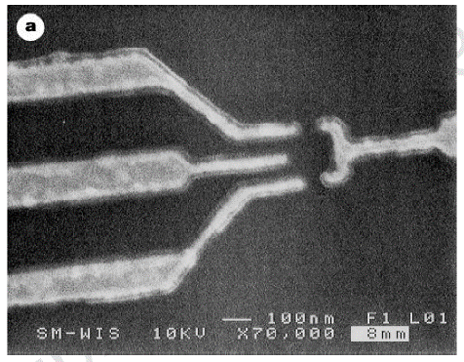
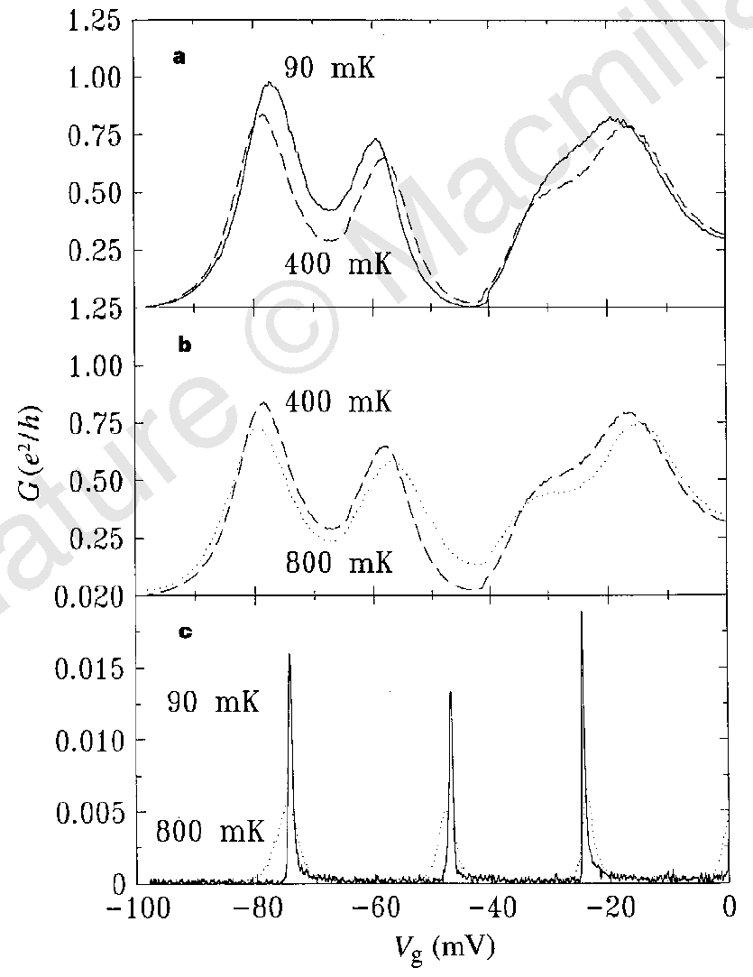
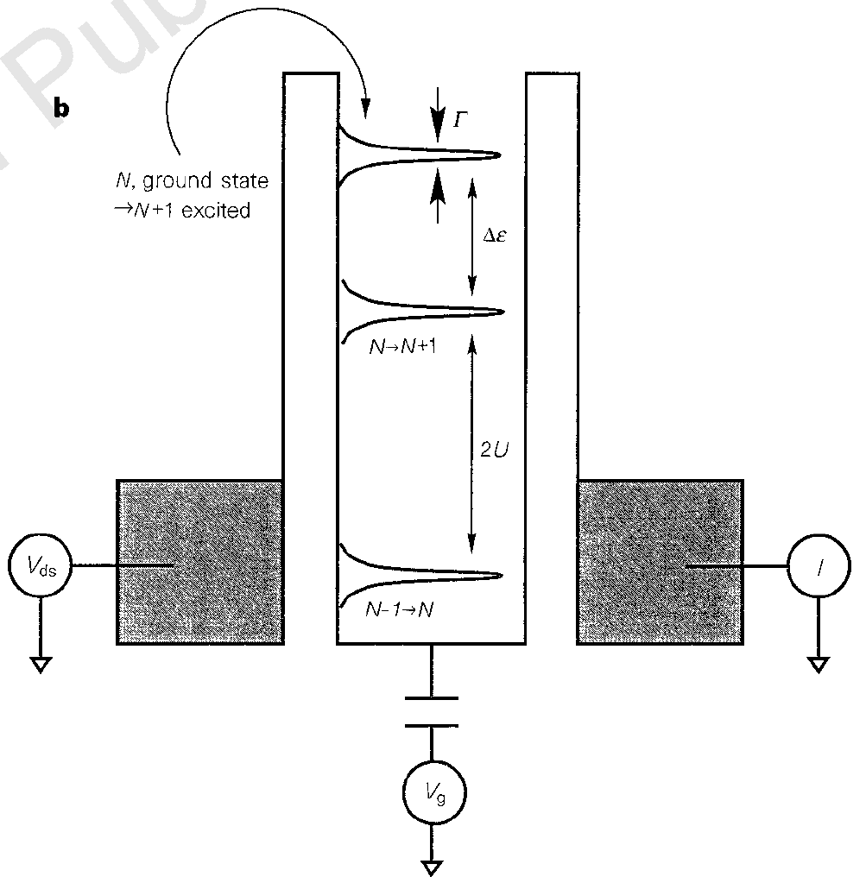
Kondo effect in quantum dots
Goldhaber-Gordon et al., Nature 391, 156 (1998)
Cronenwett et al., Science 281, 540 (1998)
Simmel et al., PRL 83, 804 (1999)

Slide 15
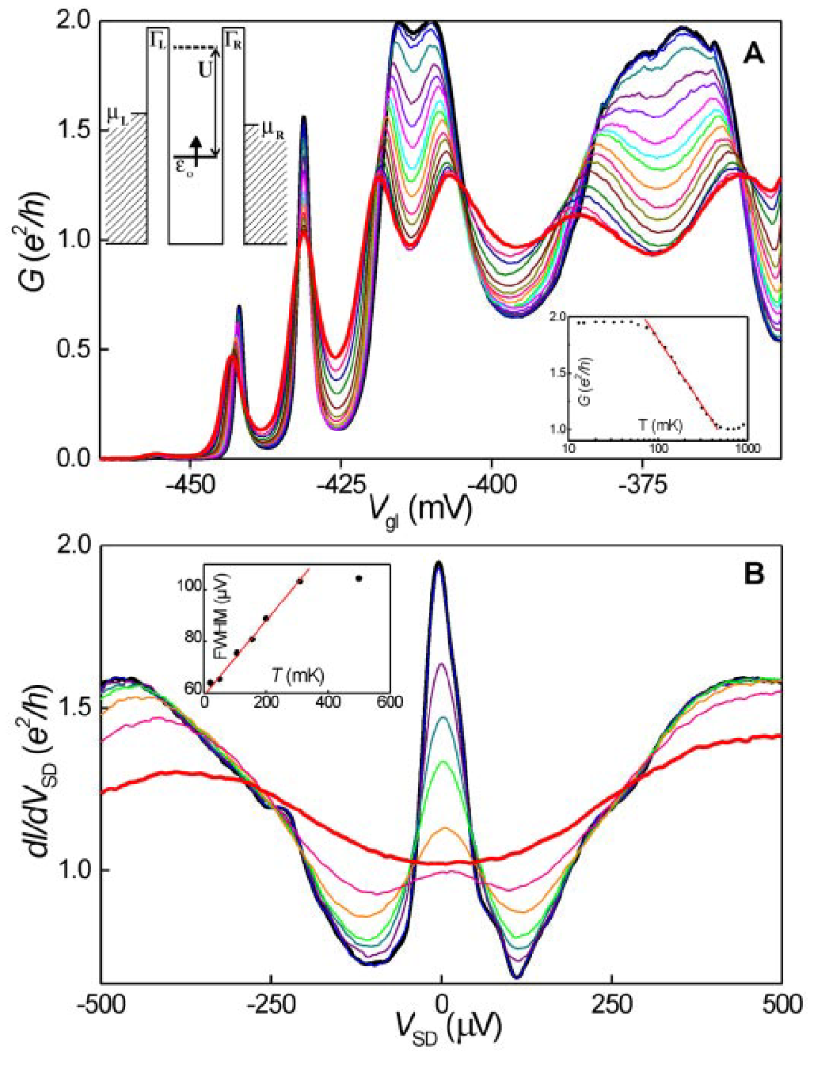
Kondo effect in quantum dots
Goldhaber-Gordon et al., Nature 391, 156 (1998)
Cronenwett et al., Science 281, 540 (1998)
Simmel et al., PRL 83, 804 (1999)
Kondo resonance
- is suppressed by temperature
- splits in magnetic field
van der Wiel et al., Sience 289, 2105 (2000)
B
T
B
sharp resonance in
: „Kondo resonance“
suppressed by temperature:

Slide 16









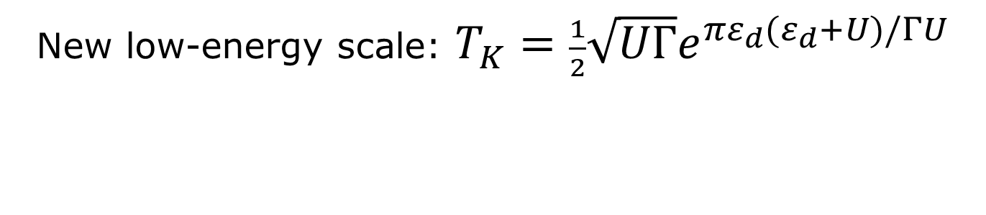
Single-impurity Anderson model (SIAM)
P.W. Anderson, Phys. Rev. (1961)
parameters (all tunable!):
local energy level
charging energy
level width
magnetic field
$$\frac{1}{2}$$
$$\vec{σ}∙\vec{S}$$
New low-energy scale: $T_{K}=\frac{1}{2}\sqrt{UΓ}e^{πε_{d}(ε_{d}+U)/ΓU}$
For T<T_{K} , local spin screened into singlet: “Kondo effect”
Local density of states develops “Kondo resonance”
Kondo resonance is due to many-body correlations between dot and leads
Notes:
Anderson model cartoon: change e to ed, add U indicate gamma, draw hopping pictures, magnetic field
Add another animation in lower right corner
Add yellow message

Slide 17
Nonequilibrium SIAM
Meir, Wingreen, Lee, PRL 1993
parameters (all tunable!):
local energy level
eV
charging energy
level width
magnetic field
$$\frac{1}{2}$$
$$\vec{σ}∙\vec{S}$$
source-drain bias V
New low-energy scale: $T_{K}=\frac{1}{2}\sqrt{UΓ}e^{πε_{d}(ε_{d}+U)/ΓU}$
For T<T_{K} , local spin screened into singlet: “Kondo effect”
Local density of states develops “Kondo resonance”
Kondo resonance is due to many-body correlations between dot and leads
What happens at finite source-drain voltage?
Notes:
Anderson model cartoon: change e to ed, add U indicate gamma, draw hopping pictures, magnetic field
Add another animation in lower right corner
Add yellow message

Slide 18
Nonequilibrium Kondo & SIAM: theory
Meir, Wingreen, Lee, PRB (1993) [equations of motion]
Jakobs, Meden, Schoeller, PRL (2007) [functional RG]
Gezzi, Pruschke, Meden, PRB (2007) [functional RG]
Kehrein, PRL (2005), Fritsch, Kehrein, Ann. Phys. (2009) [flow equation RG]
Anders, PRL (2008) [scattering-states NRG]
Dias da Silva, Heidrich-Meisner, Feiguin, Busser, Martins, Anda, Dagotto, PRB (2008) [tDMRG]
Eckel, Heidrich-Meisner, Jakobs, Thorwart, Pletyukhov, Egger, NJP (2010) [tDMRG, fRG]
Pletyukhov, Schoeller, PRL (2012) [real-time RG]
Smirnov, Grifoni, PRB (2013) [Keldysh effective action]
Reininghaus, Pletyukhov, Schoeller, PRB (2014) [real-time RG]
Cohen, Gull, Reichman, Millis, PRL (2014) [Quantum Monte Carlo]
Dorda, Ganahl, Evertz, von der Linden, Arrigoni, PRB (2015) [auxiliary master equation approach with MPS]
…

Slide 19
Nonequilibrium SIAM: experiment
Kretinin, Shtrikman, Mahalu, PRB (2012)
Universal line shape of the Kondo zero-bias anomaly in a quantum dot

Slide 20
Experimental studies of SIAM
Kretinin, et al. PRB (2012): Spin-$12$ Kondo effect in an InAs nanowire
quantum dot: unitary limit, conductance scaling, and Zeeman splitting
Kondo resonance
splits with magnetic field
How quickly does it split?

Slide 21
Why is nonequilibrium Kondo so difficult?
Kondo physics requires resolving exponentially small energy scales → Wilson chains
numerical methods for Wilson chains (NRG, DMRG) require discretized leads
nonequilibrium steady-state transport requires the description of an open quantum system
particle enter on left, leave on right, dissipate energy in leads
Introduce additional Lindblad reservoirs
Anders, Phys. Rev. Lett. 101, 066804 (2008)
Boulat, Saleur, Schmitteckert, Phys. Rev. Lett. 101, 140601 (2008)
Heidrich-Meisner, Feiguin, Dagotto, Phys. Rev. B 79, 235336 (2009)

Slide 22



Lindblad-driven discrete leads
Dzhioev, Kosov, J. Chem. Phys. (2011)
Ajisaka, Barra, Meja-Monasterio, Prosen, PRB (2012)
Schwarz, Goldstein, Dorda, Arrigoni, Weichselbaum, von Delft, arXiv:1604.02050, accepted in PRB (2016)
Lindblad driving rate
peak width:
= level spacing
Hybridization
Lindblad driving should reproduce
bare Green’s functions!

Slide 23

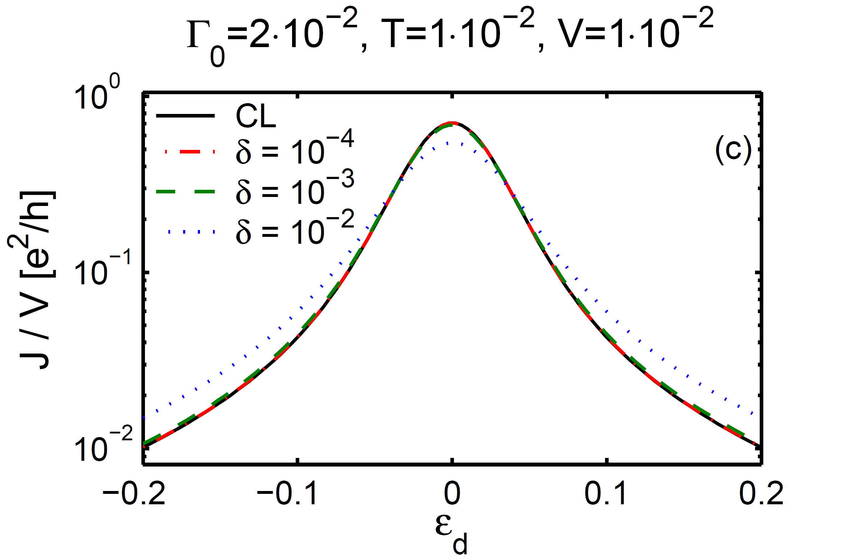
Noninteracting Resonant Level Model
Schwarz, Goldstein, Dorda, Arrigoni, Weichselbaum, von Delft, arXiv:1604.02050, accepted in PRB (2016)
condiction on Lindblad driving $γ$ versus level spacing $δ:$
to reproduce continuum leads: $δ≤$

Slide 24


Log-linear chain
Güttge, Anders, Schollwöck, Eidelstein, Schiller, PRB (2013)
Lindblad driving
becomes nonlocal
map to chain
Lindblad
driving
effective NRG basis¹
DMRG methods
Linear within the transport window
Logarithmic outside the transport window
Exponentially small
energy scales
¹Anders, Schiller, PRL (2005)
Notes:
Für die Diskretisierung habe ich jeweils drei Parameter: Lambda, Level-Spacing im Transportfenster und Größe des Transport-Fensters.
D*: entspricht für T=0 fast exakt dem chemischen Potential. Für den Plot bei endlicher Temperatur wähle ich D* so, dass die Fermifunktion dort auf ca. 1e-3 abgefallen ist, das entspricht für V=0 in etwa D*=7T.
Den Übergang von logarithmisch nach linear gestalte ich "smooth". Die NRG geht nur bis wenige Sites vor D*.
Für die NRG habe ich drei Parameter. Lambda, Nkeep und N. N ist, wie am Freitag diskutiert, die Anzahl an Sites, nachdem ich die Teilchen und Löcher tridiagonalisiert habe und damit eine effektive Einkanal-Rechnung erhalte.
Was Nkeep anbelangt, so verwende ich für die Sites zuvor deutlich größere Nkeep, da dies den Rechenaufwand nur im NRG-Lauf zu Beginn geringfügig verlängert. Relevant für den tatsächlichen Rechenaufwand ist nur das Nkeep der letzten Site.
DMRG: stol ist die SVD-Toleranz. Nkeep die maximal behaltene Bonddimension. Für die DMRG trunkiere ich dynamisch nach svd. Ist ein vorgegebens Nkeep erreicht, breche ich ab. Der Code enthält aber auch eine maximale Zeit, nach der er aufhört, falls Nkeep noch nicht erreicht ist (meistens war bisher Nkeep das Abbruchkriterium).

Slide 25








Chain doubling to keep Lindblad local
Mapping the Hamiltonian onto a chain destroys locality of the Lindblad driving
Antonius Dorda, Enrico Arrigoni,
private communication:
Solution: Equivalent Lindblad equation reproducing
the same hybridization, but with
“double leads”,
absorb information
on occupation functions
into couplings
driven to
partial filling
driven
to empty
driven
to filled
driven
to empty
driven
to filled
driven
to empty
driven
to filled
Notes:
The Lindblad setup we are aiming for must have Lindblad matrices Lambda^{(1,2)} that are proportional to the identity matrix in their q indices. They thus cannot contain any information about Fermi functions. Moreover, the occupation number towards which such matrices drive any level q is actually independent of q [see Eq. (42)]. The levels in the local scheme thus cannot correspond to physical levels; instead, they have the status of auxiliary levels, and Fermi-function information will have to be encoded in their coupling strengths to the impurity. To see heuristically how such a Lindblad driving can still be used to mimic thermal leads, we note that a physical level with occupancy f is empty with probability 1-f and filled with probability f. Now, occupancies of empty or filled are describable using q-independent diagonal Lindblad matrices, at the cost of introducing a new index, \eta= 1 or 2, to distinguish the two cases. In the local setup we thus `double' all levels: each physical level q from the non-local setup, having energy \epsilon_q and impurity coupling strength |v_{iq}|^2, is replaced by a pair of two auxiliary levels, q \to {q\eta} with \eta \in {1,2}, both with the same energy \epsilon_q. We take the auxiliary level with = 1 to have coupling strength |v_{iq}|^2[1 –f] while being Lindblad-driven towards occupancy zero, and the auxiliary level with \eta = 2 to have coupling strength |v_{iq}|^2 f("q) while being Lindblad-driven towards occupancy one. This level-doubling construction is depicted schematically in Figs. 8(a) and (b). As will be shown below, the local setup leads to the same hybridization function as the non-local one, and hence describes the same impurity physics.

Slide 26

Log-linear double chain
recombine
NRG chains
Lindblad driving
remains local
map to chain
Lindblad
driving
effective NRG basis
DMRG methods
MPS/MPO methods
Option 1. Compute steady-state density matrix using
(a) quantum trajectory methods (à la Andrew Daley)
(b) matrix operator methods (à la Mari-Carmen Bañuls, Pietro Silvi)
(not efficient for this problem)
(collaboration with
Albert Werner, Jens, Eisert)
Notes:
1.) Tridiagonalizaion of holes and particles separately. The first sites of these two chains are summarized and tridiagonalized (such that holes and particles are mixed and form a single chain). This then resembles a standard Wilson chain. Using NRG one can find an effective truncated low-energy basis for this part.
(Genaugenommen entsteht hier eine Subtilitaet. Die letzte NRG-hole-Site bzw. die letzte NRG-particle-site, die dann an die beiden DMRG-Ketten ankoppeln sind -wegen der zusaetzlichen Tridiagonalisierung- Linearkombinationen der letzten wenigen Sites meines NRG-Laufes. Zwischen diesen Sites trunkiere ich im Sinne der Standard-NRG. Ich habe den Operator, der an die DMRG-Sites ankoppelt daher nur in einer trunkierten Form. Es sollte aber in Ordnung sein, da das ganze dank Energieskalenseparierung recht lokal bleibt. Aehnliches passiert meiner Ansicht nach beispielsweise auch in der Interleaved-NRG, wo man den Operator eine Site weiterzieht, obwohl man trunkiert!)
Wo auch immer du die log-lineare Diskretisierung motivierst, dort muss natuerlich schon einfliessen, dass die logarithmische Diskretisierung und die NRG eine eindeutige Energiereferenz benoetigen, was aber kein Problem ist, da wir NRG nur fuer Energien verwenden, die wensetlich groesser sind als die Energieskalen, auf denen Transport stattfindet.
1b.) For the DMRG part we keep holes and particles separately such that the thermal state of the decoupled leads for this part is just a product state.
2.)Technically we can imagine the truncated effective NRG basis to form the local dimension of one MPS site. On this MPS we perform standard second order Trotter time evolution.
Genaugenommen tritt dabei folgendes Problem auf: ein Trotter-Operator verknuepft die erste DMRG-Site mit der Site, die die effektive Basis darstellt. Will man hier exponentieren (e^-iHt), wuerde man implizit lauter "trunkierte Einsen" der effektiven Basis einschieben. Deshalb wechsel ich hin und her zwischen zwei Bildern, in dem eine Site mehr oder weniger zur effektiven Basis dazugehoeren. Der Einfachheit halber wuerde ich darauf aber nicht eingehen. Es ist vermutlich auch der noch am wenigsten optimierte Teil meines Codes. Vielleicht muss ich das auch nochmal mit Andreas diskutieren. Letztlich war das aber nie ein Problem. Spontan wuerde ich vermuten (bzw mich zurueckerinnern), dass man auch mit den eingeschobenen Einsen passable Ergebnisse bekommt.
3.) At t=0 we have a product state of holes and particles and for the "site" corresponding to the NRG basis just the ground state (or any state in the ground state sector). One can get better convergence (e.g. in the sense of smaller amplitudes of the oscillations) if the Quench between NRG and DMRG is done slowly, meaning that the coupling connecting the NRG part of the chain with the DMRG part is zero in the beginning and is then increased slowly until it reaches its full value. (De facto lasse ich die Kopplung einfach linear mit jedem Zeitschritt anwachsen, bis sie ihren tatsaechlichen Wert erreicht hat.)
4.) After each time step we can calculate the current, the dot occupation or any other expectation value. (Nicht ganz trivial ist die Tatsache, dass durch Vermischen von linker und rechter Zuleitung der Strom nicht mehr einfach direkt an der Impurity bestimmt werden kann. Man kann aber aber alle Erwartungswerte <d^dagger f_n> rechnen [wobei sich f_n auf die NRG- und DMRG-Sites bezieht] und daraus <d^dagger c_n> bestimmen, woraus wiederum recht unmittelbar der Strom folgt. )

Slide 27
Quench from initial product state
recombine
NRG chains
MPS methods suffice!
map to chain
Initial state:
„holes states“: empty
„particles states“: filled
ground state of impurity,
renormalized by
high-energy lead states
(today’s talk)
Option 2. Switch off Lindblad driving!
- start from decoupled initial product state
- quench: turn on coupling at t=0, compute unitary evolution by tDMRG
(à la Peter Schmitteckert, Fabian Heidrich-Meisner, but with ‘better’ starting point)
Notes:
1.) Tridiagonalizaion of holes and particles separately. The first sites of these two chains are summarized and tridiagonalized (such that holes and particles are mixed and form a single chain). This then resembles a standard Wilson chain. Using NRG one can find an effective truncated low-energy basis for this part.
(Genaugenommen entsteht hier eine Subtilitaet. Die letzte NRG-hole-Site bzw. die letzte NRG-particle-site, die dann an die beiden DMRG-Ketten ankoppeln sind -wegen der zusaetzlichen Tridiagonalisierung- Linearkombinationen der letzten wenigen Sites meines NRG-Laufes. Zwischen diesen Sites trunkiere ich im Sinne der Standard-NRG. Ich habe den Operator, der an die DMRG-Sites ankoppelt daher nur in einer trunkierten Form. Es sollte aber in Ordnung sein, da das ganze dank Energieskalenseparierung recht lokal bleibt. Aehnliches passiert meiner Ansicht nach beispielsweise auch in der Interleaved-NRG, wo man den Operator eine Site weiterzieht, obwohl man trunkiert!)
Wo auch immer du die log-lineare Diskretisierung motivierst, dort muss natuerlich schon einfliessen, dass die logarithmische Diskretisierung und die NRG eine eindeutige Energiereferenz benoetigen, was aber kein Problem ist, da wir NRG nur fuer Energien verwenden, die wensetlich groesser sind als die Energieskalen, auf denen Transport stattfindet.
1b.) For the DMRG part we keep holes and particles separately such that the thermal state of the decoupled leads for this part is just a product state.
2.)Technically we can imagine the truncated effective NRG basis to form the local dimension of one MPS site. On this MPS we perform standard second order Trotter time evolution.
Genaugenommen tritt dabei folgendes Problem auf: ein Trotter-Operator verknuepft die erste DMRG-Site mit der Site, die die effektive Basis darstellt. Will man hier exponentieren (e^-iHt), wuerde man implizit lauter "trunkierte Einsen" der effektiven Basis einschieben. Deshalb wechsel ich hin und her zwischen zwei Bildern, in dem eine Site mehr oder weniger zur effektiven Basis dazugehoeren. Der Einfachheit halber wuerde ich darauf aber nicht eingehen. Es ist vermutlich auch der noch am wenigsten optimierte Teil meines Codes. Vielleicht muss ich das auch nochmal mit Andreas diskutieren. Letztlich war das aber nie ein Problem. Spontan wuerde ich vermuten (bzw mich zurueckerinnern), dass man auch mit den eingeschobenen Einsen passable Ergebnisse bekommt.
3.) At t=0 we have a product state of holes and particles and for the "site" corresponding to the NRG basis just the ground state (or any state in the ground state sector). One can get better convergence (e.g. in the sense of smaller amplitudes of the oscillations) if the Quench between NRG and DMRG is done slowly, meaning that the coupling connecting the NRG part of the chain with the DMRG part is zero in the beginning and is then increased slowly until it reaches its full value. (De facto lasse ich die Kopplung einfach linear mit jedem Zeitschritt anwachsen, bis sie ihren tatsaechlichen Wert erreicht hat.)
4.) After each time step we can calculate the current, the dot occupation or any other expectation value. (Nicht ganz trivial ist die Tatsache, dass durch Vermischen von linker und rechter Zuleitung der Strom nicht mehr einfach direkt an der Impurity bestimmt werden kann. Man kann aber aber alle Erwartungswerte <d^dagger f_n> rechnen [wobei sich f_n auf die NRG- und DMRG-Sites bezieht] und daraus <d^dagger c_n> bestimmen, woraus wiederum recht unmittelbar der Strom folgt. )

Slide 28







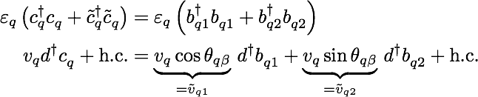
Thermofield Approach
de Vega, Bañuls, PRA (2015)
Purification:
Rotation:
Hamiltonian in doubled space depends Fermi functions
„holes“ „particles“
Steady-state
nonequilibrium:

Slide 29

Thermofield Approach
de Vega, Bañuls, PRA (2015)
Purification:
Rotation:
Hamiltonian:
„holes“ „particles“
kinetic term remains simple
hybridization now depends
on Fermi functions

Slide 30


Interacting Resonant Level Model (IRLM)
t’=t/2
Boulat, Saleur, Schmitteckert
PRL 101,140601 (2008).
Solved this model by two methods:
1. Bethe ansatz
2. tight-binding chain,
turn on dot-lead coupling at t=0
compute unitary evolution by tDMRG
Notes:
To do: tight-binding chain

Slide 31
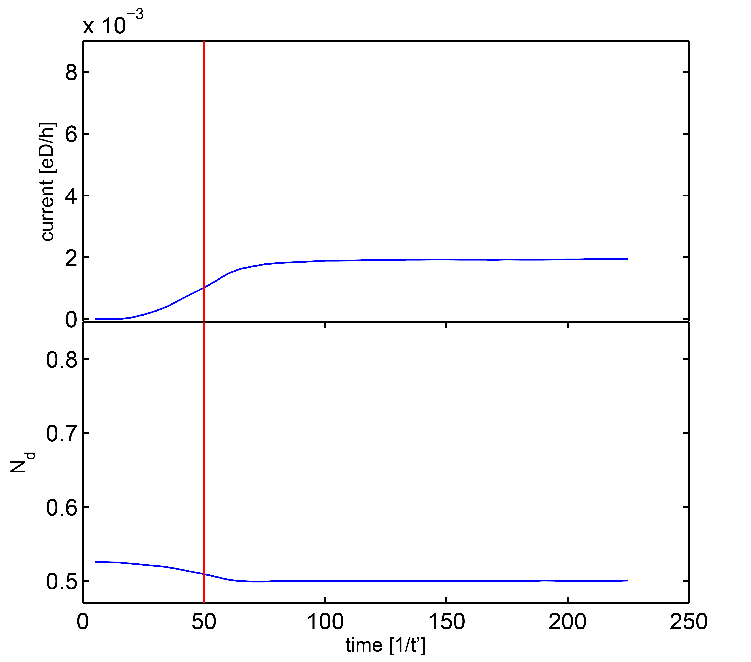
IRLM: hybrid NRG+DMRG
t’=D/2
current
Start with product state for decoupled leads:
level occupation
Logarithmic discretization for large
energies and NRG basis allows us
to reach much lower energies!
switch on coupling to leads at t=0
time evolve with voltage-dependent
Hamiltonian
Notes:
IRLM_diffU (rechts oben)
Diskretisierung: Lambda = 2, delta/D*=0.01, D* \approx mu
keine NRG!
DMRG: stol=1e-4, Nkeep:100-700
auch hier ist die Dot-Besetzung für größere Spannungen nicht
konvergiert, ähnlich zu Fig IRLM_1.pdf und IRLM_2.pdf
IRLM_Scaling_tprime_small (rechts unten)
Diskretisierung: Lambda = 2, delta/D*=0.1, D* \approx mu
NRG: Nkeep=300, 10<=N<=22.
DMRG: stol=1e-3-1e-4, Nkeep:270-350
Hier bekomme ich saubere Oszillationen. Die Dot-Besetzung ist für große Spannungen jedoch nicht konvergiert. Im Anhang dazu Figure IRLM_1.pdf (Strom über Zeitschritte für größte Spannung) und IRLM_2.pdf (die zugehörige Dot-Besetzung, die eigentlich 0.5 erreichen sollte!). Die Oszillationen lassen sich in Relation mit der Spannung setzen (T_osz ~ 4pi/V Wenn ich mich richtig erinnere, vermisste ich in der Diskussion mit Andreas mal einen Faktor 2, aber das kann ich dir im Moment nicht mehr genau sagen.) In vielen Fällen scheint es aber nur fast und nicht ganz zu passen (??).

Slide 32
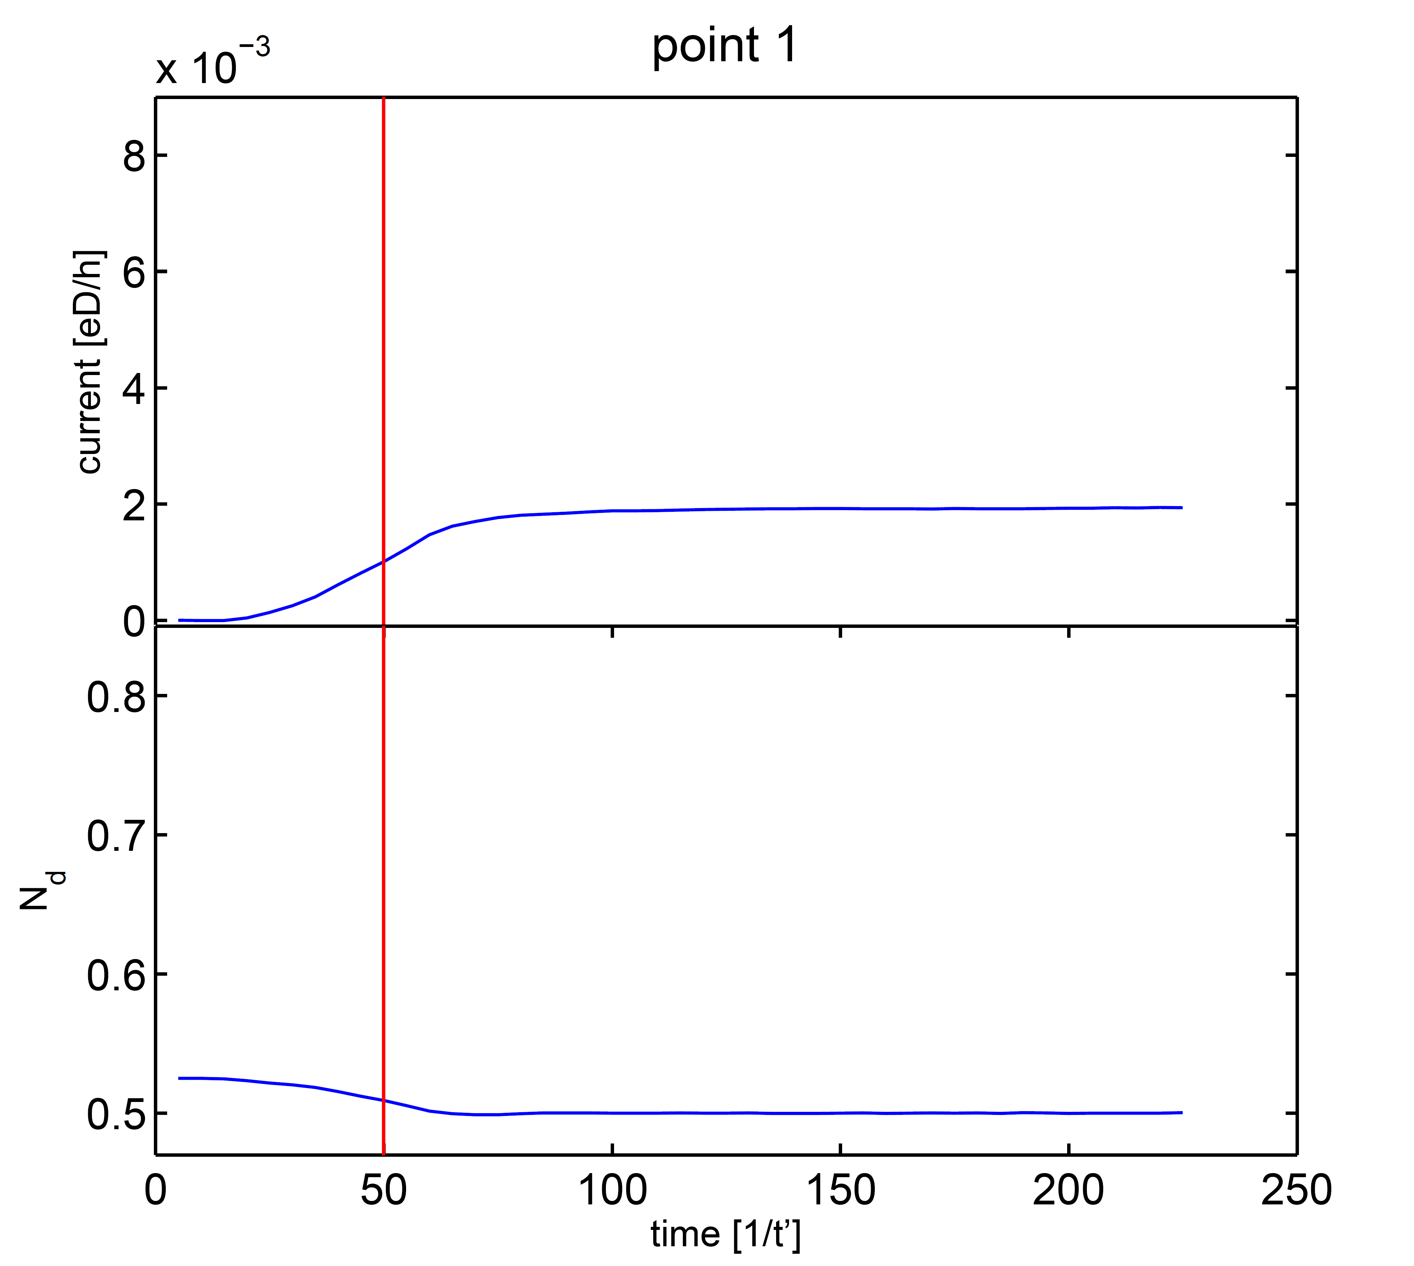
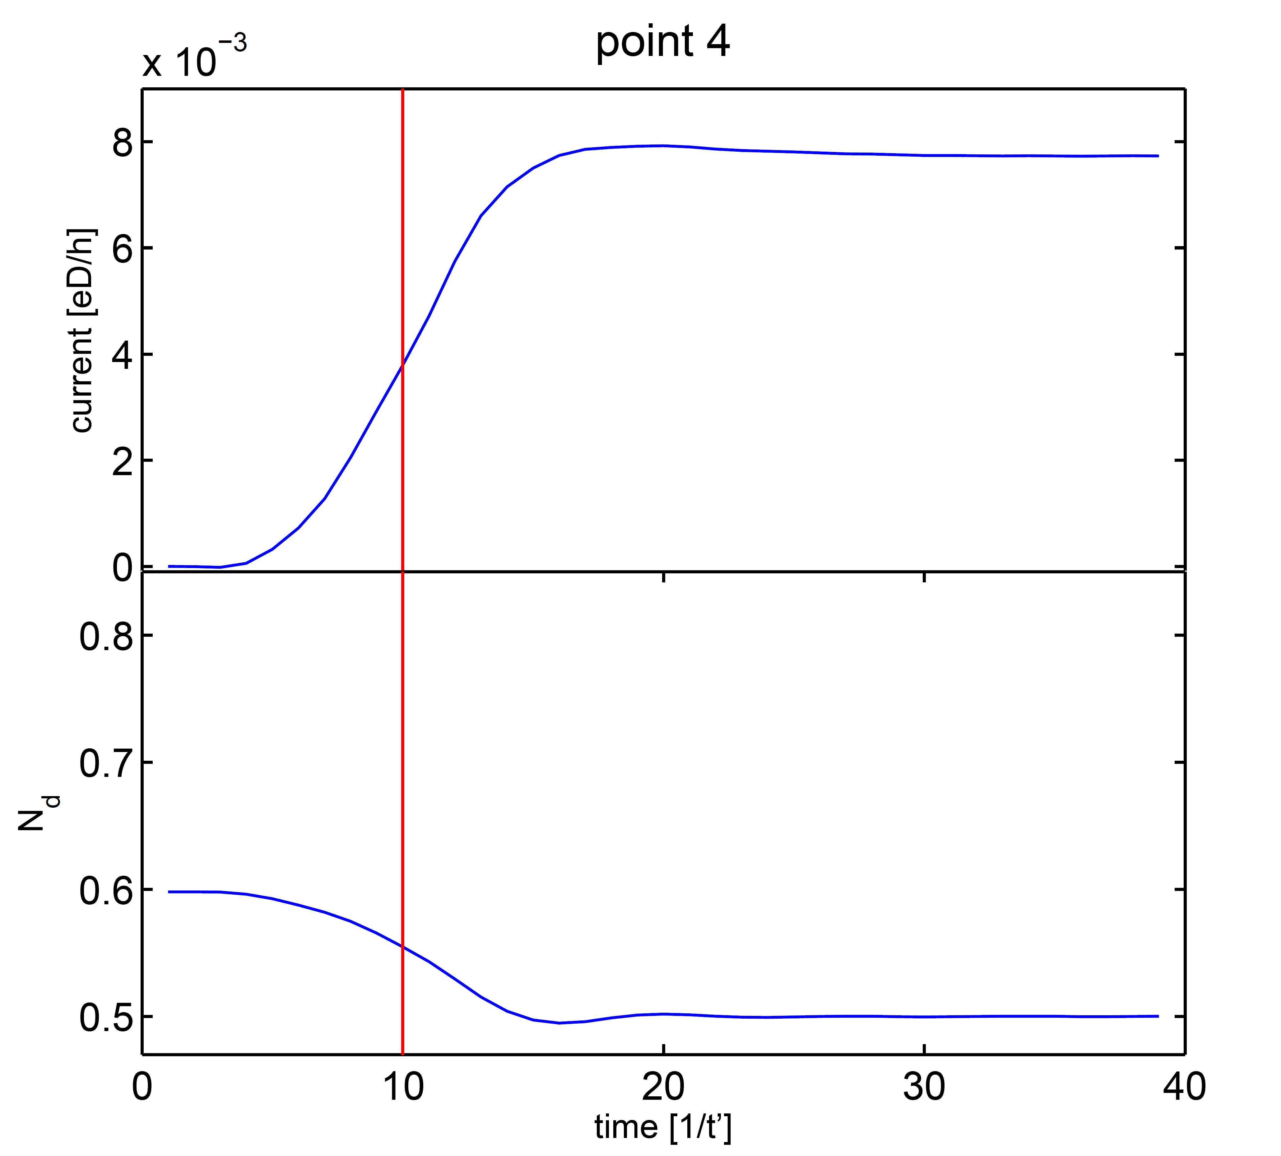
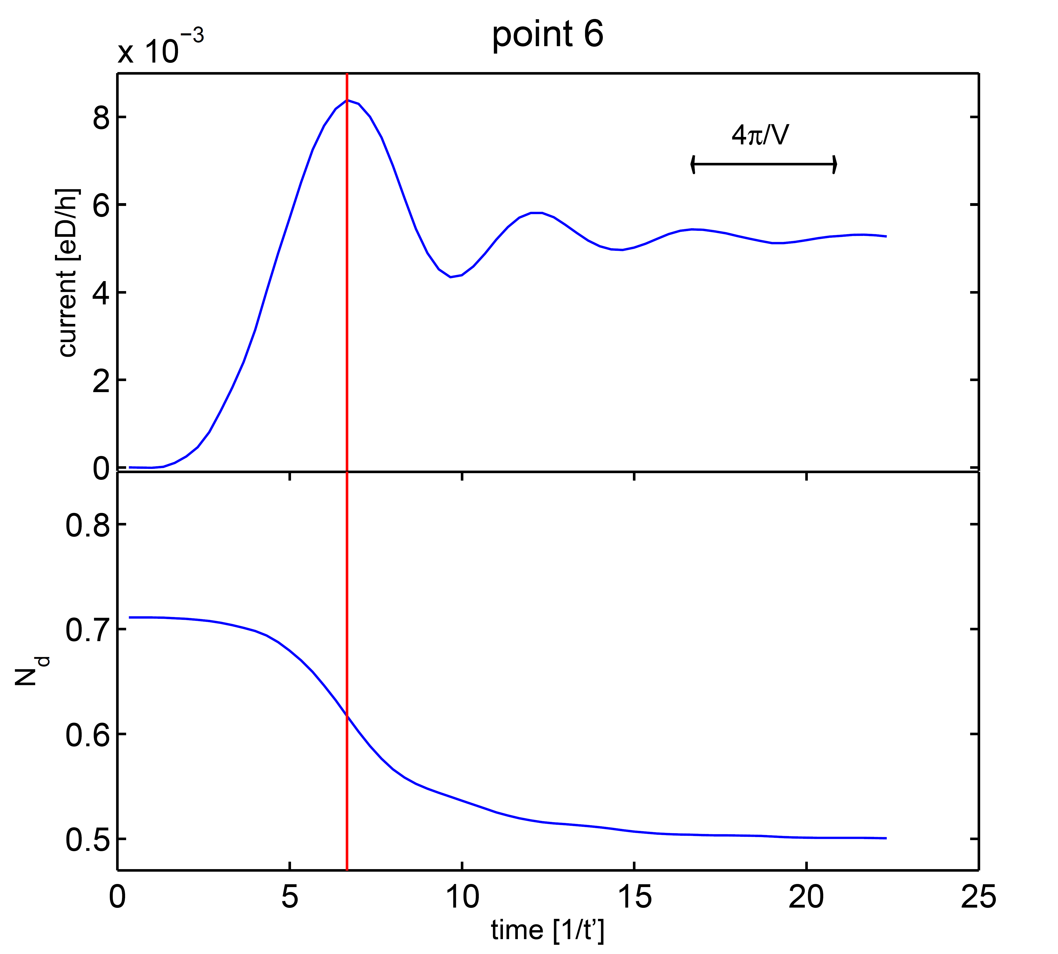
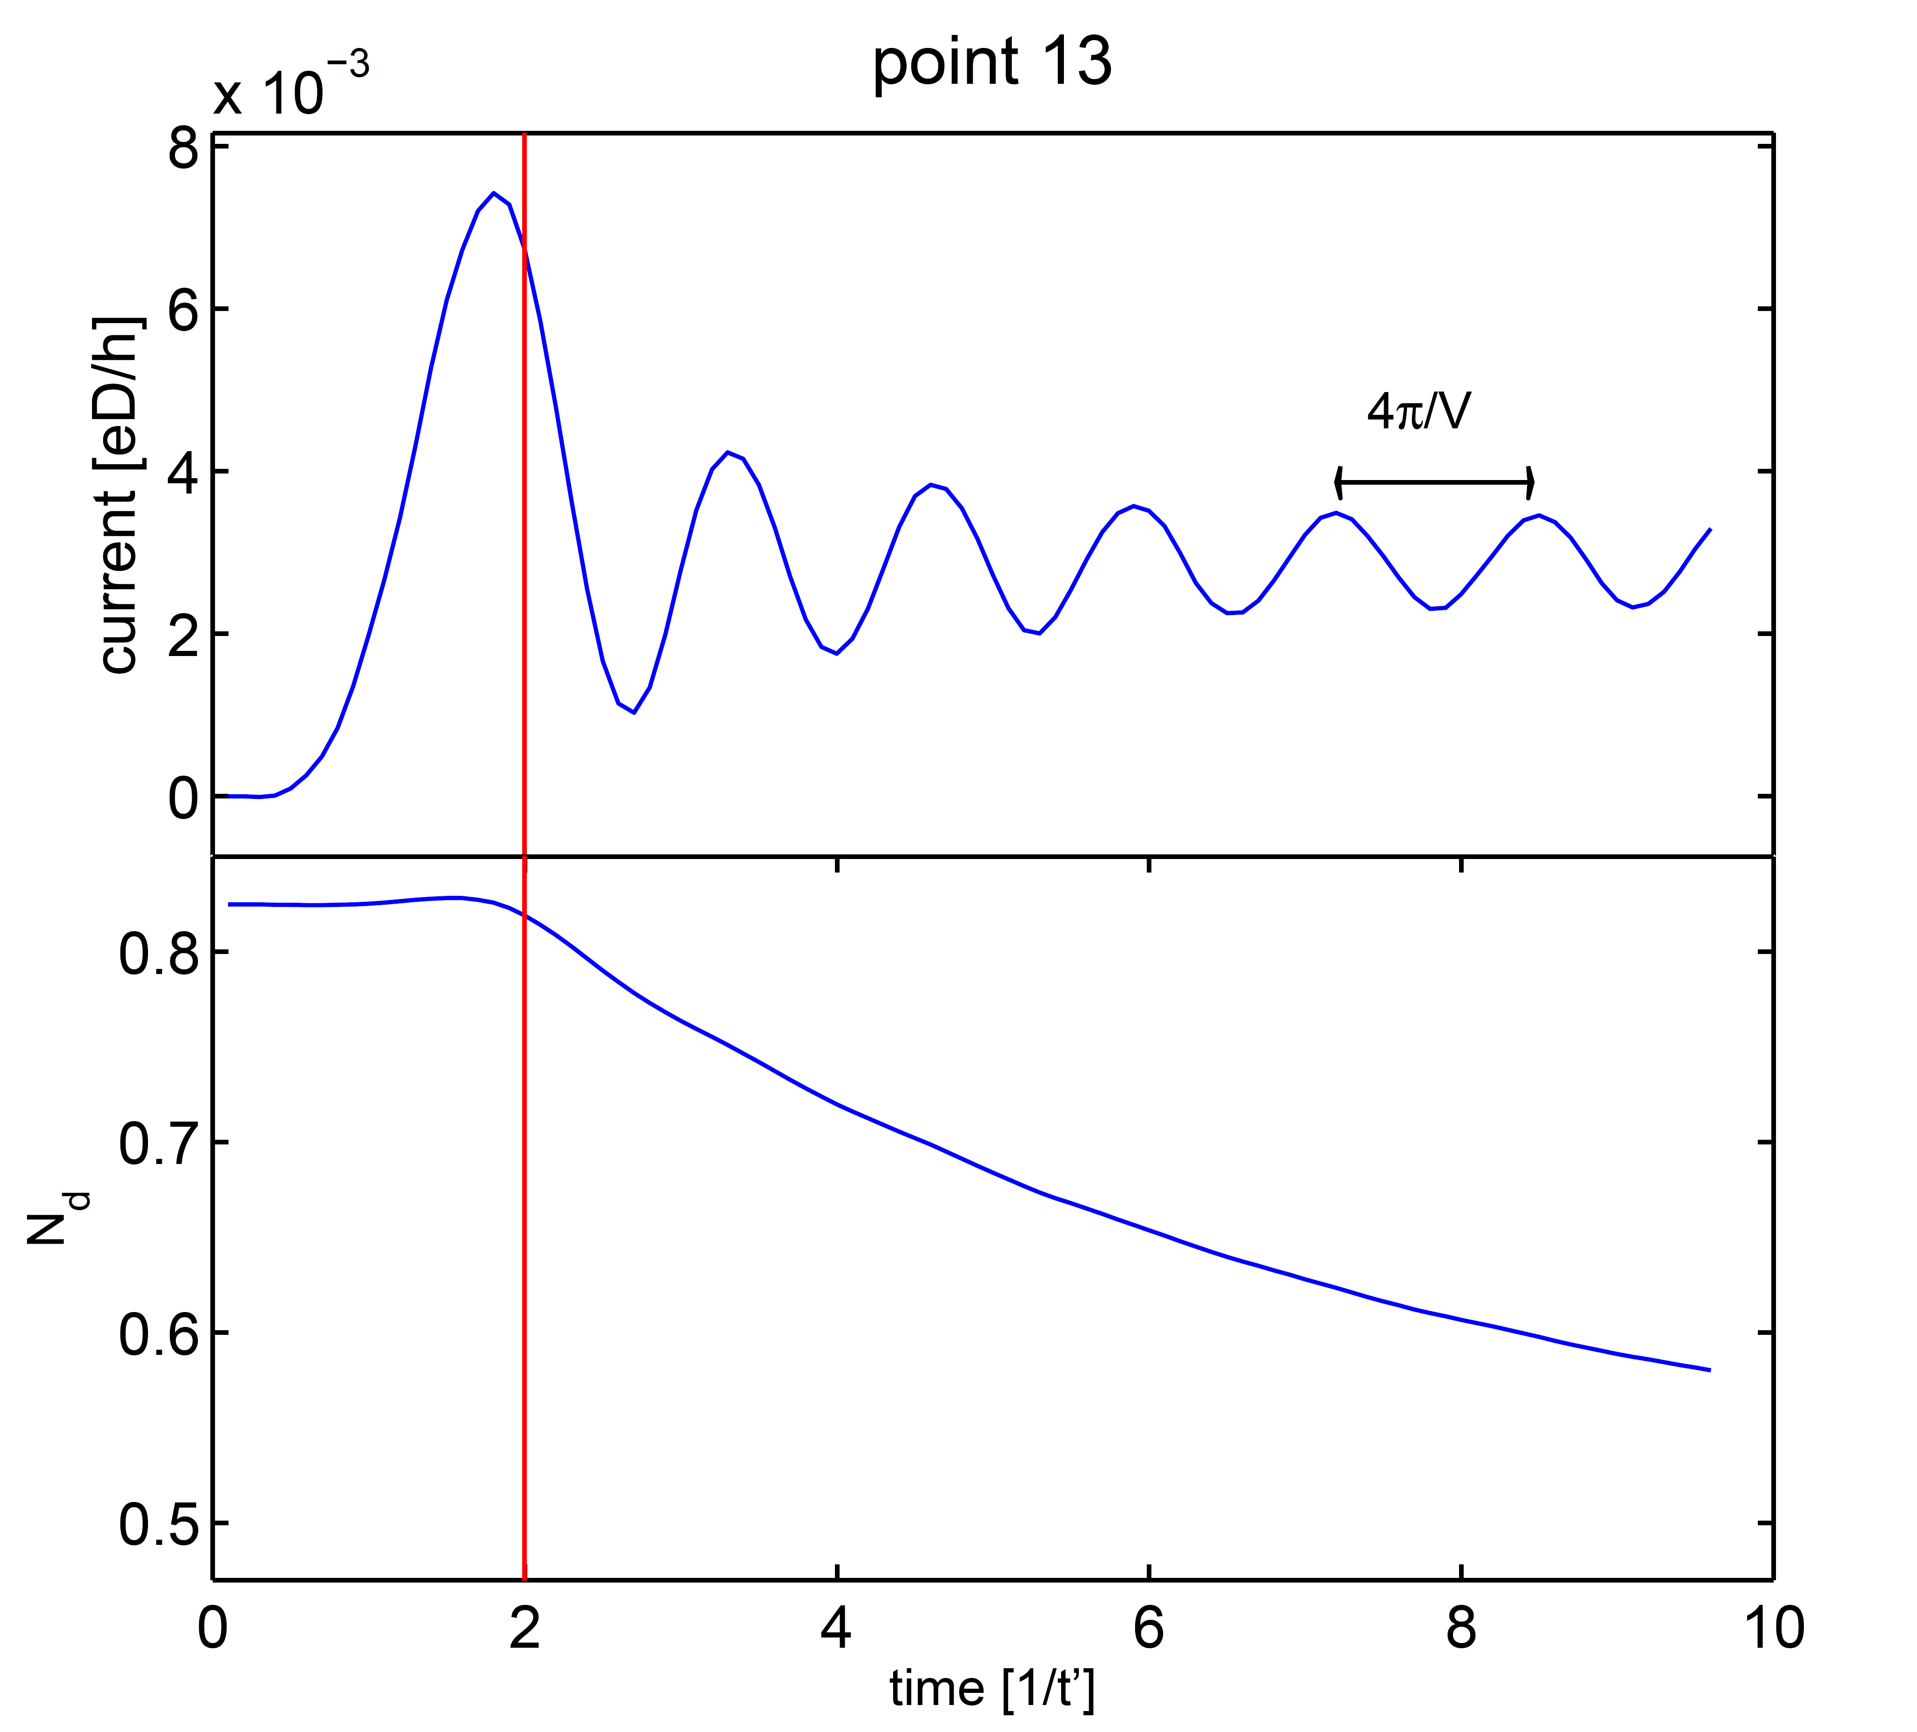
IRLM: time evolution
Notes:
Diskretisierung: Lambda = 2, delta/D*=0.1, D* \approx mu
Hier bekomme ich saubere Oszillationen. Die Dot-Besetzung ist für große Spannungen jedoch nicht konvergiert. Im Anhang dazu Figure IRLM_1.pdf (Strom über Zeitschritte für größte Spannung) und IRLM_2.pdf (die zugehörige Dot-Besetzung, die eigentlich 0.5 erreichen sollte!). Die Oszillationen lassen sich in Relation mit der Spannung setzen (T_osz ~ 4pi/V Wenn ich mich richtig erinnere, vermisste ich in der Diskussion mit Andreas mal einen Faktor 2, aber das kann ich dir im Moment nicht mehr genau sagen.) In vielen Fällen scheint es aber nur fast und nicht ganz zu passen (??).

Slide 33
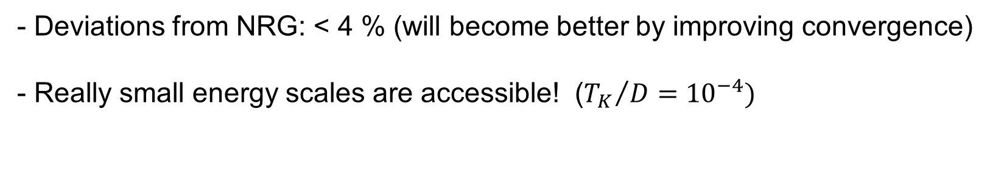
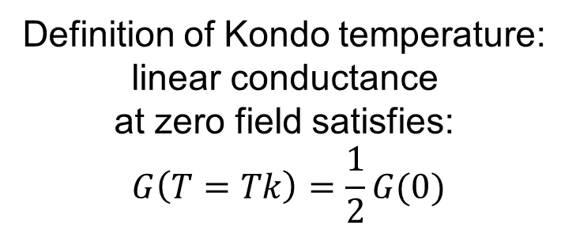
Single-Impurity Anderson Model
Definition of Kondo temperature:
linear conductance
at zero field satisfies:
$$G\left(T=Tk\right)=\frac{1}{2}G(0)$$
Linear conductance
- Deviations from NRG: < 4 % (will become better by improving convergence)
- Really small energy scales are accessible! (${T_{K}}/{D={10}^{−4})}$
Notes:
Fig_SIAM_GoverT:
Diskretisierung: Lambda = 2, delta/D*=0.02, D* \approx 7*T
NRG: Nkeep: 700-800, 4<=N<=36
DMRG: stol=1e-4, Nkeep:200-500
Die Stromkurven zeigen keine Oszillationen (Spannung<<T!). Abweichung von NRG bis ca. 4%.
Vorsicht: Dieser Check zeigt zwar, dass wir T-Abhängikeit beschreiben können, allerdings sind es alles linear-response-Daten, die besonders leicht fallen! Die Dot-Besetzung ist bei Weitem noch nicht konvergiert! Mein schlechtestes Beispiel (größte Spannung) ist im Anhang (SIAM_3.pdf: Strom, SIAM_4.pdf: Dot-Besetzung.). Für kleinere Spannungen ist auch der Strom besser konvergiert.

Slide 34
Single-Impurity Anderson Model
Notes:
Gleichen Parameter wie der vorige Plot.
Vorsicht: Dieser Check zeigt zwar, dass wir T-Abhängikeit beschreiben können, allerdings sind es alles linear-response-Daten, die besonders leicht fallen! Die Dot-Besetzung ist bei Weitem noch nicht konvergiert! Mein schlechtestes Beispiel (größte Spannung) ist im Anhang (SIAM_3.pdf: Strom, SIAM_4.pdf: Dot-Besetzung.). Für kleinere Spannungen ist auch der Strom besser konvergiert.

Slide 35
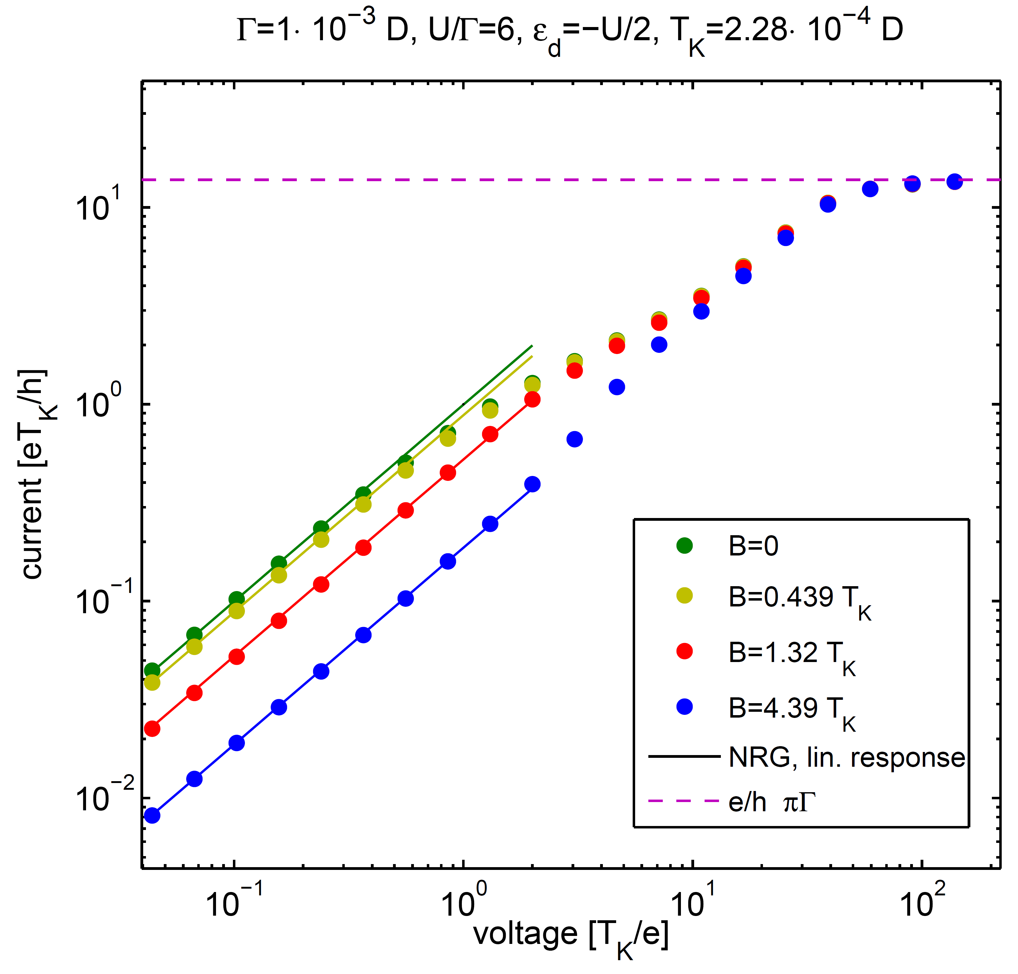
Single-Impurity Anderson Model

Slide 36
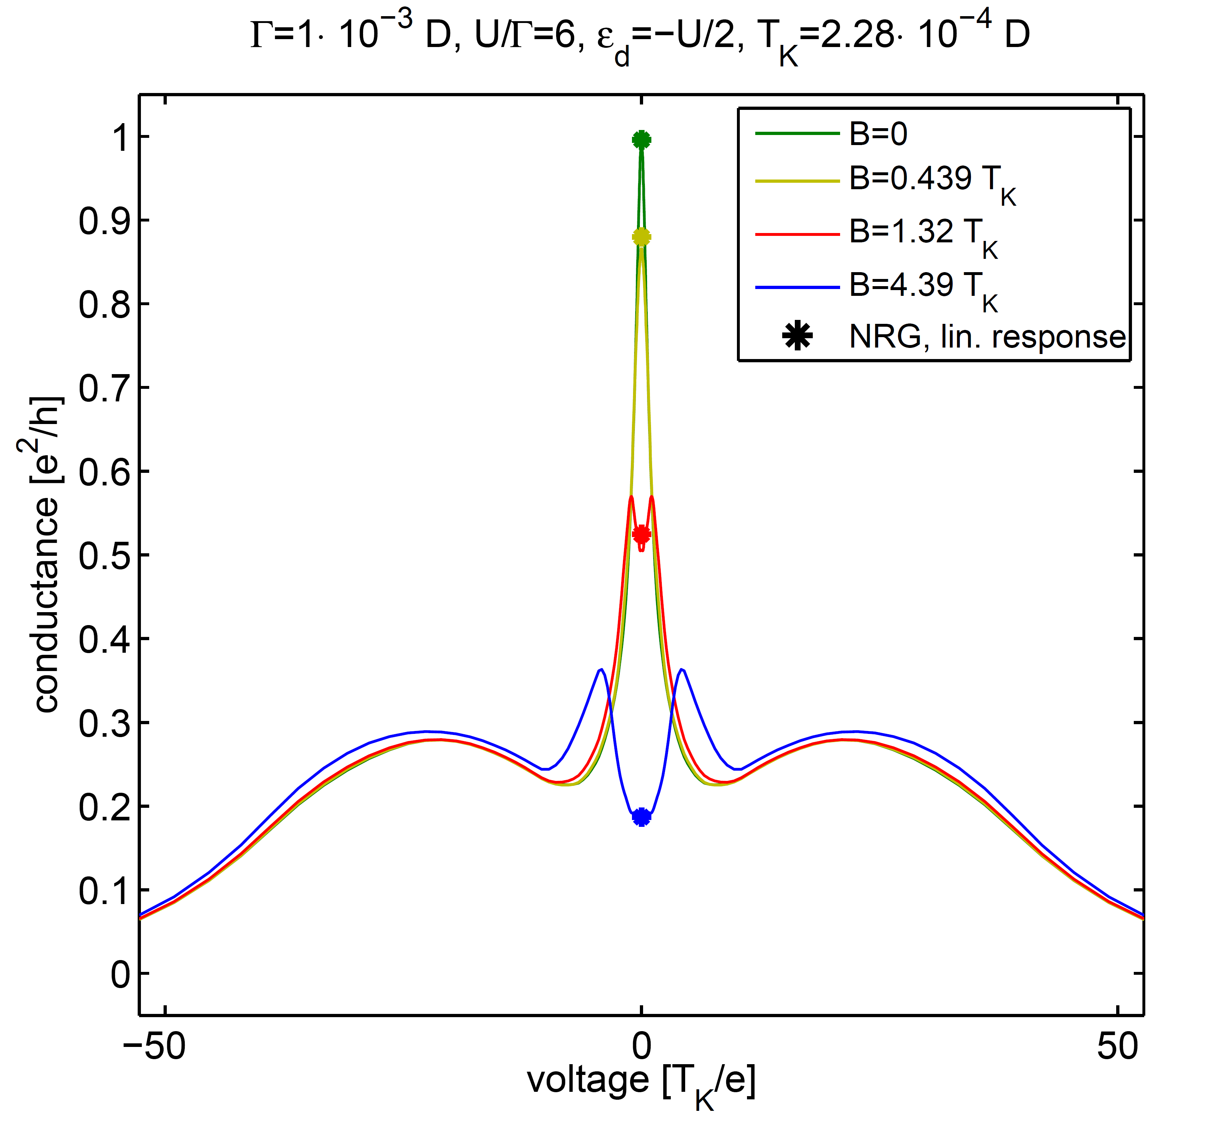
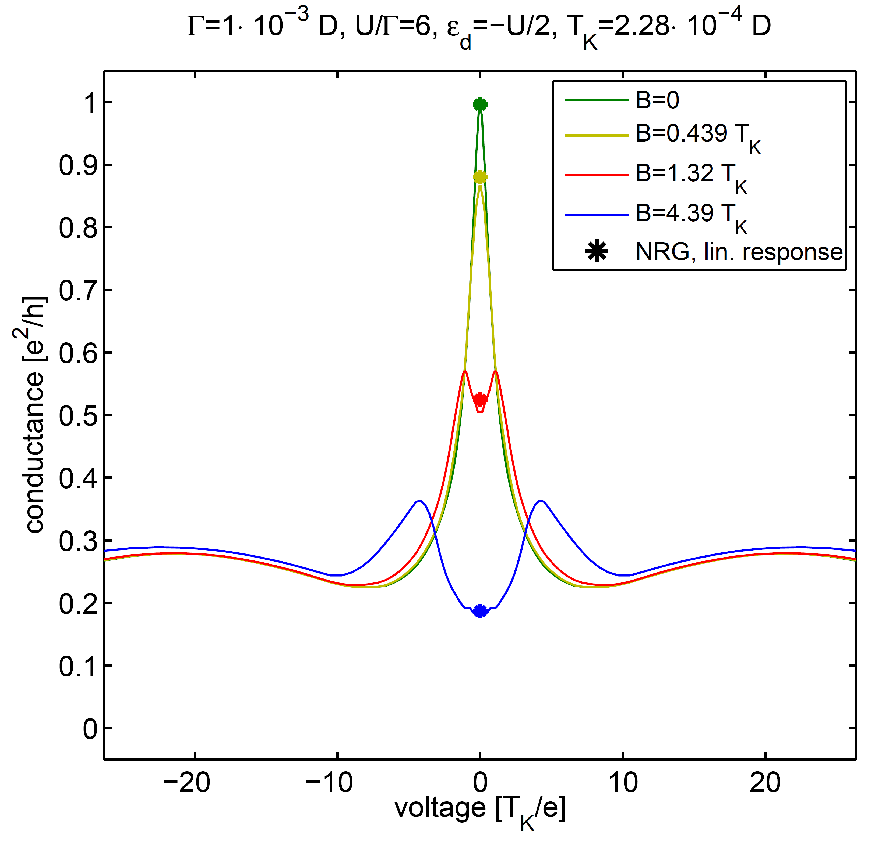
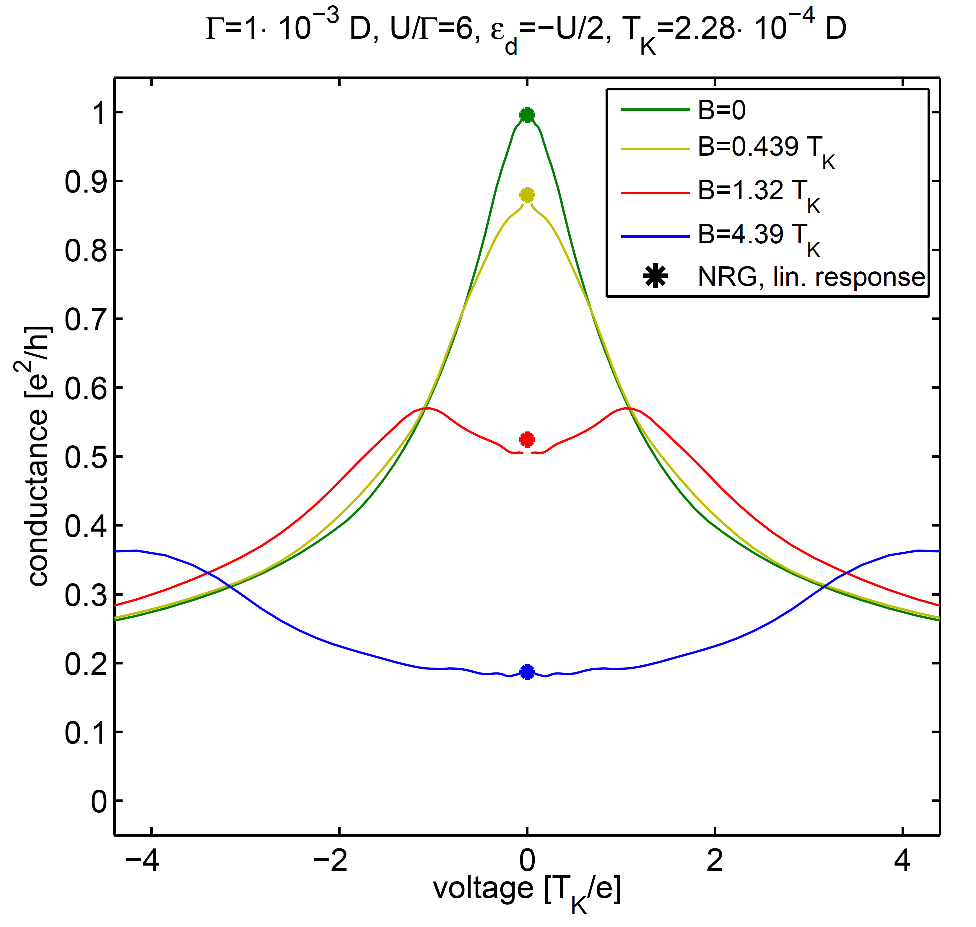
Single-Impurity Anderson Model
Notes:
Fig_SIAM_BFeld: alle drei Plots basieren auf denselben Rohdaten!
Diskretisierung: Lambda = 2, delta/D*=0.1, D* \approx volt/2
NRG: Nkeep: 600, 10<=N<=32
DMRG: stol=1e-4, Nkeep:400-600
Auch hier gilt: für große Spannungen habe ich keine saubere Konvergenz, insbesondere, wenn ich die Dot-Besetzung betrachte (siehe Anhang: SIAM_1.pdf zeigt Strom über Zeitschritten für die größte Spannung und B=0. SIAM_2.pdf die zugehörige Dot-Besetzung. Die Dot-Besetzung beschreibt dabei nur eine Spin-Richtung.)
Für kleine Spannungen ist die Konvergenz kein so großes Problem, die Tatsache, dass die linear-Response-Ergebnisse passen, sind daher nur begrenzt Hinweis darauf, dass es klappt.
Insgesamt sehe ich hier weniger Oszillation als im IRLM (warum kann ich dir im Moment nicht sagen).
Die numerische Ableitung habe ich wie folgt bestimmt:
im semilogarithmischen Plot: die Punkte durch einfaches Bestimmen von DeltaJ/DeltaV. Die Linien durch Five-Point-Stencil auf dem logarithmischen Grid.
im linearen Plot: durch Fitten eines Polynoms durch den Strom, die ich dann ableite.

Slide 37
Single-Impurity Anderson Model
Notes:
Fig_SIAM_BFeld: alle drei Plots basieren auf denselben Rohdaten!
Diskretisierung: Lambda = 2, delta/D*=0.1, D* \approx volt/2
NRG: Nkeep: 600, 10<=N<=32
DMRG: stol=1e-4, Nkeep:400-600
Auch hier gilt: für große Spannungen habe ich keine saubere Konvergenz, insbesondere, wenn ich die Dot-Besetzung betrachte (siehe Anhang: SIAM_1.pdf zeigt Strom über Zeitschritten für die größte Spannung und B=0. SIAM_2.pdf die zugehörige Dot-Besetzung. Die Dot-Besetzung beschreibt dabei nur eine Spin-Richtung.)
Für kleine Spannungen ist die Konvergenz kein so großes Problem, die Tatsache, dass die linear-Response-Ergebnisse passen, sind daher nur begrenzt Hinweis darauf, dass es klappt.
Insgesamt sehe ich hier weniger Oszillation als im IRLM (warum kann ich dir im Moment nicht sagen).
Die numerische Ableitung habe ich wie folgt bestimmt:
im semilogarithmischen Plot: die Punkte durch einfaches Bestimmen von DeltaJ/DeltaV. Die Linien durch Five-Point-Stencil auf dem logarithmischen Grid.
im linearen Plot: durch Fitten eines Polynoms durch den Strom, die ich dann ableite.

Slide 38
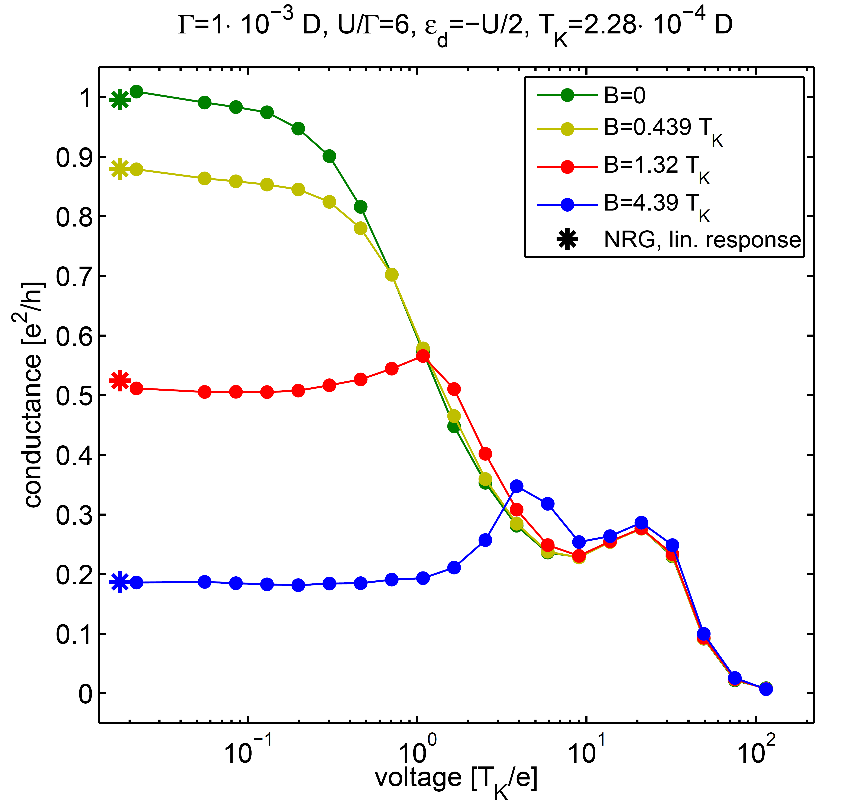
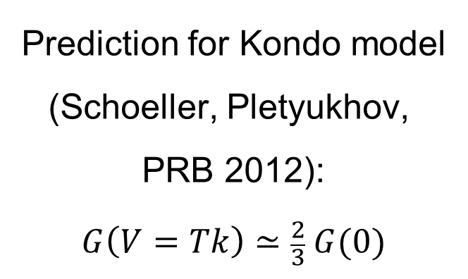
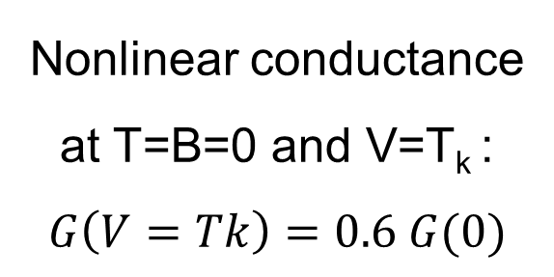
Single-Impurity Anderson Model
Nonlinear conductance
at T=B=0 and V=T_{k} :
$$G\left(V=Tk\right)=0.6 G(0)$$
Prediction for Kondo model
(Schoeller, Pletyukhov,
PRB 2012):
$$G\left(V=Tk\right)≃\frac{2}{3} G(0)$$

Slide 39
Single-Impurity Anderson Model
Notes:
Auch hier gilt: für große Spannungen habe ich keine saubere Konvergenz, insbesondere, wenn ich die Dot-Besetzung betrachte (siehe Anhang: SIAM_1.pdf zeigt Strom über Zeitschritten für die größte Spannung und B=0. SIAM_2.pdf die zugehörige Dot-Besetzung. Die Dot-Besetzung beschreibt dabei nur eine Spin-Richtung.)
Für kleine Spannungen ist die Konvergenz kein so großes Problem, die Tatsache, dass die linear-Response-Ergebnisse passen, sind daher nur begrenzt Hinweis darauf, dass es klappt.

Slide 40
Conclusion
Lindblad-driven discrete leads
yield exact representation of
thermal leads in continuum limit
Log-linear discretization yiels access to
low energy scales using NRG
Local Lindblad driving on chain
Quenches starting with product state
IRLM
SIAM
Good agreement with benchmark
data for IRLM
Similar numerical effort for SIAM

Slide 41
Open Wilson chains
Benedikt Bruognolo, Nils-Oliver Linden,
Frauke Schwarz, Katharina Stadler, Andreas Weichselbaum,
Fritjhof Anders, Matthias Vojta, Jan von Delft

Slide 42
Open Wilson chains
Open Wilson chains generate an exact continued-fraction expansion for the
bath coupling function

Slide 43
OpenWilson chains cures mass flow problem
Cures “mass-flow” problem for Sub-ohmic spin-boson model:
Local spin susceptibility:
Resolves flow towards a Gaussian fixed point with a bosonic zero model

