Slide 1
The Challenge of Time-Predictability in Modern Many-Core Architectures
Vincent Nelis
WCET workshop 2014

Slide 2
What’s a many-core platform?

Slide 3
“Many-core processors are defined as chips with several tens, but more likely hundreds, or even thousands of processor cores”
-- András Vajda
András Vajda. Programming Many-Core Chips.
ISBN: 978-1-4419-9738-8 (Print) 978-1-4419-9739-5 (Online)
A many-core platform is a platform containing many cores.
Notes:
Many-core is too many cores

Slide 4
A many-core platform, it is like an entire distributed system squeezed into a single chip.
“A distributed system is a software system in which components located on networked computers communicate and coordinate their actions by passing messages.”
-- Coulouris, George; Jean Dollimore; Tim Kindberg; Gordon Blair (2011). Distributed Systems: Concepts and Design (5th Edition). Boston: Addison-Wesley.

Slide 5
A many-core platform, it is like an entire distributed system squeezed into a single chip.
Mix between parallel computing where all processors communicate through a shared memory, and distributed computing, where memory is distributed and processors communicate by passing messages.

Slide 6
Quick overview of the architecture
Processing unit[s]
Processing unit[s]
Local Mem[s]
Local Mem[s]
External Mem[s]
Network Interface
Network Interface
NoC
Processing unit[s]
Processing unit[s]
Local Mem[s]
Local Mem[s]
Network Interface
Network Interface
Notes:
It can be hierarchical

Slide 7
What types of application it is designed for?
Provide huge computing power through parallelization → HPC
May provide low-power and isolation? → Embedded
HPC
EC
Best effort
“The faster, the better”
Strong guarantees
“The safer, the better”
Embedded CEP, B-critical, etc.
Notes:
Event processing is a method of tracking and analyzing (processing) streams of information (data) about things that happen (events),^{[1]} and deriving a conclusion from them. Complex event processing, or CEP, is event processing that combines data from multiple sources^{[2]} to infer events or patterns that suggest more complicated circumstances. The goal of complex event processing is to identify meaningful events (such as opportunities or threats)^{[3]} and respond to them as quickly as possible.
These events may be happening across the various layers of an organization as sales leads, orders or customer service calls. Or, they may be news items,^{[4]} text messages, social media posts, stock market feeds, traffic reports, weather reports, or other kinds of data.^{[1]}An event may also be defined as a "change of state," when a measurement exceeds a predefined threshold of time, temperature, or other value. Analysts suggest that CEP will give organizations a new way to analyze patterns in real-time, and help the business side communicate better with IT and service departments.^{[5]}

Slide 8
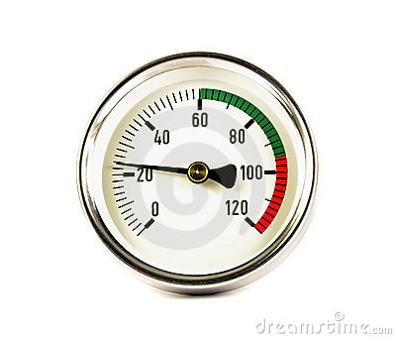
Embedded Complex Event Processing
Notes:
A more systemic example of CEP involves a car, some sensors and various events and reactions. Imagine that a car has several sensors—one that measures tire pressure, one that measures speed, and one that detects if someone sits on a seat or leaves a seat.
In the first situation, the car is moving and the pressure of one of the tires moves from 45 psi (pound per square inch) to 41 psi over 15 minutes. As the pressure in the tire is decreasing, a series of events containing the tire pressure is generated. In addition, a series of events containing the speed of the car is generated. The car's Event Processor may detect a situation whereby a loss of tire pressure over a relatively long period of time results in the creation of the "lossOfTirePressure" event. This new event may trigger a reaction process to note the pressure loss into the car's maintenance log, and alert the driver via the car's portal that the tire pressure has reduced.
In the second situation, the car is moving and the pressure of one of the tires drops from 45 psi to 20 psi in 5 seconds. A different situation is detected—perhaps because the loss of pressure occurred over a shorter period of time, or perhaps because the difference in values between each event were larger than a predefined limit. The different situation results in a new event "blowOutTire" being generated. This new event triggers a different reaction process to immediately alert the driver and to initiate onboard computer routines to assist the driver in bringing the car to a stop without losing control through skidding.
In addition, events that represent detected situations can also be combined with other events in order to detect more complex situations. For example, in the final situation the car was moving normally but suffers a blown tire which results in the car leaving the road and striking a tree and the driver is thrown from the car. A series of different situations are rapidly detected. The combination of "blowOutTire", "zeroSpeed" and "driverLeftSeat" within a very short space of time results in a new situation being detected: "occupantThrownAccident". Even though there is no direct measurement that can determine conclusively that the driver was thrown, or that there was an accident, the combination of events allows the situation to be detected and a new event to be created to signify the detected situation. This is the essence of a complex (or composite) event. It is complex because one cannot directly detect the situation; one has to infer or deduce that the situation has occurred from a combination of other events.

Slide 9
Parallel Software Framework for Time-Critical Many-core Systems
Goal: allow current and future applications with high-performance and real-time requirements to fully exploit the huge performance opportunities brought by the most advanced many-core processors, whilst ensuring a predictable performance and maintaining (or even reducing) development costs of applications.
Purpose: develop a new design framework, from the conceptual design of the system functionality to its physical implementation, to facilitate the deployment of standardized parallel architectures in all kinds of systems.
Notes:
P-SOCRATES (Parallel Software Framework for Time-Critical Many-core Systems) is an European project which intends to allow current and future applications with high-performance and real-time requirements to fully exploit the huge performance opportunities brought by the most advanced many-core processors, whilst ensuring a predictable performance and maintaining (or even reducing) development costs of applications.
The purpose of P-SOCRATES is to develop an entirely new design framework, from the conceptual design of the system functionality to its physical implementation, to facilitate the deployment of standardized parallel architectures in all kinds of systems.

Slide 11
Regarding the time-predictability, we have identified a few main challenges that we will need to take up before the end of the project.
And that’s why I’m here today...
Interested?
-> nelis@isep.ipp.pt
00 351 91 206 68 04

Slide 12
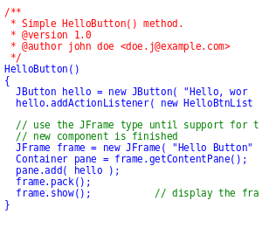
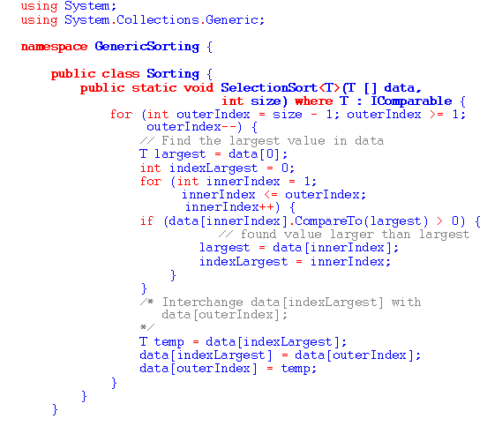
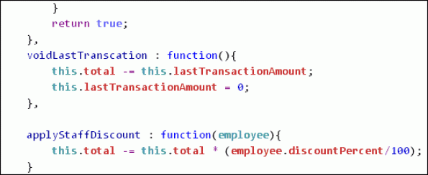
Challenge number 1
Define a suitable application model

Slide 13
Liu & Layland and all derivatives
C_{i} , T_{i}
O_{i} = O_{j}
T_{i} spor.
O_{i} ≠ O_{j}
T_{i} = T_{j}
C_{i} < D_{j}
T_{i} ≠ T_{j}
C_{i} = D_{j}
T_{i} = kT_{j}
C_{i} > D_{j}
C_{i} = [c_{k},..., c_{l}]

Slide 14
Liu & Layland and all derivatives
C_{i} , T_{i}
Model the timing aspects only
No information on
The inner structure of the task
The functional properties
The parallelization opportunities
Etc.
Not rich enough!
O_{i} = O_{j}
T_{i} spor.
O_{i} ≠ O_{j}
T_{i} = T_{j}
C_{i} < D_{j}
T_{i} ≠ T_{j}
C_{i} = D_{j}
T_{i} = kT_{j}
C_{i} > D_{j}
C_{i} = [c_{k},..., c_{l}]

Slide 15
And what about the // task models?
Data
Task

Slide 16
Data parallelism
Array =
5 | 18 | 9 | 3
if Core = A
lower_limit := 1
upper_limit := 4
else if Core = B
lower_limit := 5
upper_limit := 8
for i from lower_limit to upper_limit by 1
foo(Array[i])
foo([5, 18])
foo([9, 3])
Core “A”
Core “B”

Slide 17
Data parallelism
Array =
5 | 18 | 9 | 3
Fork/join task model
Precedence
constraint
WCET
foo([5, 18])
fork
join
foo([9, 3])

Slide 18
Task parallelism
Array =
5 | 18 | 9 | 3
if Core = A
for i from 1 to 4 by 1
func(Array[i])
else if Core = B
for i from 1 to 4 by 1
otherfunc(Array[i])
func([5, 18, 9, 3])
otherfunc([5, 18, 9, 3])
Core “A”
Core “B”

Slide 19
Task parallelism
Array =
5 | 18 | 9 | 3
if Core = A
for i from 1 to 4 by 1
func(Array[i])
else if Core = B
for i from 1 to 4 by 1
otherfunc(Array[i])
Actor “X”
Actor “Y”
for i from 1 to 4 by 1
func(Array[i])
for i from 1 to 4 by 1
otherfunc(Array[i])
func([5, 18, 9, 3])
otherfunc([5, 18, 9, 3])
Core “A”
Core “B”

Slide 20
Task parallelism
Array =
5 | 18 | 9 | 3
data
dependency
Actor “X”
Actor “Y”
Actor “X”
Actor “Y”
for i from 1 to 4 by 1
func(Array[i])
for i from 1 to 4 by 1
otherfunc(Array[i])
WCET
WCET
Precedence
constraint
func([5, 18, 9, 3])
otherfunc([5, 18, 9, 3])
Core “A”
Core “B”

Slide 21
Task parallelism
DAG task model
Actor “B”
Actor “A”
WCET
Actor “E”
WCET
WCET
Actor “D”
Actor “I”
Actor “C”
WCET
WCET
WCET
Actor “H”
Actor “F”
Actor “G”
WCET
WCET
WCET
Actor “K”
Actor “J”
WCET
WCET

Slide 22
What are the limitations of these models?
x := A()
if (x > 1) {
#pragma omp parallel for reduction(+:y)
for (i=0; i<4; i++)
y := B(i)
} else {
#pragma omp parallel for reduction(+:y)
for (i=0; i<2; i++)
y := C(i)
}
z := D(y)
Execution path
A()
B(0)
B(1)
B(2)
B(3)
C(0)
C(1)
D(y)

Slide 23
x := A()
if (x > 1) {
#pragma omp parallel for reduction(+:y)
for (i=0; i<4; i++)
y := B(i)
} else {
#pragma omp parallel for reduction(+:y)
for (i=0; i<2; i++)
y := C(i)
}
z := D(y)
None of these models properly capture the conditional execution!
Let’s have a look at how the F/J and DAG model this task...

Slide 24
Option 1:
Ignore the conditional execution
WCET
WCET
WCET
WCET
WCET
WCET
WCET
A()
WCET
B(0)
B(1)
B(2)
B(3)
C(0)
C(1)
D(y)

Slide 25
Option 1:
Ignore the conditional execution
WCET
WCET
WCET
WCET
WCET
WCET
WCET
WCET
It assumes that every single line of the code of the task is executed each time the task is run, including the code of every if and else statement, every function, etc.

Slide 26
Option 2:
Identify the worst-case execution path
Challenge
number 2

Slide 27
Challenge number 2
Identify the worst-case execution path in a parallel program
Not this way
Not this way
Not this way

Slide 28
What does it mean:
“worst-case” execution path?
From a response time point of view, the “worst-case” execution path is the one that creates the maximum interference on the other tasks
Sequential task
worst-case execution path = longest path
Notes:
What do we mean by
“worst-case execution path”?

Slide 29
x := A()
if (x > 1) {
#pragma omp parallel for reduction(+:y)
for (i=0; i<4; i++)
y := B(i)
} else {
#pragma omp parallel for reduction(+:y)
for (i=0; i<2; i++)
y := C(i)
}
z := D(y)
Execution path
A()
B(0)
B(1)
B(2)
B(3)
C(0)
C(1)
D(y)

Slide 30
“if” path
“else” path
1
A()
1
A()
A()
A()
B(0)
B(0)
B(2)
B(1)
B(2)
B(1)
B(3)
B(3)
C(0)
C(0)
C(1)
C(1)
4
8
11
19
20
20
2
D(y)
2
D(y)
D(y)
D(y)
Workload (W) = 45
Crit. Path (CP) = 22
Conc. Level (CL) = 4
Workload (W) = 43
Crit. Path (CP) = 23
Conc. Level (CL) = 2
Notes:
What do we mean by
“worst-case execution path”?

Slide 31
“if” path
“else” path
1
A()
1
A()
B(0)
B(1)
B(2)
B(3)
C(0)
C(1)
4
8
11
19
20
20
2
D(y)
2
D(y)
HP
Workload (W) = 45
Crit. Path (CP) = 22
Conc. Level (CL) = 4
Workload (W) = 43
Crit. Path (CP) = 23
Conc. Level (CL) = 2
Response time
LP
10
Notes:
What do we mean by
“worst-case execution path”?

Slide 32
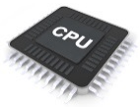
Case 1: the “if” path
Response time = 22
1
4
8
9
2
1
11
19
time
Case 2: the “else” path
Response
time = 30
1
20
2
1
20
9
time

Slide 33
1
4
9
2
1
8
Response time = 14
11
19
time
1
20
2
1
20
9
Response time = 10
time

Slide 34
Task 1: HIGH
Max Conc. Lvl
Max Workload
Max Crit. Path
Lead to worst-case
response time
Task 2: LOW
Max Conc. Lvl
Max Crit. Path
Max Workload

Slide 35
Challenge number 2
Identify the worst-case execution path in a parallel program (from a schedulability point of view)
Sequential task
worst-case execution path = longest path
Parallel task
worst-case execution path = ???
Notes:
What do we mean by
“worst-case execution path”?

Slide 36
Challenge number 3
Even if we know what’s the worst path, how do we find it?

Slide 37
The number of execution paths is extredibly high
for(int i=0; i<N; i++) {
if(i > x) cilk_spawn func(i);
}
Intuitively, we want to think that x > N is the worst-case scenario, but is it?

Slide 38
The number of execution paths is extredibly high
Void compute (int* A, int i, int j) {
#pragma omp task depend(out:A[i])
Produce(&A[i])
#pragma omp task depend(in:A[j])
Consume(&A[j])
}
Depending if i=j or i<>j, at runtime we will have
i=j
i<>j
P
C
P
C

Slide 39
Even if we know what’s the worst path, how do we find it?
entry
exit

Slide 40
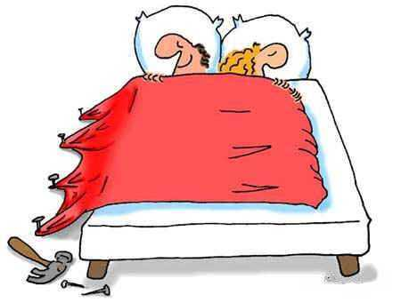
Challenge number 4
What about the use and impact of the shared resources?

Slide 41
What matters is “when” the task executes, not “where”.
Cache
WCET
WCET
WCET
WCET
WCET
WCET
Memory

Slide 42
Now, the position matters.
What matters is “when” the task executes, not “where”.
Memory

Slide 43
Challenge number 5
What about the implementation?

Slide 44
Quick overview of the architecture
Processing unit[s]
Processing unit[s]
Local Mem[s]
Local Mem[s]
External Mem[s]
Network Interface
Network Interface
NoC
Processing unit[s]
Processing unit[s]
Local Mem[s]
Local Mem[s]
Network Interface
Network Interface

Slide 45
Processing unit[s]
Processing unit[s]
Local Mem[s]
Local Mem[s]
External Mem[s]
Network Interface
Network Interface
NoC
Processing unit[s]
Processing unit[s]
A()
Local Mem[s]
Local Mem[s]
Network Interface
Network Interface
B(0)
B(1)
B(2)
B(3)
C(0)
C(1)
D(y)

Slide 46
Summary
Plenty of new problems for everybody and no “smart” solutions so far
At the modelling level
At the WCET and scheduling analysis level
At the implementation level
If you find a solution to one of these problems or you wish to collaborate with us on solving them:
nelis@isep.ipp.pt
+351 91 206 68 04

Slide 47
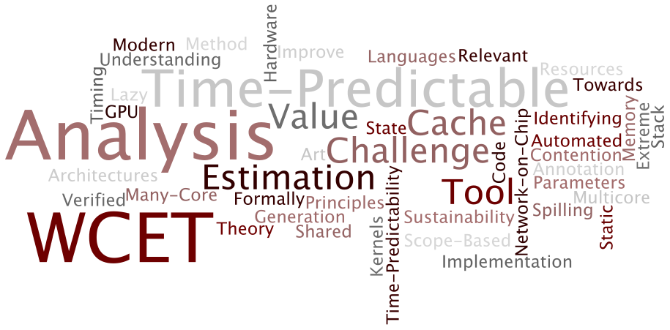
Thank you
for inviting me,
for listening to me,
and for helping us solve these problems

Slide 48
Expert System

Slide 49
user
News
provider

Slide 50
user
How do I pick the right ads?
Companies
News
provider

Slide 51
user
Companies
News
provider
Expert
System

Slide 52
user
Companies
News
provider
Expert
System

Slide 53
user
Condition 1:
Do your job properly!
Companies
News
provider
Expert
System

Slide 54
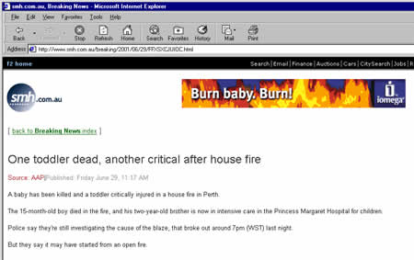
What does that mean?

Slide 55
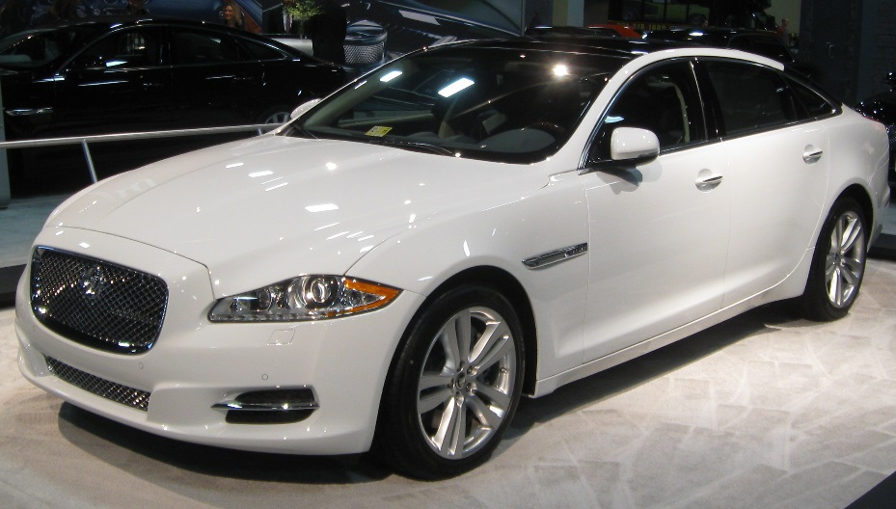
My jaguar
consumes a lot
of meat.
gaz

Slide 56
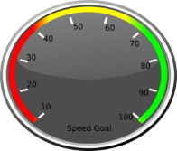
Condition 1:
Do your job properly!
Condition 2:
Do it on time!
user
Companies
10
milli-seconds!
News
provider
Expert
System
Notes:
Check the 4

Slide 57
Solution?
Task:
Creates the max interference
To be used in the sched. analysis

