Slide 1
DISCLAIMER:
Profiles used are fictional for illustrative purposes
English and German languages available
Picture used is a model taken from google pictures
Text&content used is just a placeholder and is not a recommended content
CV templates pages 2-13 are editable and made by making-my-career
CV templates pages 14-20 are none-editable inspirations taken from Canva
For the best result, request a free CV-guide and learn more about how to write CV
free for everyone under https://making-my-career.com/cv.html
Share it on social media, if you like it ☺
LAST UPDATE May 2020

Slide 2
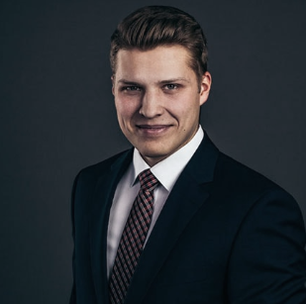






ROISO HATOU
D A T A S C I E N T I S T
Owning, managing and driving local data analytics initiatives, such as Predictive Maintenance. Focus on developing and maintain ETL processing pipelines for batch and near-real time data as well as analytical/machine learning workflows.
emailemail@gmail.com
+49(0)15667444444
K E R N K O M P E T E N Z
04/15
-
heute
Senior Data Scientist
INTERNATIONAL FIRM
Frontend Web Technologien und Frameworks (HTML 5,SCSS/CSS, Angular und TypeScript)
Continuous Integration, Build und Release Management
Agilen Software-Entwicklungsmethoden
Entwicklung von Webservices und API Design (SOAP und REST/JSON)
Datenanalyse
Predictive- Analytics
Flexibel
Analyseverständnis
Data-Analytics-Anwendungen
EDV - Kenntnisse MS office Python SQL Tableau Java R Sprachen EN, DE, IT – C2 ES – Muttersprache Industrie
S K I L L S
Sehr gut
Gut
07/14
-
03/18
Webdesigner
COMPANY 1234
Responsive Web Designs
Activity Planning and Sequencing, Continuous Integration, Build und Release Management
Resource Planning
Git, Docker und Microservices, Entwicklung von Webservices und API Design (SOAP und REST/JSON)
Basic
Apache Hadoop
TensorFlow
pySpark
NoSQL-Datenbanken
S T A R T U P W O R K
07/14
-
06/11
Webdesigner
COMPANY 1234
Responsive Web Designs
Activity Planning and Sequencing, Continuous Integration, Build und Release Management
Resource Planning
Git, Docker und Microservices, Entwicklung von Webservices und API Design (SOAP und REST/JSON)
Seit 2018
TUTORILA
Privates Tutoring für die Schüler
A U S B I L D U N G
2011-2012
BSc International Economics
Chicago University
- Focus area: macroeconomics
Graduation average 1,7
2008-2010
BSc International Economics
Chicago University
E X P E R T P O R T F O L I O
PROJECT LIST
PUBLICATIONS
DASHBOARDS
ACHIEVEMENTS

Slide 3
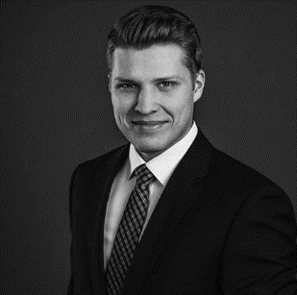



PROFILE
ROISO
HATOU
A professional profile is a brief summary of your skills, strengths, and key experiences. It also should convey what you are seeking or what you have to offer the person reading it.
EXPERIENCE
Industry know-how
Since 2017
Senior Frontend Project Manager
INTERNATIONAL FIRM
Frontend Web Technologien und Frameworks (HTML 5,SCSS/CSS, Angular und TypeScript)
Continuous Integration, Build und Release Management
Agilen Software-Entwicklungsmethoden
Entwicklung von Webservices und API Design (SOAP und REST/JSON)
Programming Skills
Machine Learning
Data Wrangling
Advanced Statistics
Density Estimation
Confidence Interval
Test of Hypotheses
ADVANCED
skills
2014-2017
Webdesigner
COMPANY 1234
Responsive Web Designs
Activity Planning and Sequencing, Continuous Integration, Build und Release Management
Resource Planning
Git, Docker und Microservices, Entwicklung von Webservices und API Design (SOAP und REST/JSON)
Tableau
Jupyter
Matplotlib
BigML
SAS
Apache
Spark
PUBLICATIONS
Data science in marketing, Harvard Business Review
09/2018
Data analytics vs. AI, The Economics, 07/2019
education
2011-2012
MSc. Advanced data science
Chicago University
Focus area: statistics
2009-2011
BSc. Business Economics
Chicago University
Focus area: economics
references
Mr. ABCD EFGH
someone someone
emaileil@googlemail.com
+49(0)15667444444

Slide 4
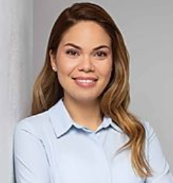
NADIZZ
FUTOURZZ
EXPERIENCE
Since 2017 Senior Project Manager
INTERNATIONAL FIRM
Project Manager
Planning and Defining Scope
Activity Planning and Sequencing
Resource Planning
2014-2017 Specialist Project Manager
COMPANY 1234
Documentation
Creating Charts and Schedules
Risk Analysis
2012-2014 Junior Project Manager
AGENCY XYZ
Developing Schedules
Time Estimating
SKILLS
EDUCATION
Very strong
Presentation
Conflict resolution
Written communication
2011-2012 BSc International Economics
Chicago University
Focus area: macroeconomics
Thesis “crises in 2008 and it global impact”
Graduation top 10 of the class, average 1,7
Fundamental Intermediate Advanced
2009-2011 School HGGS, London, UK
JAVA Power BI
HTML Python
A-levels, 1,2
CONTACT
LANGUAGES
123 Street
Some city 763 postal code
email@email.com
012345678890
A2 Business fluent Native speaker
Crotian
English, Spanish
French
SOCIAL PROFILES

Slide 5
NADIZZ FUTOURZZ
Data science manager
CONTACT
EXPERIENCE
123 Street
Some city 763 postal code
email@email.com
012345678890
2015- now
Senior Frontend Project Manager
INTERNATIONAL FIRM
Frontend Web Technologien und Frameworks (HTML 5,SCSS/CSS, Angular und TypeScript)
Continuous Integration, Build und Release Management
Agilen Software-Entwicklungsmethoden
Entwicklung von Webservices und API Design (SOAP und REST/JSON)
IT MS office Python SQL Tableau Java R LANGUAGES EN, DE, IT – C2 ES – Muttersprache CORE COMPETENCE Data analytics, agile project management, data driven decisions, predictive analytics INDUSTRY AI althorithms, data science training, data use-case rollout
SKILLS
2012 - 2015
Web-designer
COMPANY 1234
Responsive Web Designs
Activity Planning and Sequencing, Continuous Integration, Build und Release Management
Resource Planning
Git, Docker und Microservices, Entwicklung von Webservices und API Design (SOAP und REST/JSON)
Advanced
Very good
Basic
EDUCATION
2011-2012
BSc International Economics
Chicago University
- Focus area: macroeconomics
Graduation average 1,7

Slide 6


ROISO HATOURSEN
Webentwickler / Frontend Web Developer
PROFILE
A professional profile is a brief summary of your skills, strengths, and key experiences. It also should convey what you are seeking or what you have to offer the person reading it.
email@email.com
012345678890
www.website.com
linkedin/namelastname.com
EXPERIENCE
Since 2017
Senior Frontend Project Manager
INTERNATIONAL FIRM
Frontend Web Technologien und Frameworks (HTML 5,SCSS/CSS, Angular und TypeScript)
Continuous Integration, Build und Release Management
Agilen Software-Entwicklungsmethoden
Entwicklung von Webservices und API Design (SOAP und REST/JSON)
EDUCATION
2011-2012
BSc International Economics
Chicago University
- Focus area: macroeconomics
- Graduation average 1,7
2014-2017
Webdesigner
COMPANY 1234
Responsive Web Designs
Activity Planning and Sequencing, Continuous Integration, Build und Release Management
Resource Planning
Git, Docker und Microservices, Entwicklung von Webservices und API Design (SOAP und REST/JSON)
2009-2011
School HGGS
London, UK
- A-levels, 1.2
2012-2013
Webdesigner
COMPANY 1234
Activity Planning and Sequencing, Continuous Integration, Build und Release Management
Resource Planning, Entwicklung von Webservices und API Design (SOAP und REST/JSON)
Git, Docker und Microservices
LANGUAGES
English – fluent
Spanish – fluent
French – native speaker
Crotian – A2

Slide 7
ROISO HATOURSEN
Project Manager
PROFILE
EDUCATION
A professional profile is a brief summary of your skills, strengths, and key experiences. It also should convey what you are seeking or what you have to offer the person reading it.
2011-2012
BSc International Economics
Chicago University
- Focus area: macroeconomics
- Graduation average 1,7
EXPERIENCE
2009-2011
School HGGS
London, UK
- A-levels, 1.2
Since 2017 Senior Project Manager
INTERNATIONAL FIRM
Planning and Defining Scope
Activity Planning and Sequencing
Resource Planning
LANGUAGES
2014-2017 Specialist Project Manager
COMPANY 1234
English – fluent
Spanish – fluent
French – native speaker
Crotian – A2
Documentation
Creating Charts and Schedules
Risk Analysis
2012-2014 Junior Project Manager
AGENCY XYZ
SKILLS
Developing Schedules
Time Estimating
Very strong
2011-2012 Intern
AGENCY XYZ
Presentation
Conflict resolution
Written communication
Developing Schedules
Time Estimating
Fundamental Intermediate Advanced
JAVA Power BI
HTML Python
2011-2012 Intern
AGENCY XYZ
Developing Schedules
Time Estimating

Slide 8

NADIZZ
FUTOURZZ
Project Manager
CONTACT
PROFILE
123 Street
Some city 763 postal code
email@email.com
012345678890
A professional profile is a brief summary of your skills, strengths, and key experiences. It also should convey what you are seeking or what you have to offer the person reading it.
EDUCATION
EXPERIENCE
2011-2012
BSc International Economics
Chicago University
- Focus area: macroeconomics
- Graduation average 1,7
Since 2017 Senior Project Manager
INTERNATIONAL FIRM
Planning and Defining Scope
Activity Planning and Sequencing
Resource Planning
2009-2011
School HGGS
London, UK
- A-levels, 1.2
2014-2017 Specialist Project Manager
COMPANY 1234
Documentation
Creating Charts and Schedules
Risk Analysis
LANGUAGES
English – fluent
Spanish – fluent
French – native speaker
Crotian – A2
2012-2014 Junior Project Manager
AGENCY XYZ
SKILLS
Developing Schedules
Time Estimating
Very strong
2011-2012 Intern
AGENCY XYZ
Presentation
Conflict resolution
Written communication
Developing Schedules
Time Estimating
Fundamental Intermediate Advanced
JAVA Power BI
HTML Python
2011-2012 Intern
AGENCY XYZ
SOCIAL PROFILES
Developing Schedules
Time Estimating

Slide 9





NADIZZ
FUTOURZZ
CONTACT
123 Street
Some city 763 postal code
email@email.com
012345678890
Project Manager
EXPERIENCE
PROFILE
Since 2017 Senior Project Manager
INTERNATIONAL FIRM
A professional profile is a brief summary of your skills, strengths, and key experiences. It also should convey what you are seeking or what you have to offer the person reading it.
Planning and Defining Scope
Activity Planning and Sequencing
Resource Planning
2014-2017 Specialist Project Manager
COMPANY 1234
EDUCATION
Documentation
Creating Charts and Schedules
Risk Analysis
2011-2012
BSc International Economics
Chicago University
- Focus area: macroeconomics
- Graduation average 1,7
2012-2014 Junior Project Manager
AGENCY XYZ
Developing Schedules
Time Estimating
2009-2011
School HGGS
London, UK
- A-levels, 1.2
2011-2012 Intern
AGENCY XYZ
Developing Schedules
Time Estimating
LANGUAGES
2011-2012 Intern
AGENCY XYZ
English – fluent
Spanish – fluent
French – native speaker
Crotian – A2
Developing Schedules
Time Estimating
SKILLS
SOCIAL PROFILES
Very strong
Fundamental Intermediate Advanced
Presentation
Conflict resolution
Written communication
JAVA Power BI
HTML Python

Slide 10
NADIZZ FUTOURZZ
P R O J E C T M A N A G E R
CONTACT
PROFILE
123 Street
Some city 763 postal code
email@email.com
012345678890
A professional profile is a brief summary of your skills, strengths, and key experiences. It also should convey what you are seeking or what you have to offer the person reading it.
EXPERIENCE
LANGUAGES
Since 2017
Senior Fronten Project Manager
INTERNATIONAL FIRM
Frontend Web Technologien und Frameworks (HTML 5,SCSS/CSS, Angular und TypeScript)
Continuous Integration, Build und Release Management
Agilen Software-Entwicklungsmethoden
Entwicklung von Webservices und API Design (SOAP und REST/JSON)
English – fluent
Spanish – fluent
French – native speaker
Crotian – A2
SKILLS
Presentation – expert
Conflict resolution – expert
Written communication - expert
2014-2017
Webdesigner
COMPANY 1234
Responsive Web Designs
Activity Planning and Sequencing, Continuous Integration, Build und Release Management
Resource Planning
Git, Docker und Microservices, Entwicklung von Webservices und API Design (SOAP und REST/JSON)
JAVA – expert
Signavio – expert
Python – expert
HTML – expert
Power BI - student
EDUCATION
2011-2012
BSc International Economics
Chicago University
- Focus area: macroeconomics
- Graduation average 1,7
PROJECT LIST
Project 1: Updating XYZ.com 2015-2016
Duration: 9 month
Technologies Used: HTML5/CSS3, PHP, Java
Redesigned XYZ’s website to accompany branding relaunch
Converted Flash-based navigation to HTML5 standard
Optimized website for all screens
Developed mobile version
2009-2011
School HGGS
London, UK
- A-levels, 1.2

Slide 11
ROISO
HATOURSEN
W E B D E V E L O P E R
CONTACT
PROFILE
123 Street
Some city 763 postal code
email@email.com
012345678890
A professional profile is a brief summary of your skills, strengths, and key experiences. It also should convey what you are seeking or what you have to offer the person reading it.
EXPERIENCE
LANGUAGES
Since 2017
Senior Fronten Project Manager
INTERNATIONAL FIRM
Frontend Web Technologien und Frameworks (HTML 5,SCSS/CSS, Angular und TypeScript)
Continuous Integration, Build und Release Management
Agilen Software-Entwicklungsmethoden
Entwicklung von Webservices und API Design (SOAP und REST/JSON)
English – fluent
Spanish – fluent
French – native speaker
Crotian – A2
SKILLS
Presentation – expert
Conflict resolution – expert
Written communication - expert
2014-2017
Webdesigner
COMPANY 1234
Responsive Web Designs
Activity Planning and Sequencing, Continuous Integration, Build und Release Management
Resource Planning
Git, Docker und Microservices, Entwicklung von Webservices und API Design (SOAP und REST/JSON)
JAVA – expert
Signavio – expert
Python – expert
HTML – expert
Power BI - student
EDUCATION
2011-2012
BSc International Economics
Chicago University
- Focus area: macroeconomics
- Graduation average 1,7
PROJECT LIST
Project 1: Updating XYZ.com 2015-2016
Duration: 9 month
Technologies Used: HTML5/CSS3, PHP, Java
Redesigned XYZ’s website to accompany branding relaunch
Converted Flash-based navigation to HTML5 standard
Optimized website for all screens
Developed mobile version
2009-2011
School HGGS
London, UK
- A-levels, 1.2

Slide 12









NADIZZ FUTOURZZ
P R O J E C T M A N A G E R
emailemail@gmail.com
+49(0)15667444444
www.nadizzf.com
NADIZZFUTOURZZ
PROFILE
EXPERIENCE
A professional profile is a brief summary of your skills, strengths, and key experiences. It also should convey what you are seeking or what you have to offer the person reading it.
2015 - now
Senior Frontend Project Manager
INTERNATIONAL FIRM
Frontend Web Technologien und Frameworks (HTML 5,SCSS/CSS, Angular und TypeScript)
Continuous Integration, Build und Release Management
Agilen Software-Entwicklungsmethoden
Entwicklung von Webservices und API Design (SOAP und REST/JSON)
IT MS office Python SQL Tableau Java R LANGUAGES EN, DE, IT – C2 ES – Native speaker CORE COMPETENCE Data analytics, agile project management, data driven decisions, predictive analytics INDUSTRY AI althorithms, data science training, data use-case rollout
SKILLS
Advanced
2012 - 2015
Web-designer
COMPANY 1234
Responsive Web Designs
Activity Planning and Sequencing, Continuous Integration, Build und Release Management
Resource Planning
Git, Docker und Microservices, Entwicklung von Webservices und API Design (SOAP und REST/JSON)
Very good
Basic
2012 - 2015
Web-designer
COMPANY 1234
Responsive Web Designs
Activity Planning and Sequencing, Continuous Integration, Build und Release Management
REFERENCES
EDUCATION
Mr. ABCD EFGH
Head of Marketing, 1234
email@email.com +49(0)15667444444
2011-2012
BSc International Economics
Chicago University
- Focus area: macroeconomics
Graduation average 1,7

Slide 13



ROISO
HATOURSEN
W E B D E V E L O P E R
CONTACT
PROFILE
123 Street
Some city 763 postal code
email@email.com
012345678890
A professional profile is a brief summary of your skills, strengths, and key experiences. It also should convey what you are seeking or what you have to offer the person reading it.
LANGUAGES
EXPERIENCE
English – fluent
Spanish – fluent
French – native speaker
Crotian – A2
Since 2017
Senior Fronten Project Manager
INTERNATIONAL FIRM
Frontend Web Technologien und Frameworks (HTML 5,SCSS/CSS, Angular und TypeScript)
Continuous Integration, Build und Release Management
Agilen Software-Entwicklungsmethoden
Entwicklung von Webservices und API Design (SOAP und REST/JSON)
SKILLS
Presentation – expert
Conflict resolution – expert
Written communication - expert
2014-2017
Webdesigner
COMPANY 1234
Responsive Web Designs
Activity Planning and Sequencing, Continuous Integration, Build und Release Management
Resource Planning
Git, Docker und Microservices, Entwicklung von Webservices und API Design (SOAP und REST/JSON)
JAVA – expert
Signavio – expert
Python – expert
HTML – expert
Power BI - student
EDUCATION
2011-2012
BSc International Economics
Chicago University
- Focus area: macroeconomics
- Graduation average 1,7
PROJECT LIST
Project 1: Updating XYZ.com 2015-2016
Duration: 9 month
Technologies Used: HTML5/CSS3, PHP, Java
Redesigned XYZ’s website to accompany branding relaunch
Converted Flash-based navigation to HTML5 standard
Optimized website for all screens
Developed mobile version
2009-2011
School HGGS
London, UK
- A-levels, 1.2

Slide 14
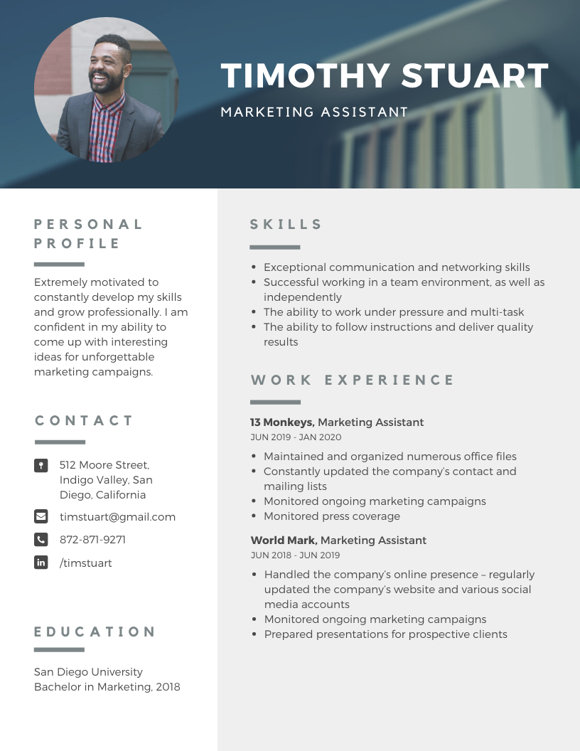

Slide 15
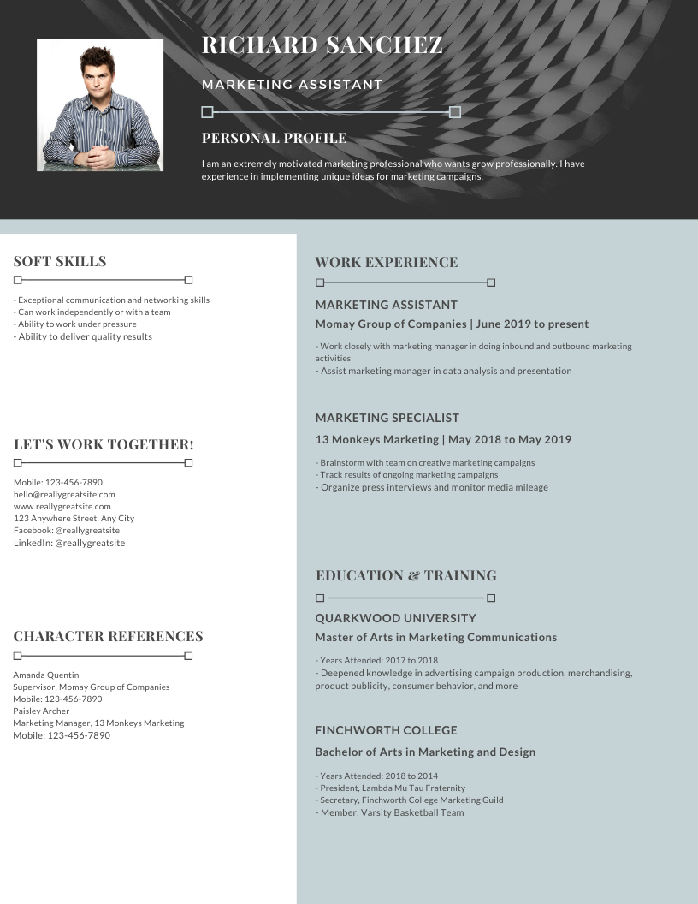

Slide 16
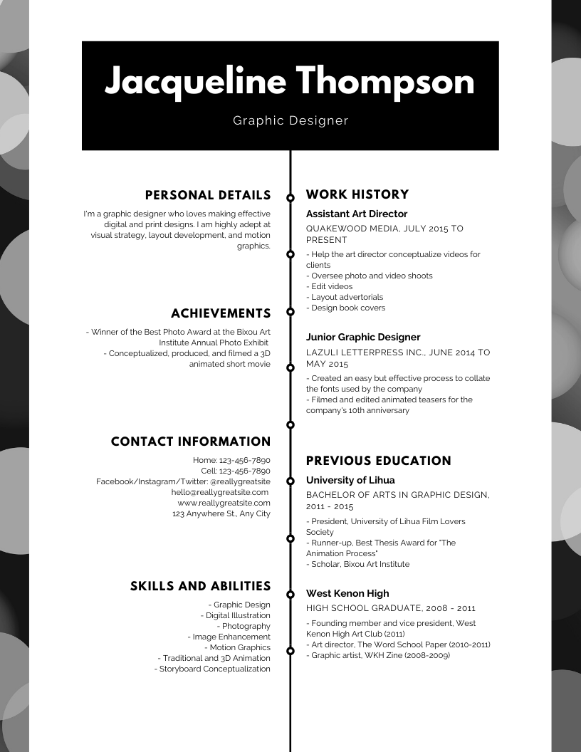

Slide 17
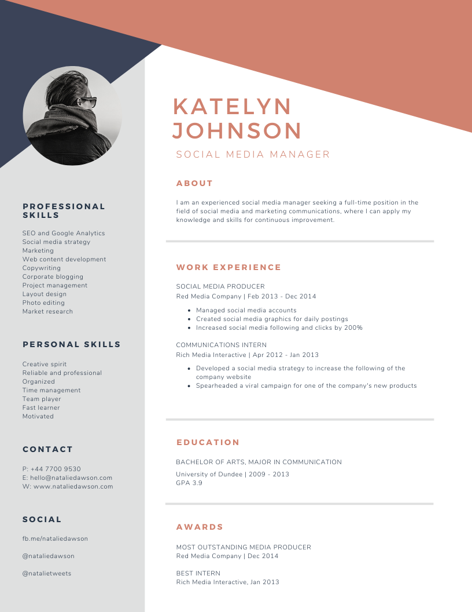

Slide 18
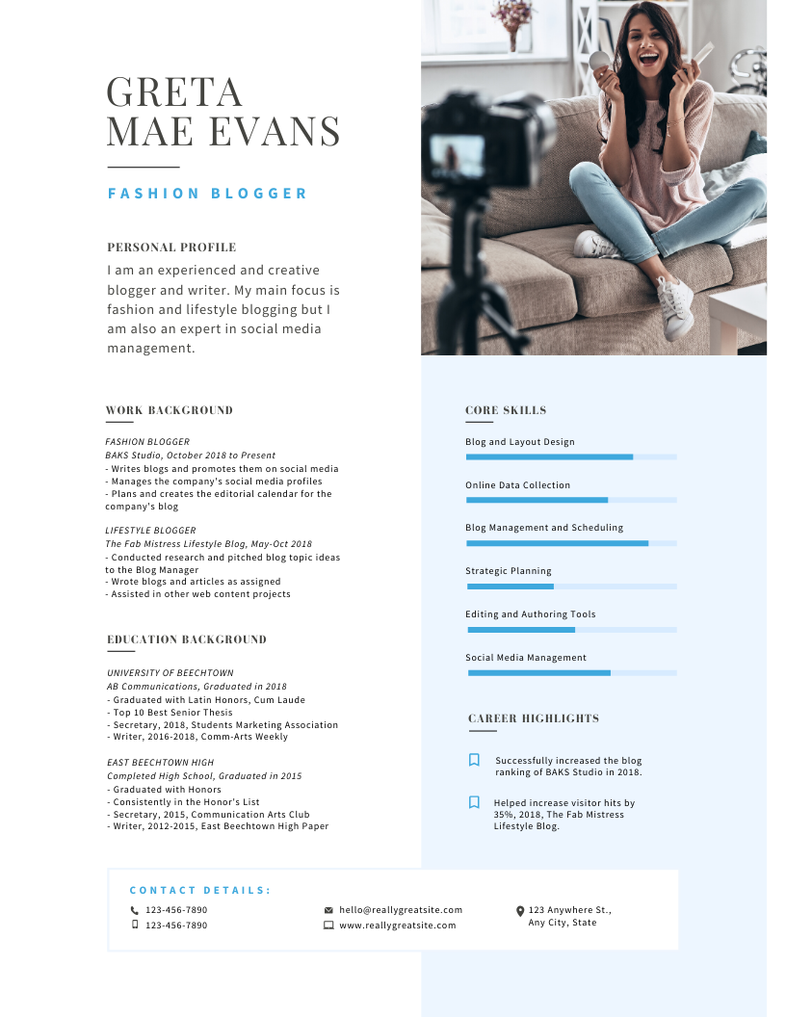
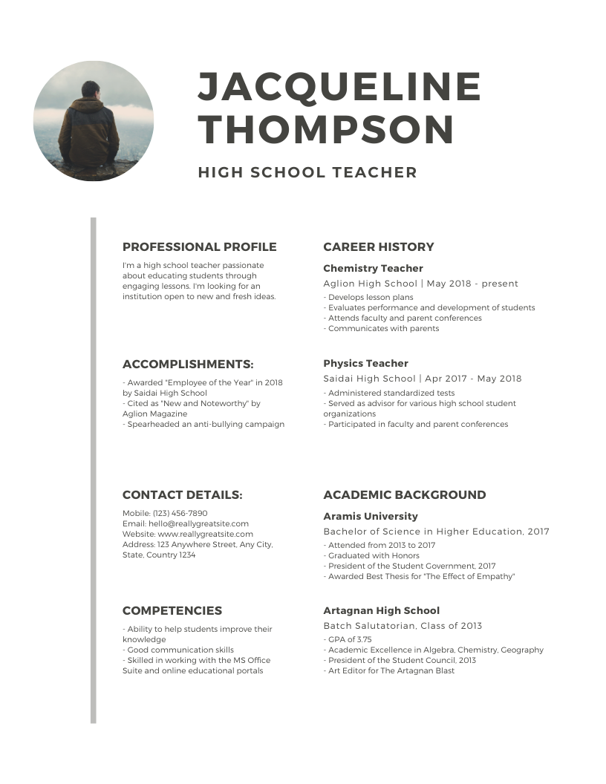

Slide 19
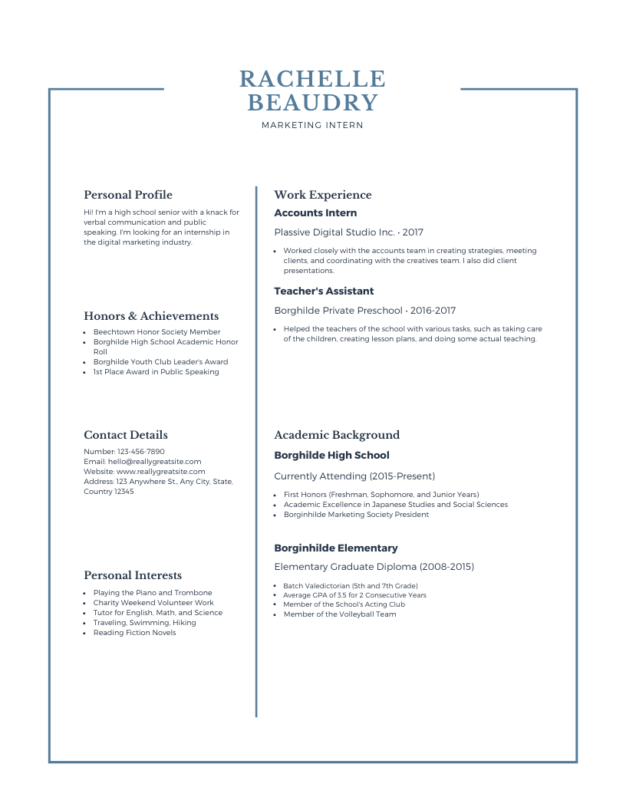

Slide 20
