Slide 1
SCHOOL OF TECHNOLOGICAL INNOVATION
Computer Science, Information Systems, Data and Networks
Embedded Systems, Electronics, Industrial Engineering
ICT for Biotechnologies and e-Health, Energy
Management of Technologies

Slide 2
School of Engineering of CCI Paris Ile-de-France
Public institute affiliated to the Chamber of Commerce and Industry of Paris Region
School created in 1904 under the name « Breguet School »
1800 students, including 1500 engineering students
110 faculty members (research and teaching)
Diplôme d’Ingénieur recognized by the CTI since1971:
10 full-time tracks plus 4 apprentice-ship tracks
Specialised Masters, M.Sc., Research Masters and PhDs
Founding member of Université Paris Est

Slide 3
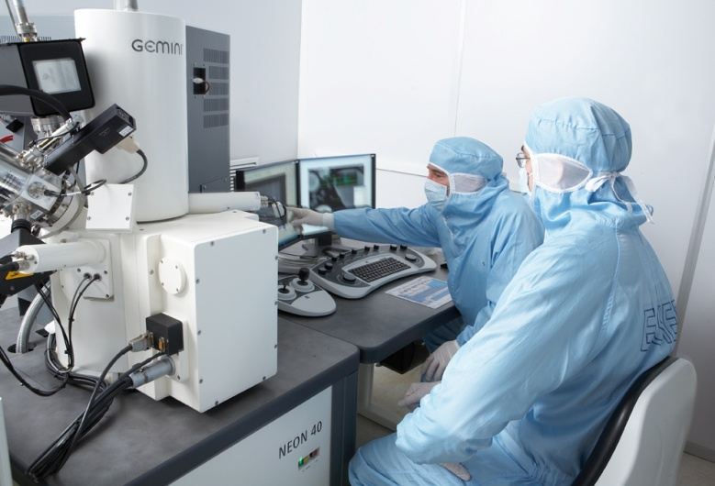
R&D at ESIEE Paris
4 departments of Education and
Research
85 research contracts
36 patents
2-3 start-up creations per year
1159 publications over the the last 4 years
2 CNRS research teams
5 technological platforms: clean-room (650m²), virtual reality, communication systems with RF, microwaves and photonics, embedded systems, database analytics

Slide 4


Université Paris-Est
3 thematic priorities:
Sustainable cities, green technologies
Health and society
Image and media
ESIEE Paris founder member:
Center for higher education and research from CCIR Paris-IdF
1800 students, 110 faculty members, 70 PhDs
3 LabEx, 1 Equipex
ESIEE Paris research activities:
Microsystems, electronics and communications
Informatics
Innovation management

Slide 5
R&D Clusters
ESIEE Paris is acting in academic and industry research with:
  Systematic
  Cap Digital
  Medicen
  Advancity
  OpticsValley

Slide 6
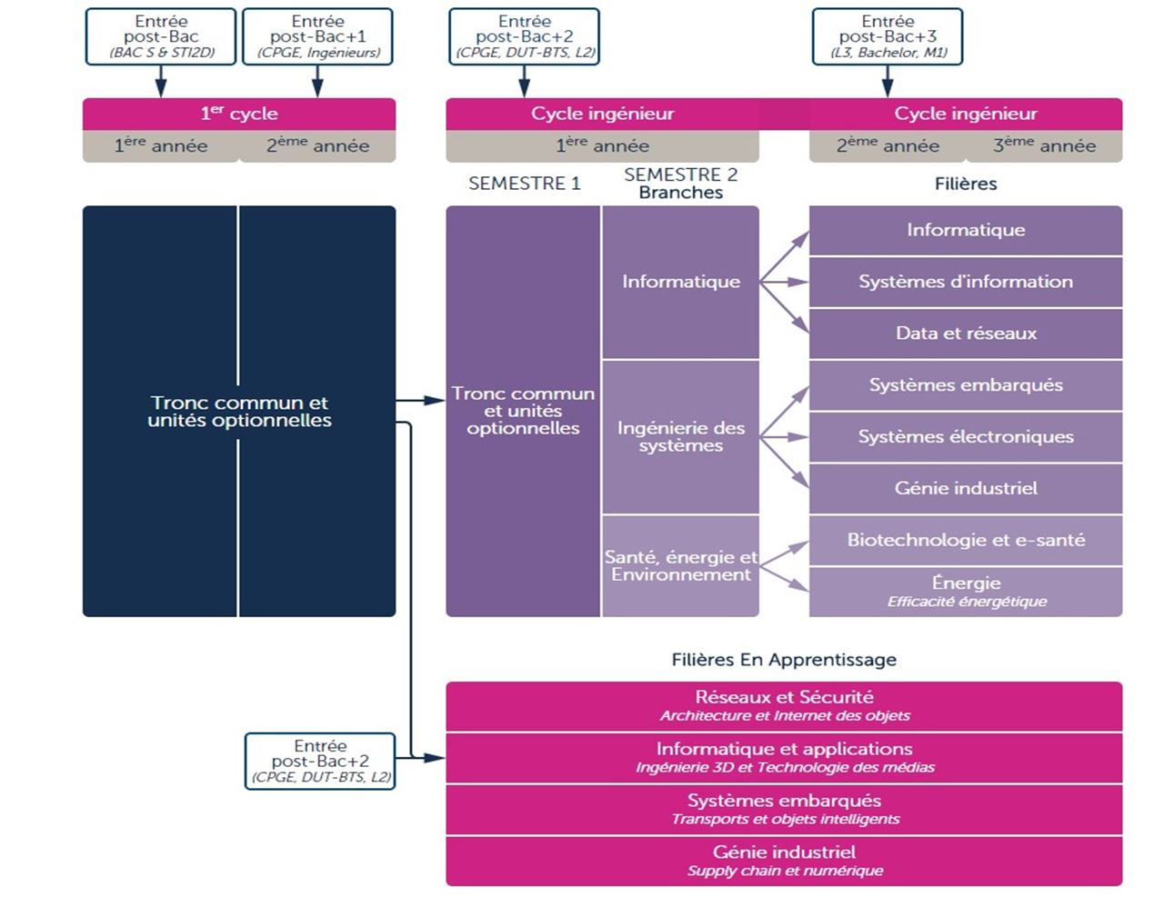
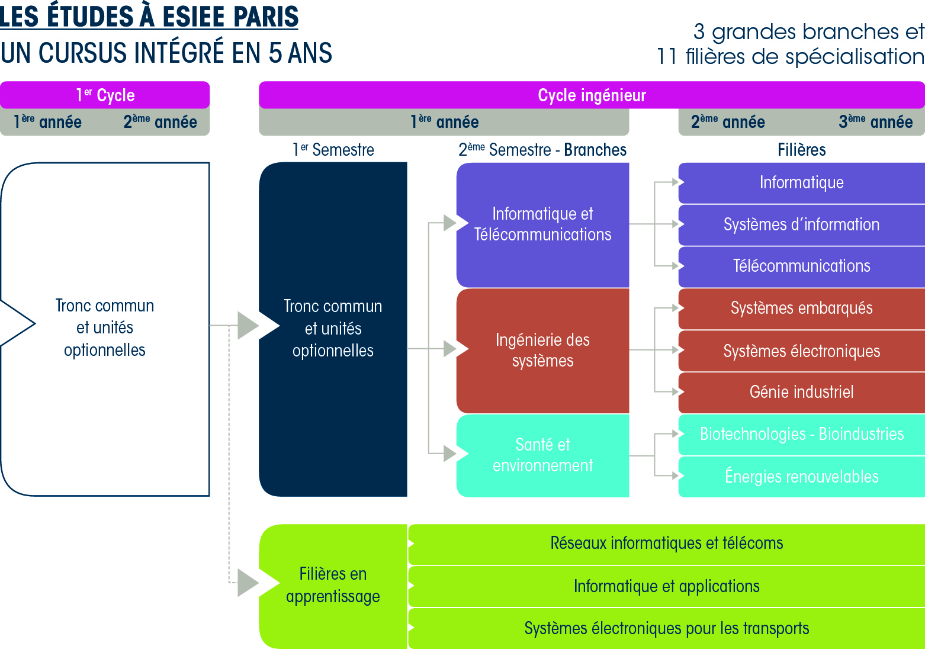
Education programmes
3 branches
10 full-time tracks including 2 taught in English
4 apprenticeship tracks
Computer Science
Electronics
*Wireless *Micro-Nano
*Sensor Networks

Slide 7
The first cycle
The first two years after high school
Education:
Fundamental sciences (mathematics – physics)
Engineering sciences (digital technologies)
Management, Humanities and Languages
Interdisciplinary projects
Electives: Chemisty, Biology, Thermodynamic, Mechanics…
Internship in a company (1 month)
Innovative Pedagogy:
Project learning
Mentorship / Individual guidance
P5 : Personal and Professional Project
The first cycle prepares for all tracks in the Engineering cycle

Slide 8
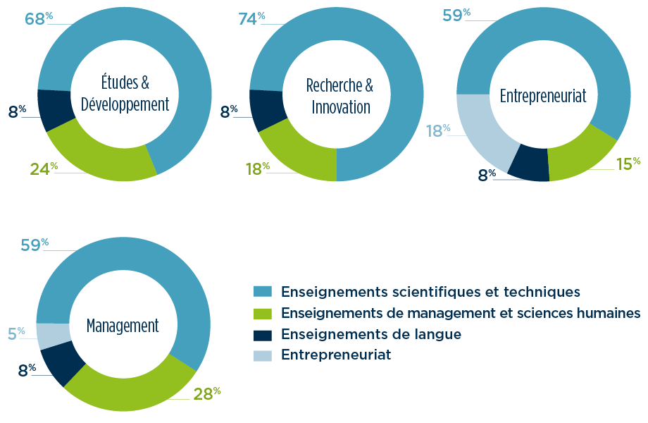
Job profiles
Depending on electives, each student creates their own profile.
4 main job profiles are possible:
Study &
Development
Research &
Innovation
Entrepreneurship
Scientific and technical courses
Management and humanities courses
Language courses
Entrepreneurship
Management

Slide 9

Internship and projects
12 months of internship over the 5 years
Within the first cycle:
  1-month internship, discovering industry
  between first and second year
  2-month internship at the beginning
  of the Engineering cycle
Engineering cycle:
  10 weeks of projects
  15 weeks of internships
  6-month final internship / Master thesis
Possibility of a gap year between the 2nd and 3rd year of the Engineering cycle

Slide 10

The « apprenticeship » track
« Apprenticeship » training over 3 years:
Under an « apprenticeship contract »
Employee status from the company
Supervised by a company mentor and
a tutor from the school
The company pays for the student’s education
Alternating long periods at school / in the company
A specific department accompanies candidates in their « apprenticeship » application: suggesting company assignments, interview training, speed-recruiting sessions…

Slide 11
Proximity with companies
More than 650 companies host our interns and graduated students each year
20 to 25 % of lectures / teaching are given by professionals from companies
Companies / Students meetings: organized all year long
Company chairs: final-year lectures/teaching by company partners (AKKA, ATOS Origin, IBM, EUROGICIEL, SOPRA)
Forum Descartes : job fair organized at ESIEE Paris
Excellence Scholarship : funded by companies

Slide 12

Job placement
ESIEE Paris graduates
Placement rate
(6 months after graduation) :
94 %
72 %
Have found a job before graduating
Average initial salary: 38400€
(Source : 2015 survey considering 2014 alumni)

Slide 13
Sectors and Jobs
Placement in various sectors of activity:
  Technologies of Information and communication, Informatics, Electronics, Telecommunications
  Automotive, Aeronautics, Space, Trains
  Health, Energy, Environment, Civil Engineering
  But also Banks, Insurances, Consultancy, etc.
Diversified Jobs:
  R&D Engineers, Design, S&T
  Network engineers
  Sales Engineers, Marketing managers, etc.

Slide 14

International opening
More than 200 international students per year
101 partnerships with 92 partners from 36 countries
3-month period minimum abroad with a company or university
18 double-degrees (Canada, China, Chile, USA, Italy, Brazil,
Czech Republic, UK)
A presence in South Africa: the French’South-African Institute of Technology (F’SATI) with TUT, Pretoria and CPUT, Cape Town
Gap-year abroad possible
Member of Erasmus+ programme, Brafitec, n+i, etc.
2 international tracks + 3 Masters/M.Sc. : taught in English and open to French and international students. Include courses of French as a foreign language
Importance of language learning: TOEIC (785), small groups -12 students;
2 foreign languages recommended; language center available to all students

Slide 15
Outgoing mobility
101 partnerships
  57 in Europe
  28 non-Eu
  18 double-degrees
36 countries
92 universities
Expected mobility
for 2018-2019: >350
      > 200 full-time
      150 apprentice-ship
229
Apprentice-ship
Incentive

Slide 16
International programs
  Master Programs taught in English:
    Electronics: Wireless communications, Micro-Nano-technologies, Sensor networks
    Computer Science for intelligent systems
    M.Sc. Management of Technology - Information System
    Short program on Wireless Communicant Sensors
  Master Programs taught in French, with from 2 months to 1 year of preparation to the French language through N+I network / Université Paris Est preparation cycle:
    Computer science
    Information systems
    Data and Networks
    Embedded systems
    Electronic systems
    Industrial engineering
    Biotechnologies – e-Health
    Renewable Energy and Energy Efficiency
  ESIEE Paris also has a campus in South-Africa with a M.Sc. degree taught in English:
    MSc Electrical and Electronic Systems Engineering
    French’ South-African Institute of Technology (F'SATI) - Pretoria and CapeTown

Slide 17


Student Entrepreneurship
Entrepreneurship track available (E4, E5)
ESIEE Paris Project Day : >100 projects each year, 7 awards, coaching
PEPITE program : students create their company during the 6m internship
Incubator Descartes (UPE)
ESIEE Connect
More than 5 companies created by alumni / year
InAGrad program

Slide 18
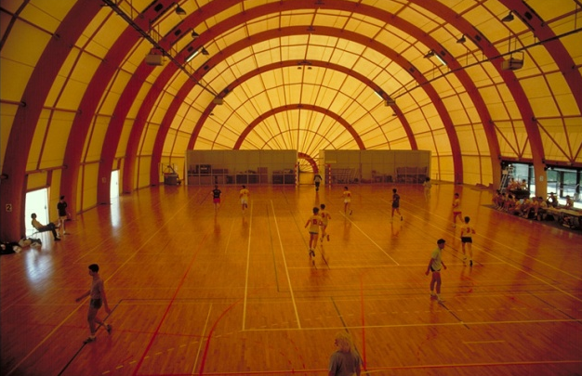

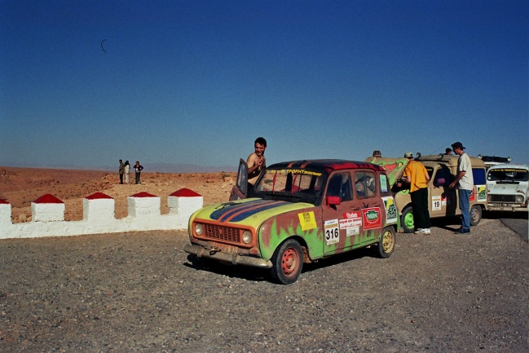

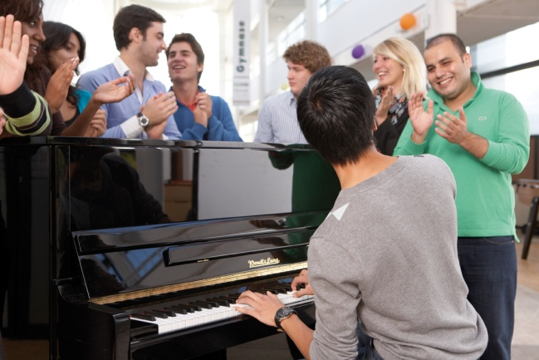
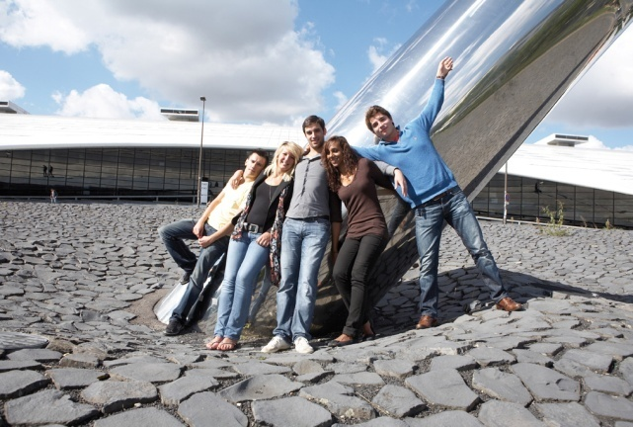
Student life at ESIEE PARIS
  A rich and active student life:
  More than 30 sports
  More than 20 Student Clubs

Slide 19
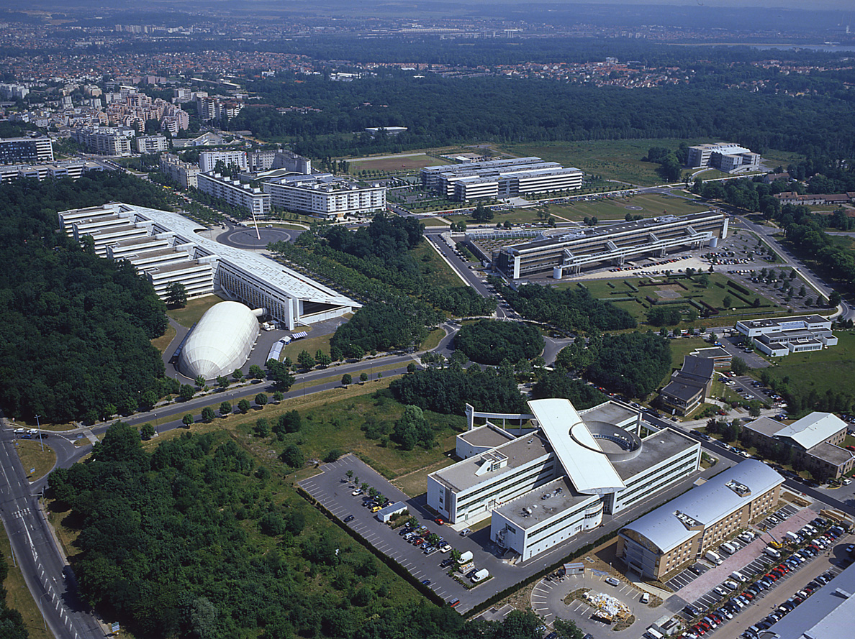
La Cité Descartes
Ecole des Ponts
ENSG
School
of architecture
Ampère
Housing
CROUS + Perronet
Housing
RER A
ESIEE PARIS
UPEM
Gymnase
IUT
Université Paris Est
Campus

Slide 20
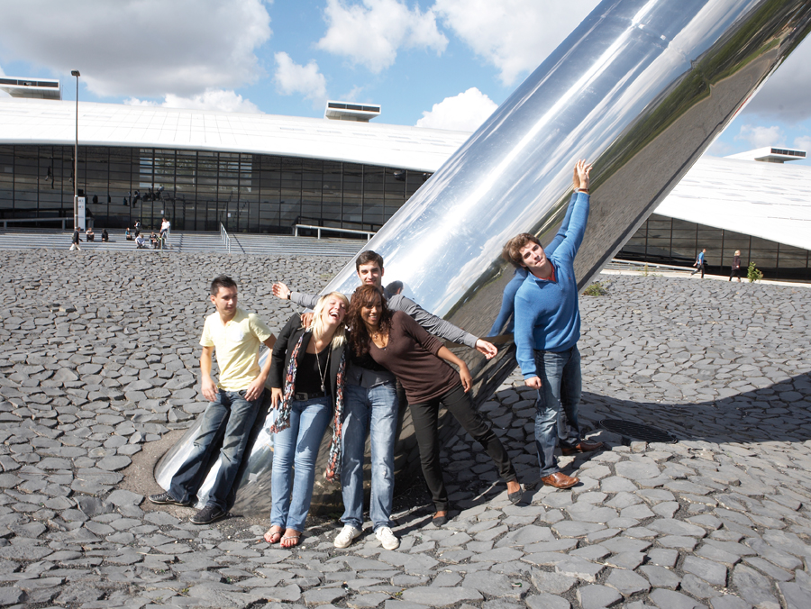
Creating technological Innovation

