Slide 1


Manfred Reichert
Institute of Databases and Information Systems
Ulm University
manfred.reichert@uni-ulm.de
June 3, 2019
Time-Aware BPM Systems
Challenges, Foundations, Time Patterns
Manfred Reichert, Andreas Lanz, Barbara Weber
Celebrating 20 yrs BPMDS @ CAiSE 2019
Image by www.sxc.hu, saavem
Notes:
Simple Temporal Networks with
Partially Shrinkable Uncertainty (STNPSU)
Contingent constraints are extended to guarded constraints

Slide 2
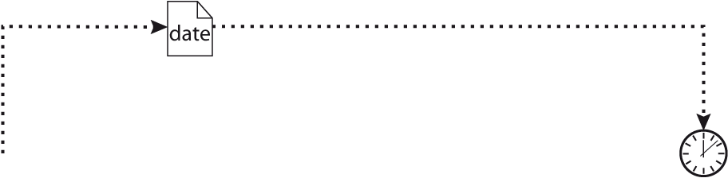
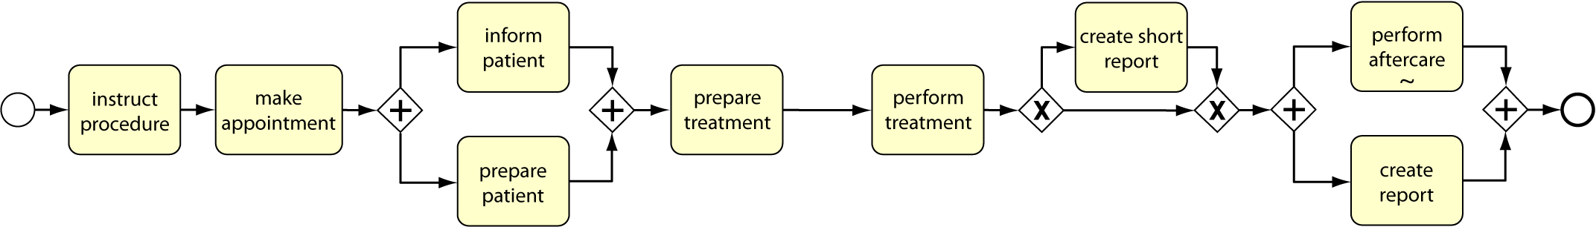


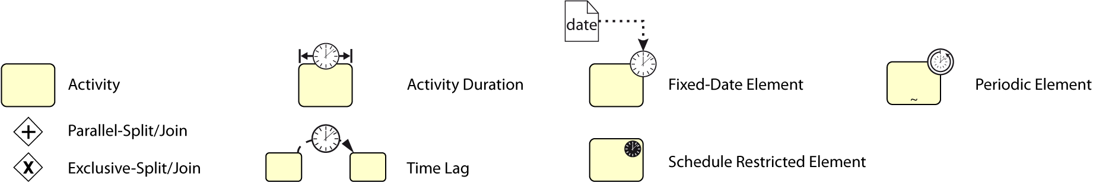
Introduction
Appointment of perform treatment fixed by activity
make appointment
Temporal aspects play a crucial role in today's business life
Time perspective raises fundamental challenges for any process-aware information system
Activity
prepare patient can only be executed on working days between 8am and 4pm
Time support is very limited in existing PAIS
Failure to obey time restrictions leads to increased costs
Time Lag between prepare patient and
perform treatment
needs to be exactly one day
Notes:
Zeit spielt im heutigen Geschäftsleben eine sehr wichtige Rolle. Nicht zuletzt gilt auch hier das Sprichwort Zeit ist Geld.
Entsprechendes gilt natürlich auch für die in den Unternehmen ablaufenden Geschäftsprozesse. Diese haben gewissen zeitliche Eigenschaften wie Bearbeitungsdauern und müssen sich an verschiedenste zeitliche Bedingungen halten.
Um das alles zu verdeutlichen und plastischer zu machen habe ich hier einen relativ einfachen Prozess aus dem klinischen Umfeld dargestellt.
Dieser hat, wie man unschwer erkennen kann, mindestens eine zeitliche Bedingungen:
Zu beginn des Prozesses, nach dem die Behandlung angeordnet wurde, wird ein Termin vereinbart, zu dem die eigentliche Behandlung durchgeführt werden soll.
Dieser Termin muss dann auch entsprechend eingehalten und der restliche Prozess dementsprechend geplant werden.
Letzteres ist in so fern wichtig, da die Vorbereitung des Patienten genau einen Tag vor der Behandlung durchgeführt werden muss.
Dabei ist zusätzlich zu beachten, dass das Personal, dass die Vorbereitung durchführen kann nur zu den normalen Arbeitszeiten verfügbar ist und die Vorbereitung somit auch nur zu diesen Zeiten stattfinden kann.

Slide 3




Introduction
Temporal aspects play a crucial role in today's business life
Time perspective raises fundamental challenges for any process-aware information system
Activity
prepare treatment
takes at least 1 hour
Activity
prepare treatment
can be executed at most 3 hours before
perform treatment
Time support is very limited in existing PAIS
Failure to obey time restrictions leads to increased costs
Notes:
Zwischen der Vorbereitung des Patienten und der Behandlung muss die Behandlung selbst vorbereitet werden. Dies Dauert mindestens eine Stunde und kann frühestens 3 Stunden vor der Behandlung begonnen werden. Neben diesen Zeitbedingungen gibt es noch eine ganz Reihe weiterer die alle während der Ausführung des Prozesses beachtet werden müssen.
Wie man sich unschwer vorstellen kann kommt es bei einem solchen zeitbehafteten Prozess ohne eine entsprechend Unterstützung häufig zu einer Verletzung der Zeitbedingungen. Dies kann dann in letzter Konsequenz sogar dazu führen, dass der Prozess abgebrochen und komplett von vorne begonnen werden muss. Was natürlich nicht zuletzt aufgrund der damit verbundenen höheren Kosten vermieden werden sollte.
Es ist damit klar, das die Unterstützung von Zeitaspekten für prozessorientierte Informationssysteme eine äußerst wichtige Rolle spielt. Unter diesen Eindrücken ist es durchaus überraschend, dass Zeitaspekten in heutigen Informationssystemen nur sehr begrenzt bis gar nicht unterstütz werden. Insbesondere, da das nicht-beachten von Zeitbedingungen sehr häufig mit schwerwiegenden Konsequenzen verbunden ist.

Slide 4
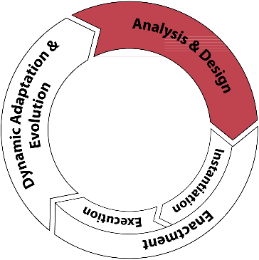
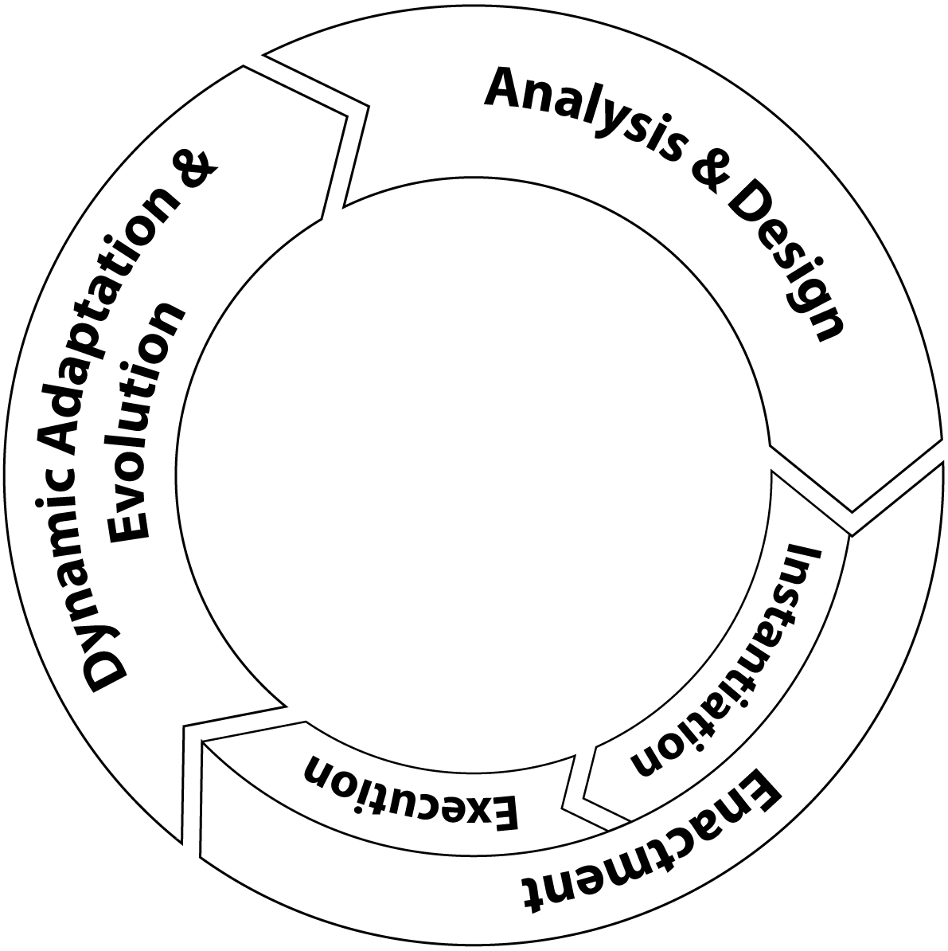
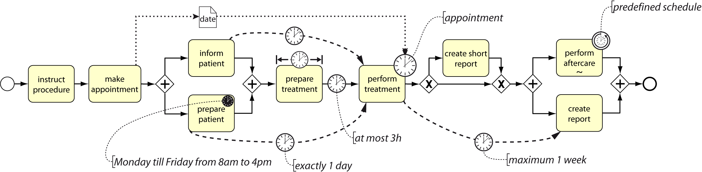
Introduction
Analysis & Design
Specification of time perspective
  High expressiveness
  Relation to other process perspectives (Data)
  Soundness (Executability)
Notes:
Ziel meiner Arbeit ist daher die Entwicklung eines Rahmenwerks zur Unterstützung zeitbehafteter Prozesse in einem prozessorientierten Informationssystems während des gesamten Prozesslebenszyklus. Dieser besteht vereinfacht gesagt aus den drei Phasen Analyse, Ausführung und Evolution.
Der Lebenszyklus eines Prozesses beginnt mit der Analyse des realen Prozesses und der Modellierung eines entsprechenden Prozessmodells.
Dabei ist es wichtig, das die Zeiteigenschaften und –bedingungen des Prozesses vollständig erfasst werden können.
Es ist also eine entsprechende Ausdrucksmächtigkeit, der zugrundeliegenden Prozessmodellierungssprachen erforderlich.
Hierbei müssen auch die Verbindungen der Zeitaspekte mit anderen Prozessperspektiven, wie beispielsweise den Daten bedacht werden.
Als Beispiel sei hier der Termin genannt der innerhalb des Prozesses vereinbart und in einem Datenelement gespeichert wird und dann im späteren Verlauf des Prozesses entsprechend eingehalten werden muss.
Schließlich ist es wichtig sicherzustellen, dass das entstandene Prozessmodell korrekt und insbesondere auch fehlerfrei ausführbar ist.

Slide 5
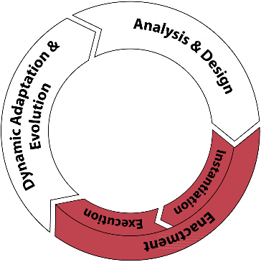
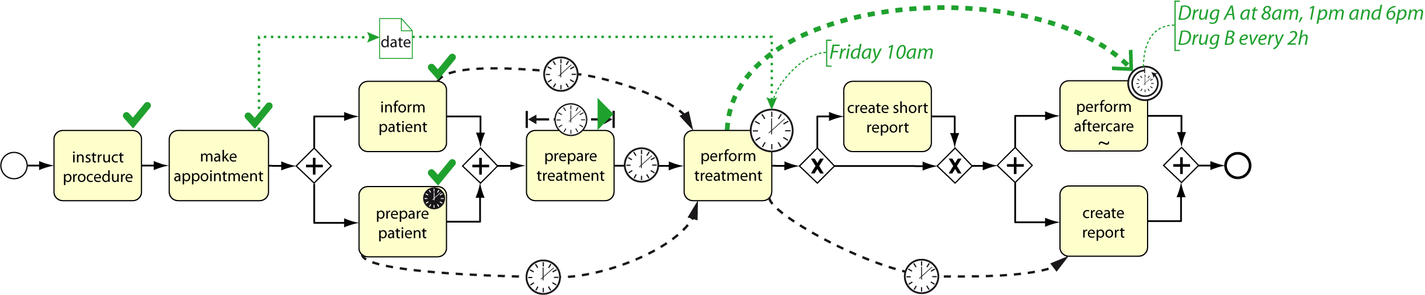
Introduction
Execution
Executing and monitoring time-aware process instances
Monitoring
Predicting execution times
Predicting and detecting critical situations
Ensuring efficiency
Notes:
Ist dies gegeben kann der Prozess zur Ausführung gebracht werden.
Während der Ausführung ist es wichtig die vorhandenen Zeitbedingungen zu überwachen, um so im Problemfall frühzeitig eingreifen zu können.
Dabei spielt unter anderem auch das Zusammenspiel komplexer und dynamischer Zeitbedingungen eine wichtige Rolle.
Weiter muss es möglich sein Ausführungszeiten von Aktivitäten vorherzusagen, um so unter anderem kritische Situationen frühzeitig erkennen und damit hoffentlich verhindern zu können.
Schließlich spielt bei all diesen Aspekten die Sicherstellung der Effizienz eine sehr große Rolle, da innerhalb eines einzelnen prozessorientierten Informationssystems nicht selten 100te bis 1000de Prozessinstanzen gleichzeitig ausgeführt werden.

Slide 6
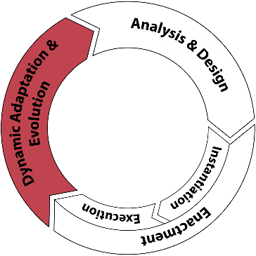
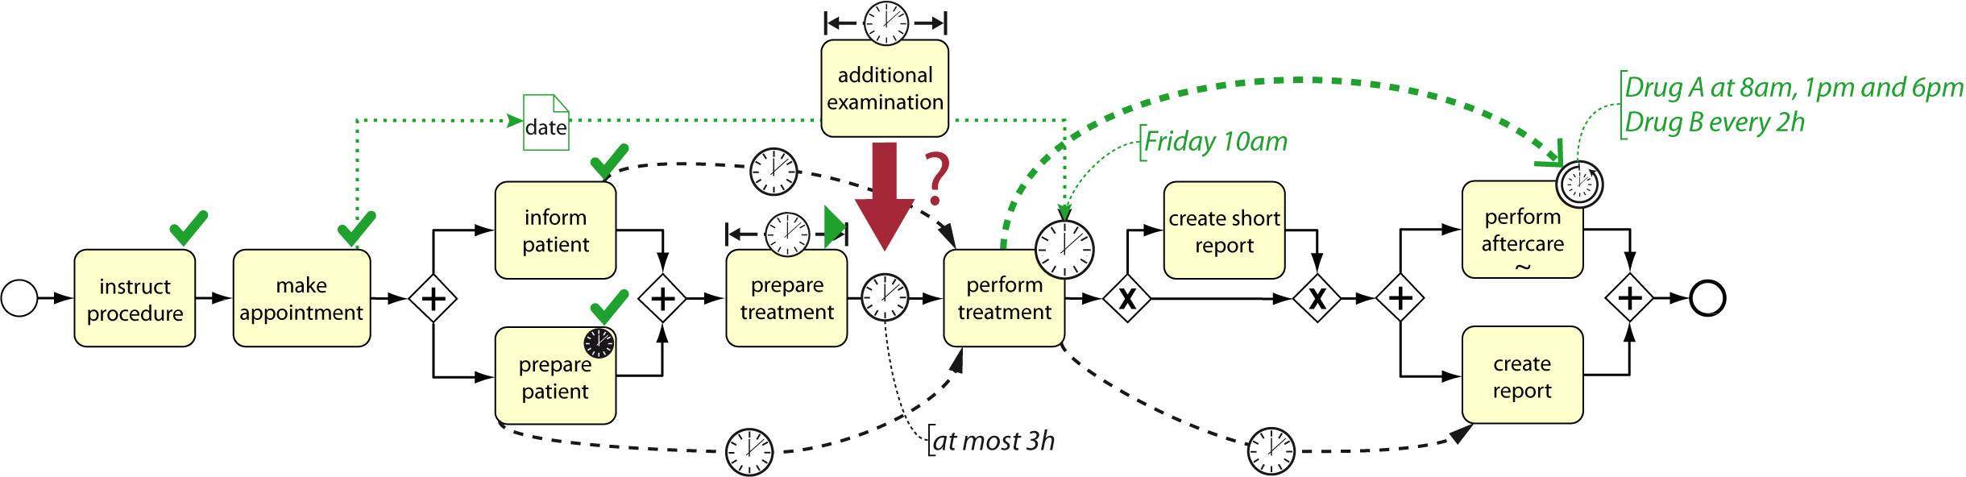
Introduction
Dynamic Adaptation and Evolution
Dynamic changes of time-aware process instances
Structural and temporal changes
Preserving correctness and executability
Ensuring efficiency
Notes:
Nicht nur im Fehlerfall ist es außerdem notwendig, das Prozessinstanzen während der Laufzeit dynamisch verändert werden können. Dies ist beispielsweise auch häufig notwendig um auf geänderte Kontextbedingungen reagieren zu können.
Dabei müssen neben strukturellen Änderungen, wie dem Einfügen und Löschen von Aktivitäten, auch Änderungen an den Zeitbedingungen einer Prozessinstanz unterstützt werden.
Hierbei ist es zentral, sicherzustellen, dass die Prozessinstanz nach den Änderungen weiterhin korrekt und fehlerfrei Ausführbar ist.
Auch hierbei spielt die Effizienz der eingesetzten Algorithmen eine wichtige Rolle, da häufig dutzende oder 100te Prozessinstanzen gleichzeitig angepasst werden müssen.

Slide 7



Introduction
Modelling & Design
Comprehensive time support during the whole process life cycle
Modeling: Comprehensive approach to model time aspects of business processes.
Correctness: Ensure syntactical correctness and executability.
Execution: Efficient and effective execution of time-aware process instances.
Adaptation & Evolution: Dynamically react to changes in the process context.
Execution
Dynamic Adaptation and Evolution
Notes:
Das Ziel meines Promotionsvorhabens ist daher die umfassende Unterstützung zeitlicher Aspekte während des gesamten Prozesslebenszyklus.
Hierzu zählt wie eben erläutert die umfassende Unterstützung zeitlicher Aspekte bei der Modellierung, die Überprüfung der modellierten Prozesse auf ihre Korrektheit und Ausführbarkeit, die effiziente Ausführung und Überwachung zeitbehafteter Prozessinstanzen, sowie die dynamische Anpassung entsprechender Prozessinstanzen zur Laufzeit.

Slide 8
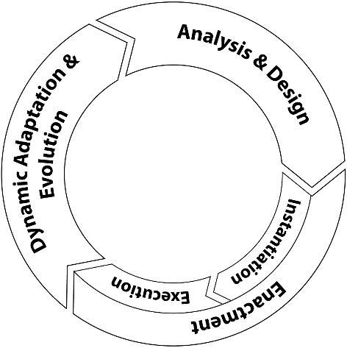
Introduction
Research Questions
What is required to model time-aware processes?
How can the executability of a time-aware process model be verified?
How to monitor and re-check executability during run time?
How can time-aware process instances be dynamically adapted?
Notes:
These requirements motivated the following four research questions with respect to time- and process-aware information systems, which I focused on during my thesis.
During my thesis I developed advanced concepts to deal with all four of these questions.
Due to the limited time, in todays talk I will mainly focus on the first two and the last question.

Slide 9
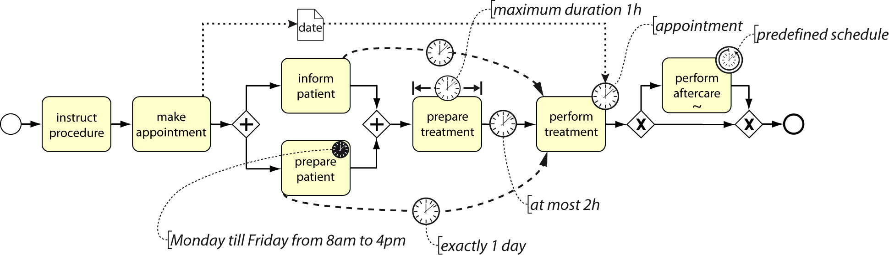
Modeling Time-Aware Processes
Question 1: What is required to model time-aware processes?
No common understanding of time constraints in processes
  Each approach defines its own set of time constraints
  Not validated!
  No common semantics!
Notes:
At the beginning of my thesis stood the question, what it actually is, that makes a process time-aware, and what is required to properly describe a time-aware process in a process-aware information system.
What I found, when looking at the current literature, is,* that there actually was no common understanding of temporal aspects in processes.
In particular there, existed no in-depth analysis of the actual requirements of processes regarding their required support of the temporal perspective.
The first step of my thesis, therefore, was to analyze the requirements of business processes.

Slide 10
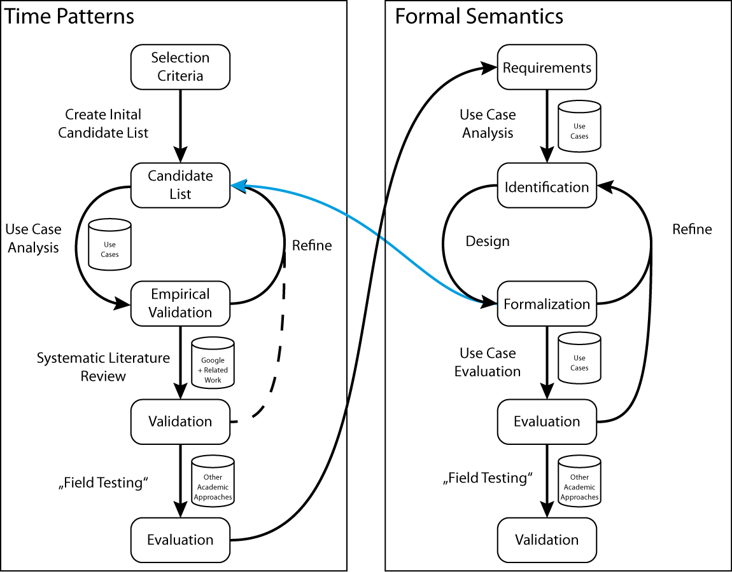
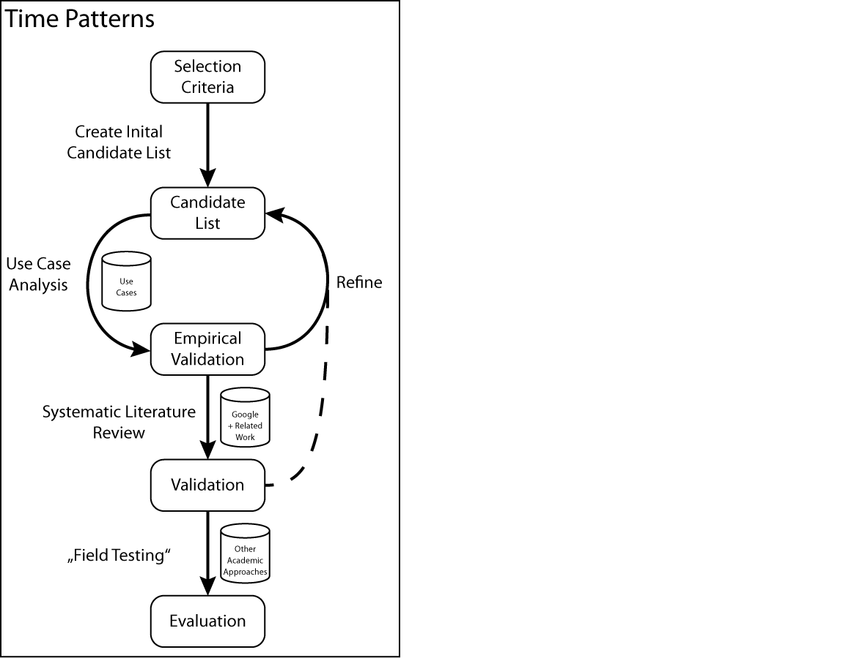
Research Method
Requirements:
Generic and precise
All patterns variants must be considered
Interactions with control flow
Impact of process instance data
Independent of any process modeling language
Criteria
High coverage of real-world scenarios
Covering temporal aspects relevant for process modeling and control
Identification
~ 400 processes analyzed
Derive pattern semantics of each pattern variant.
Identification
Large set of process models and process descriptions from different domains
~ 270 processes analyzed
Systematic Literature Review
~ 10.000 hits
73 primary papers
A. Hevner and S. Chatterjee. Design Research in Information Systems, Springer. 2010.
B. Kitchenham and S. Charters. Guidelines for performing systematic literature reviews in software engineering, TR, 2007.
Notes:
To put this on a solid foundation, I followed a classical design science approach to identify and validate these requirements.
Motivated by other works in the field of process management, the aims of this step, was to develop a set of so called time patterns describing common aspects of time-aware processes in a universal and re-usable way. Another goal was to achieve a high coverage of real world scenarios in order to be able to properly support real processes.
Unfortunately, the initial analysis as well as the final systematic literature review and the evaluation of existing approaches revealed several ambiguities with respect to the temporal concepts behind the time patterns.
These ambiguities could not be fully resolved by the informal description of the time patterns provided by me.
*My next step, therefore, was the definition of a precise and formal semantics for each time pattern.
For this, I again followed a design science approach.

Slide 11
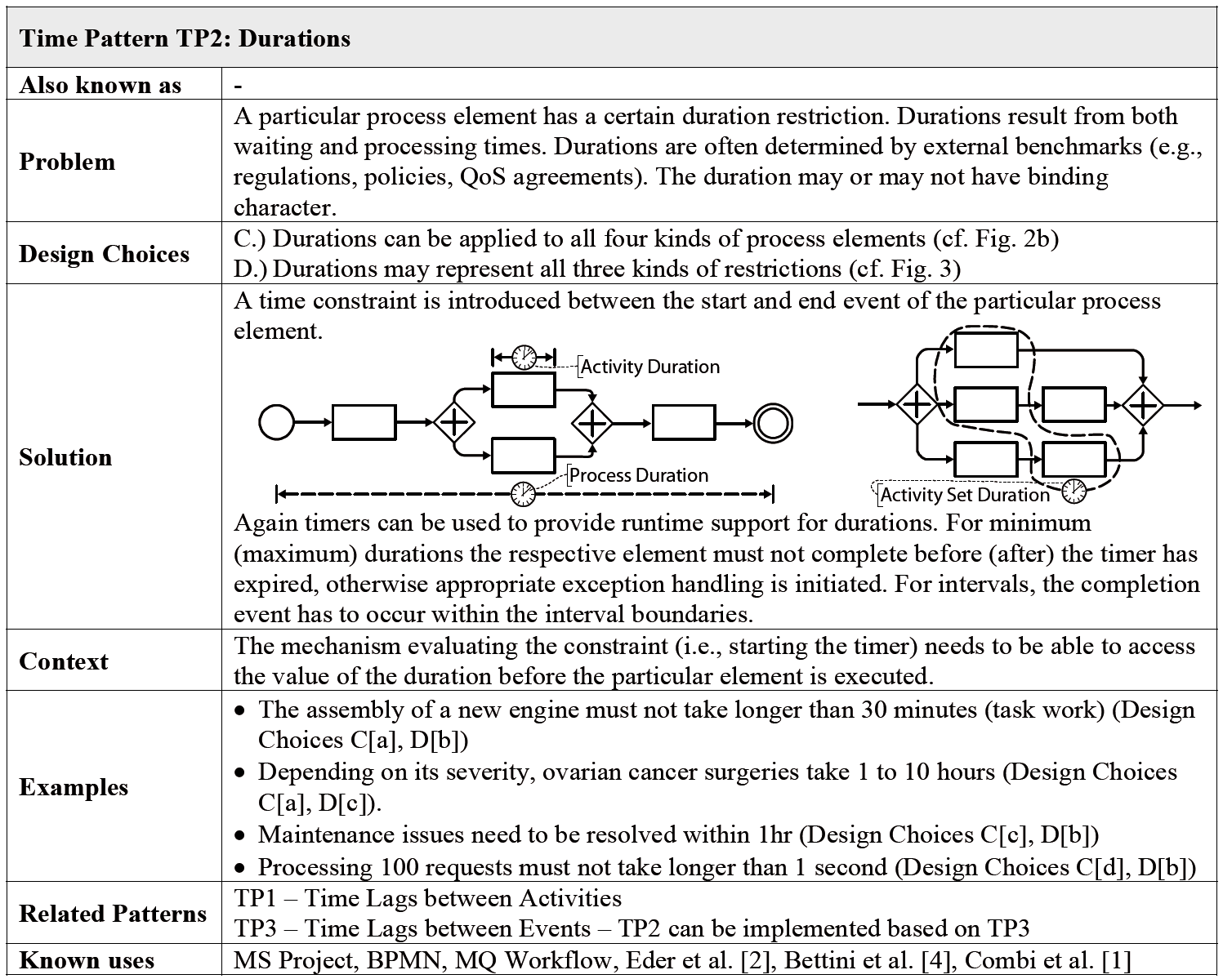
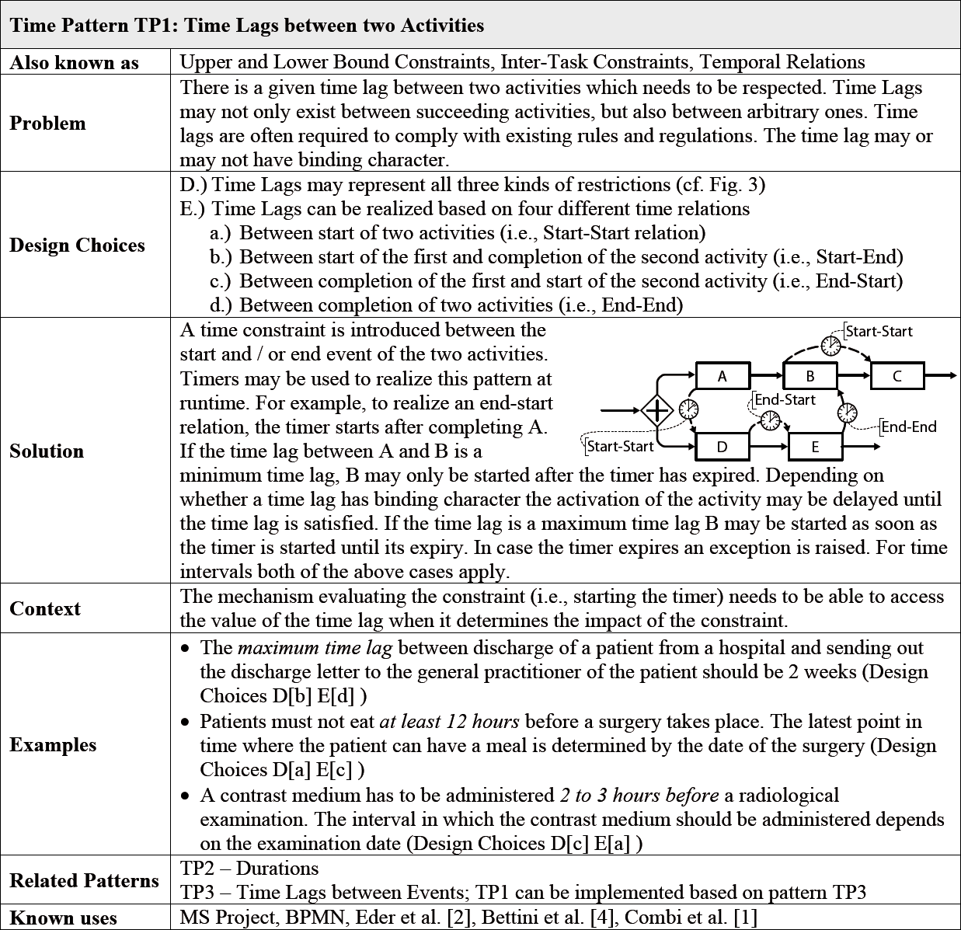
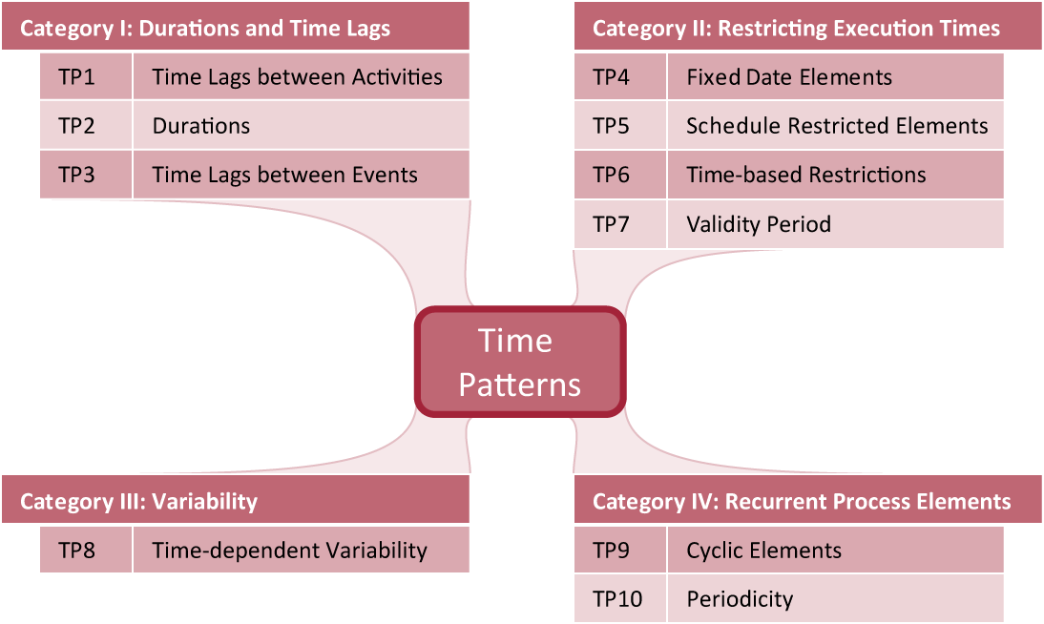
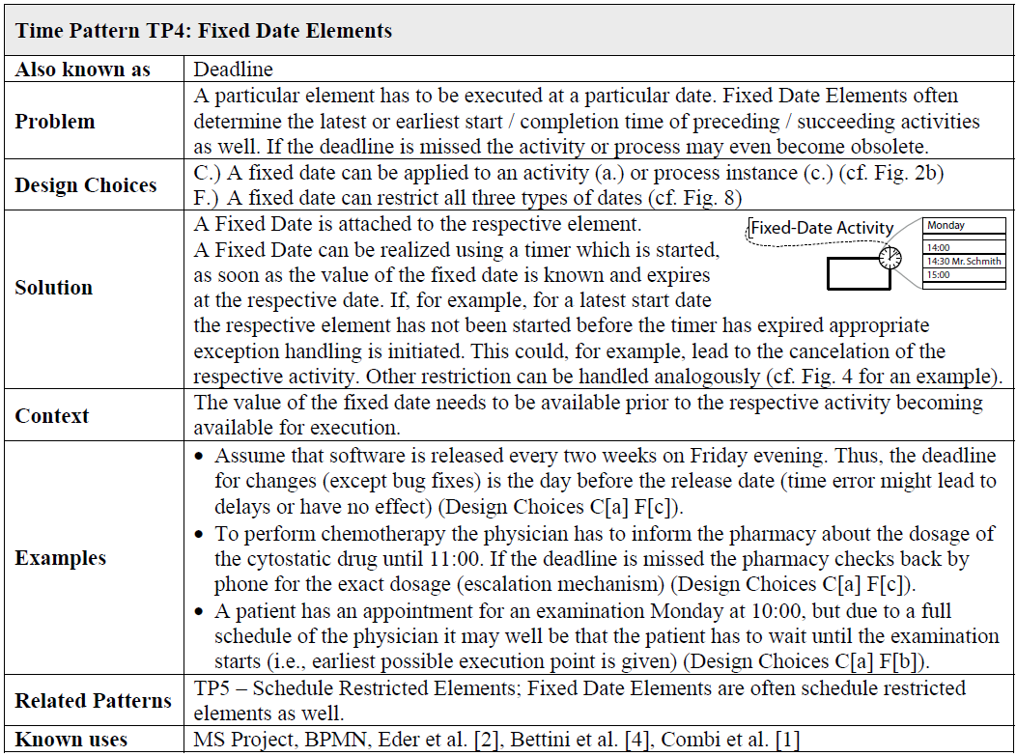
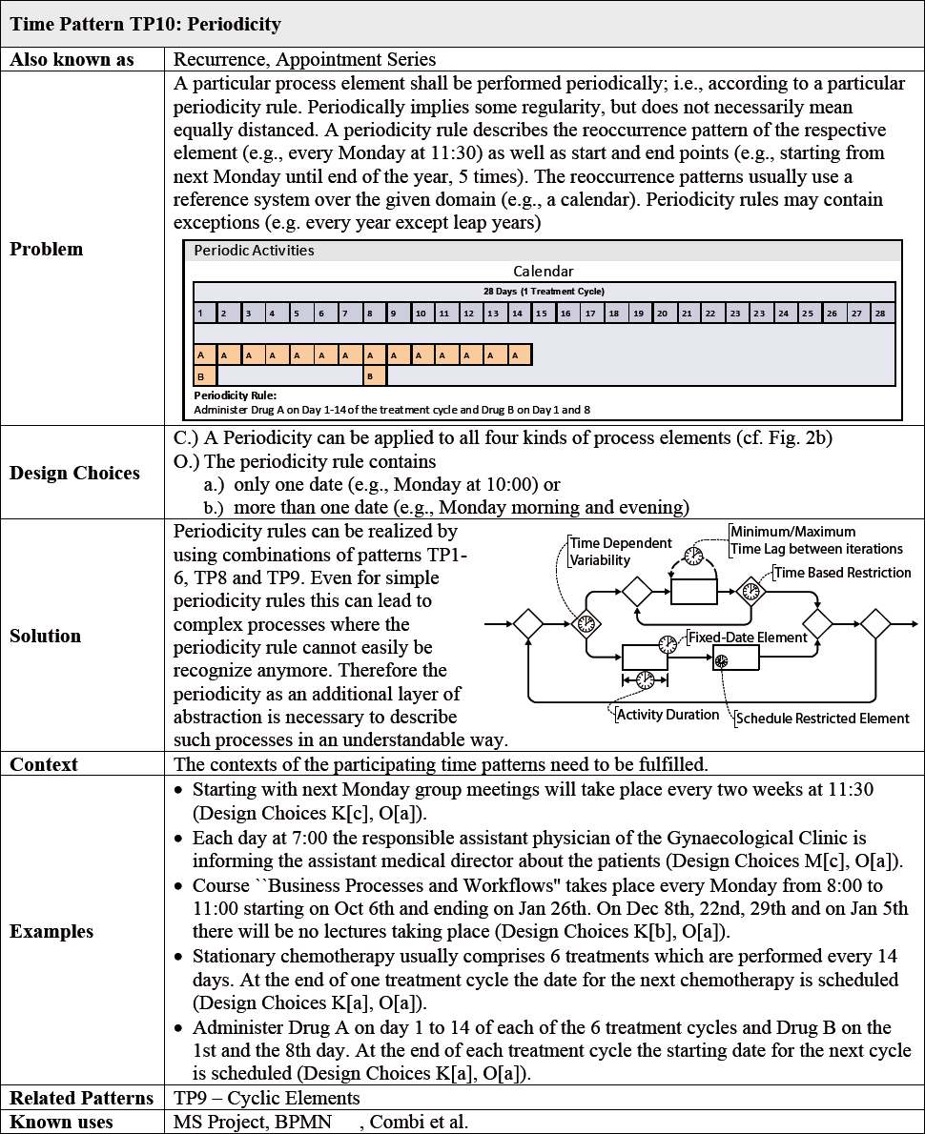
Process Time Patterns
Andreas Lanz, Barbara Weber, and Manfred Reichert. Workflow time patterns for process-aware information systems. In 11th International Workshop, BPMDS 2010, pages 94-107, 2010.
Andreas Lanz, Barbara Weber, and Manfred Reichert. Time patterns for process-aware information systems. Requirements Engineering, 2013.
Notes:
The end result of this whole process is a list of 10 time patterns which are shown here. The time patterns are separated into 4 categories based on their general meaning.
As part of the overall research process, each pattern was *analyzed and described by me in great detail. Including a general problem description, a list of process elements the pattern can be applied to, and examples from my analysis.
Its important to note that each pattern comprises a set of design choices basically helping to aggregate multiple variants of the same temporal aspect into one pattern. Overall I have identified more than 100 different pattern variants.
As mentioned before, *for each time pattern I formally defined the semantics of the respective pattern including all its pattern variants. This formal semantics is defined based on so called temporal execution traces and describes the conditions to be met by a trace in order to satisfy one particular instance of a time pattern.
*The time patterns and their formal semantics now provide the necessary requirements and their formal specification for creating a process modeling language that is expressive enough to capture time-aware processes. However, the topic of actually defining, verifying and usability testing such a language has been out of scope of my thesis.
After having identified and formally described the time patterns…

Slide 12
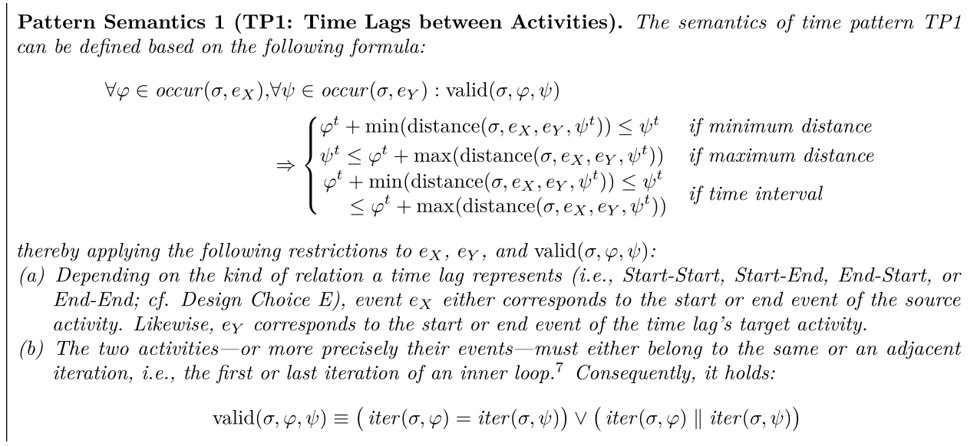
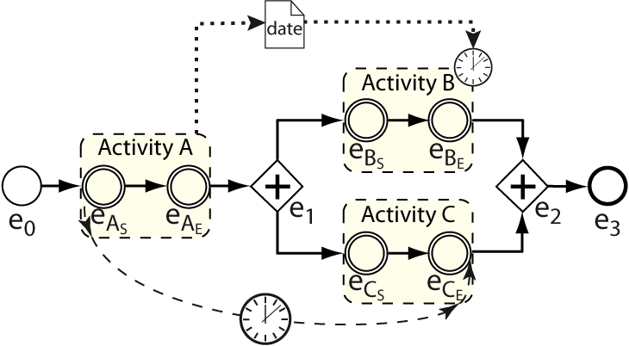
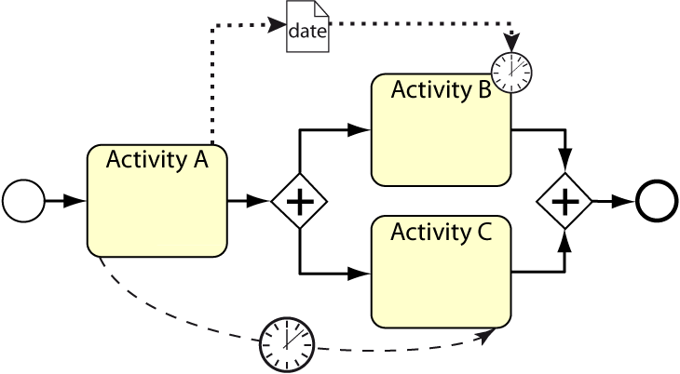
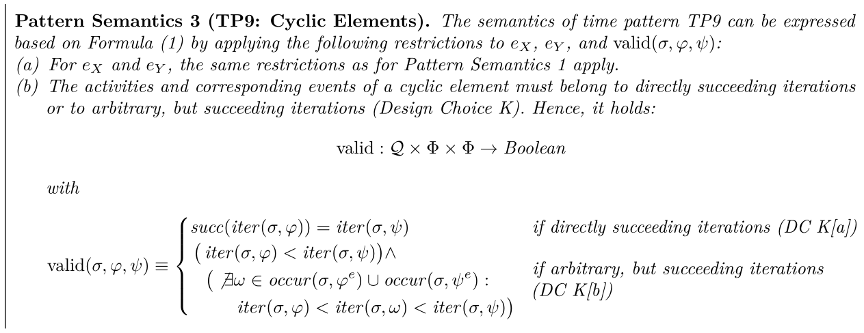
Process Time Patterns – Formal Foundations
Temporal execution traces
  Event-based process representation
Temporal Execution Trace
Andreas Lanz, Barbara Weber, and Manfred Reichert. A Formal Semantics of Time Patterns for Process-aware Information Systems. Technical Report UIB-2013-02, Ulm University, 2013.
Andreas Lanz, Barbara Weber, and Manfred Reichert. Process Time Patterns: A Formal Foundation. Information Systems, 2016

Slide 13
Process Time Patterns – Practical Relevance

Slide 14
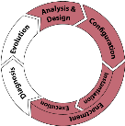
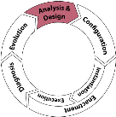
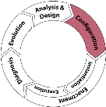
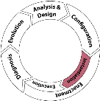
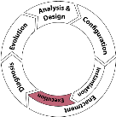
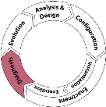
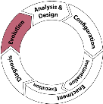
Process Time Support Features
Time Patterns
Time Support Features
Language Requirements
LR1: Temporal Specification
LR2: Time Constraint Types
LR3: Time Constraint Configuration Context
LR4: Time Constraint Configuration Time
LR5: Execution Semantics
LR6: Specification of Escalation Mechanism
LR7: Specification of Temporal Exception Handling
LR8: Scheduling Advice
1) Analysis & Design
F1.1: Modeling Support
F1.2: Verification
F1.3: Validation
F1.4: Implication Analysis
F1.5: Simulation
2) Configuration
F2.1: Parameterization
3) Instantiation
F3.1: Configuration
F3.2: Executability Checking / Validation
F3.3: Blocking
F3.4: Deferred Start
4) Enactment
F4.1: Monitoring
F4.2: Run Time Validation
F4.3: Run Time (Re-) Configuration
F4.4: Delayed Execution
F4.5: Prediction / Look Ahead
F4.6: Notification
F4.7: Escalation
F4.8: Temporal Exception Handling
F4.9: Run Time Adaptation
F4.10: Manual Scheduling
F4.11: Automatic Scheduling Support
F4.12: Logging Configuration Settings
5) Diagnosis
F5.1: Mining
F5.2: Data History
F5.3: Congestion / Bottleneck Detection
F5.4: Optimizing process schemas
F5.5: Risk Analysis
6) Evolution
F6.1: Schema Evolution
F6.2: Refactoring

Slide 15

Executability of Time-Aware Processes
Is it possible to execute a time-aware process model without violating any of its time constraints?
Is it possible to execute a time-aware process model for all possible durations of its activities and any possible execution path without violating any of its time constraints or requiring any a priori knowledge about the execution ?
Question 2: How can the executability of a time-aware process model
be verified?
Notes:
Insgesamt ist für zeitbehaftete Prozess somit die Frage die gestellt werden muss viel mehr:
Ist es möglich ein zeitbehaftetes Prozessmodell für alle möglichen Dauern seiner Aktivitäten und alle möglichen Ausführungspfade auszuführen, ohne eine Zeitbedingung zu verletzten und ohne das a priori wissen über die Ausführung benötigt wird.
Die zweite Forschungsfrage die ich mir daher im Rahmen meiner Promotion gestellt haben war, wie die korrekte Ausführbarkeit eines zeitbehafteten Prozessmodells unter den genannten Anforderungen sichergestellt werden kann.

Slide 16

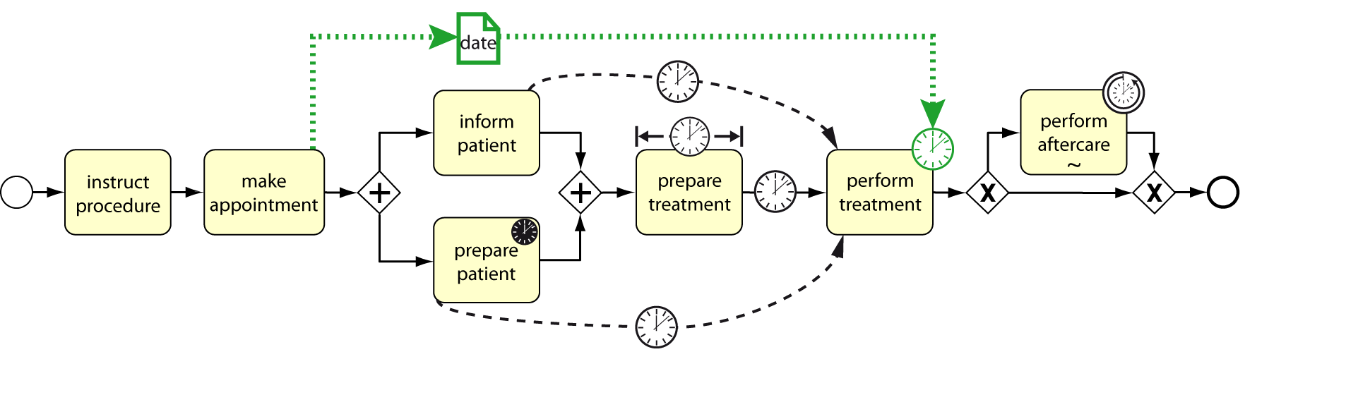
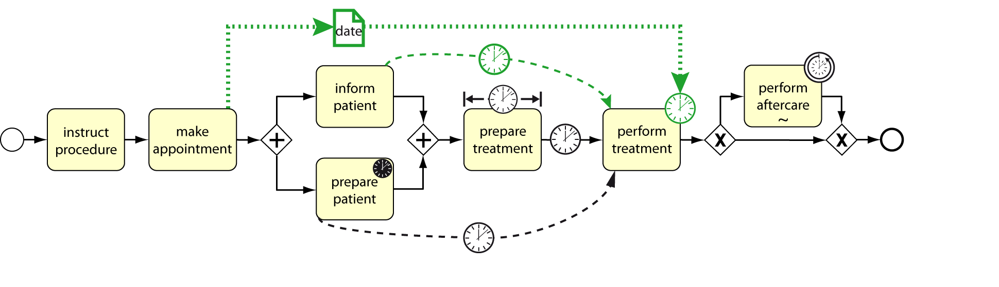
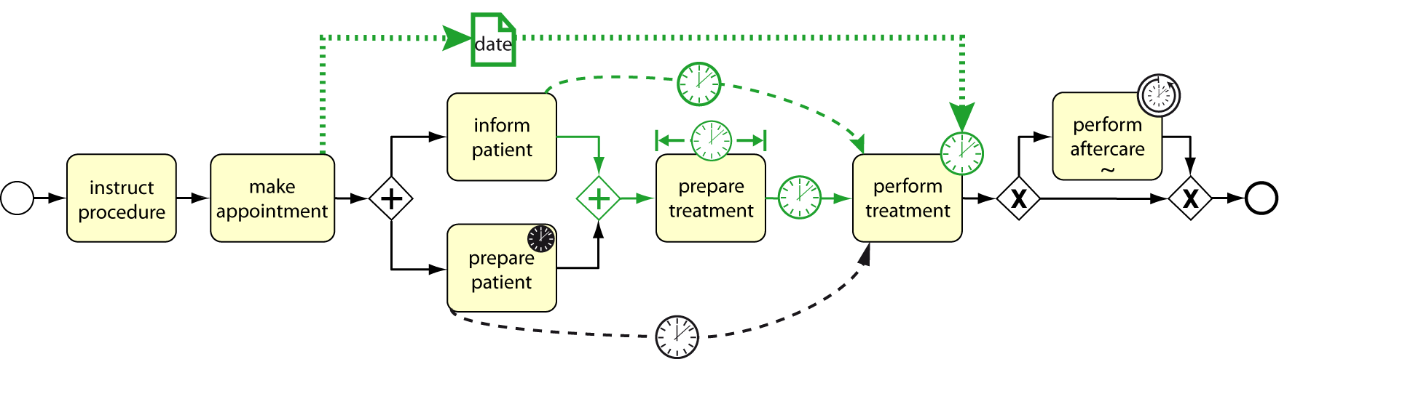
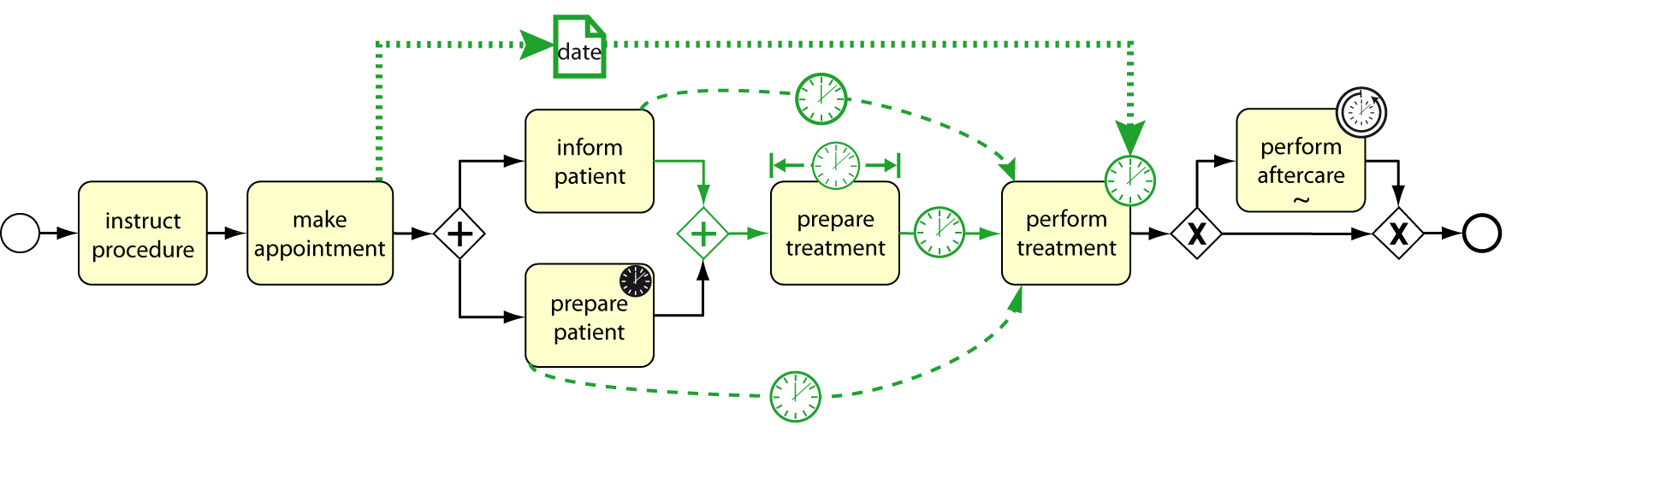

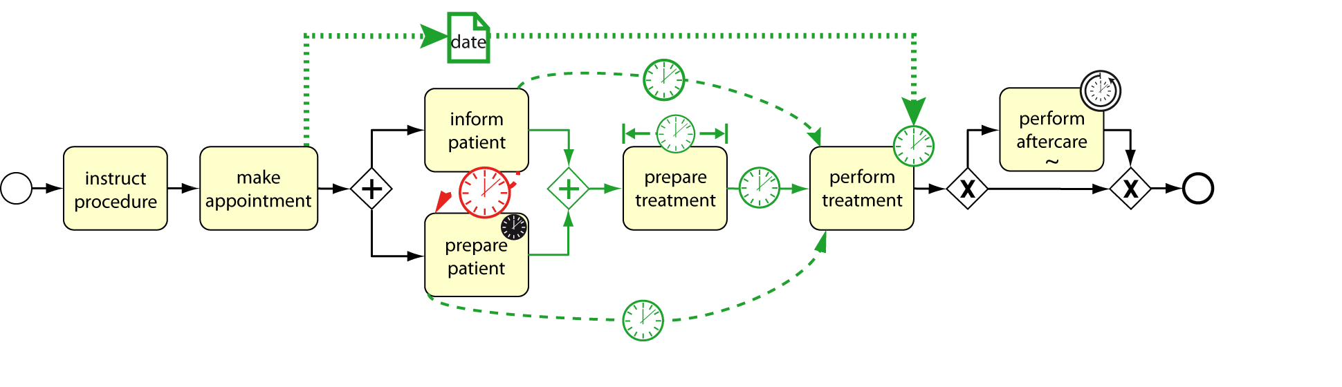
Executability of Time-Aware Processes
Question 2: How can the executability of a time-aware process model
be verified?
Challenges:
  Complex interdependencies between time constraints
Notes:
After having identified and formally described the time patterns I focused on the question of how to verify the executability, that is the soundness, of a time-aware process model.
But, first I had to answer the questions, what executability of a process actually means?
In this context, I identified several important challenges, which had not been considered to their full extended in the past.*
First of all, there is the issue of complex interdependencies between different elements of the process, which I already talked about before.
For example, in our clinical process there is an interdependency between our appointment* for the treatment and the task* of informing the patient. However, looking closer one can perceive that this interdependency actually also involves* the preparation of the treatment. Moreover, there, is the aforementioned interdependency between the preparation of the patient* and the treatment.
It is important to note that such interdependencies are not always obvious or even explicitly visible in the process. For example, in the given process the combination of the shown interdependencies leads to a hidden interdependency between the task of informing the patient and preparing the patient. That is, although from the perspective of the process model the two tasks seam unrelated may be executed in any order, from the time perspective they are not.
Such complex and sometimes hidden interdependencies make the manual checking of the executability of a time-aware process model almost impossible.

Slide 17
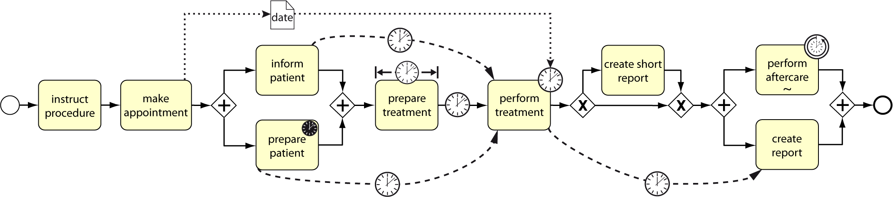
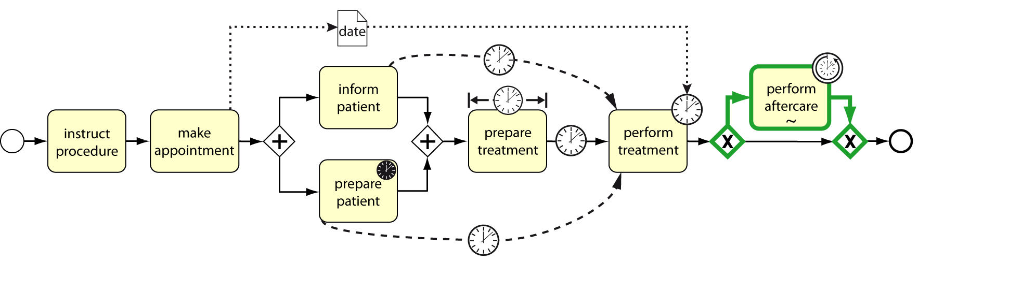
Executability of Time-Aware Processes
Question 2: How can the executability of a time-aware process model
be verified?
Challenges:
  Complex interdependencies between time constraints
  Alternative execution paths lead to different temporal properties
Notes:
In addition to that, alternative execution paths in the process may lead to instances of the same process with significantly different temporal behavior
Therefore, each possible path of the process needs to be verified separately.
But unfortunately, this is also not sufficient. In particular, although each path may be executable, the combination does not necessarily have to be executable without having a-priori knowledge about future decisions.
But, as nobody has invented a time machine yet, in reality such knowledge is not available. Therefore, such a process is not executable in practice.

Slide 18
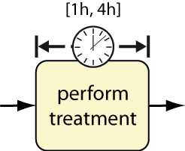

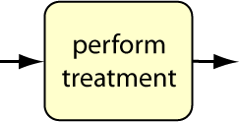
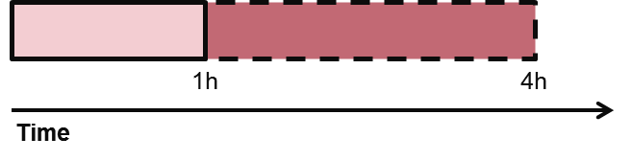
Executability of Time-Aware Processes
Question 2: How can the executability of a time-aware process model
be verified?
Challenges:
  Complex interdependencies between time constraints
  Alternative execution paths lead to different temporal properties
  Activity durations are bound but uncontrollable
Actual
Duration
Actual
Duration
Actual
Duration
Activity
perform treatment
takes between 1 and 4 hours
Cannot be influenced
by the system!
1h
4h
Time
Notes:
Another important thing to be considered is, that the duration of activities is uncontrollable by the PAIS. That is, *although we can define a minimum and maximum duration for each activity, their actual duration only becomes known during runtime* after the activity has been completed by the user. Therefore, the duration cannot be controlled, but only be observed by the system.
The system, therefore, need to ensure that the process can be completed for any possible duration of its activities.
Yet, on the other hand, durations are usually specified …

Slide 19

Executability of Time-Aware Processes
Question 2: How can the executability of a time-aware process model
be verified?
Challenges:
  Complex interdependencies between time constraints
  Alternative execution paths lead to different temporal properties
  Activity durations are contingent
  Durations are often specified with a reasonable margin for delays
Normal case
“Worst case”
Actual
Duration
Actual
Duration
Actual
Duration
May be “influenced”
by the system!
"Flexible"
Cannot be influenced
by the system!
1h
4h
Time
Notes:
Yet, on the other hand, durations are usually specified with a reasonable margin for delays.
In turn, this margin could be used by the system during process execution to restrict activity durations to some extend* in order to ensure the successful completion of the process.
Hence, it should be possible to specify activity durations in a more flexible way and then use this flexibility for checking the executability of the process model as well as during process execution.

Slide 20
Executability of Time-Aware Processes
Question 2: How can the executability of a time-aware process model
be verified?
Challenges:
  Complex interdependencies between time constraints
  Alternative execution paths lead to different temporal properties
  Activity durations are contingent
  Durations are often specified with a reasonable margin for delays
→ Conditional Simple Temporal Network with Uncertainty (CSTNU)*
* [Hunsberger et al., 12]
Notes:
Having identified this requirements, my next step was to search for a way to actually answer the question of how to verify executability.
To avoid re-inventing the wheel I started by carefully analyzing the related work in different research areas.
In the end, I found so called* Conditional Simple Temporal Networks with Uncertainty, or CSTNU, to be the perfect formalism for verifying executability of time-aware processes.
CSTNUs are an extension of Temporal Networks, capable of considering uncertain durations and alternative executing paths.

Slide 21

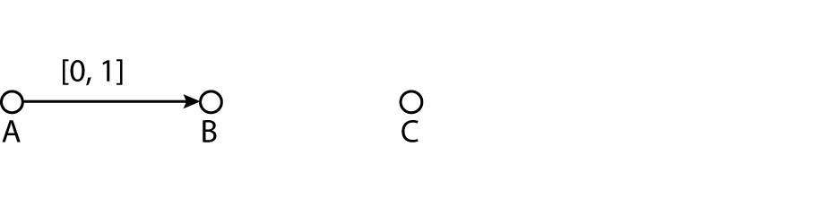
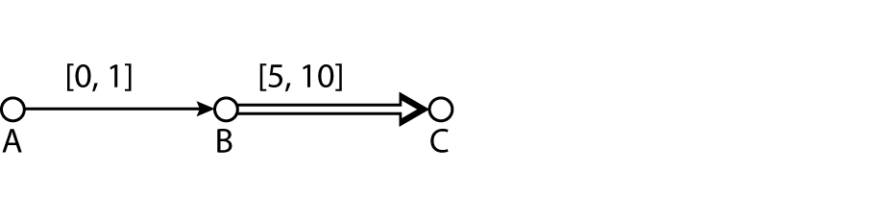
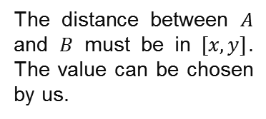
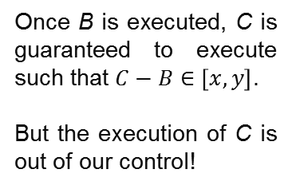
Conditional Simple Temporal Network with Uncertainty
(CSTNU)*
timepoint variables
requirement constraint
contingent constraint
The distance between $A$ and $B$ must be in $[x, y]$. The value can be chosen by us.
Once B is executed, C is guaranteed to execute such that $C−B∈\left[x,y\right]$.
But the execution of C is out of our control!
* [Hunsberger et al., 12]
Notes:
Als Lösungsansatz zur Beantwortung dieser Frage habe ich nach Abwägung der Alternativen die sogenannten Conditional Simple Temporal Networks with Uncertainty ausgewählt.
Dabei handelt es sich um eine spezielle Form der Temporal Constraint Networks einer auf Zeit spezialisierten Untergruppe der Constraint Satisfaction Probleme.
Ein solches CSTNU besteht dabei aus
Einer Menge von Zeitpunkt Variablen, sogenannten timepoints, die den Zeitpunkt eines Ereignisses bestimmen.
Der Abstand zwischen zwei Timepoints kann über sogenannte Requirement Constraints eingeschränkt werden.
Ein requirement constraint zwischen zwei timepoints A und B bedeutet, dass der Abstand zwischen den beiden Ereignissen im angegeben Intervall liegen muss. Die konkreten Werte können innerhalb dieser Grenzen aber vom System frei gewählt werden.
Es handelt sich hierbei um die klassische Art der Constraints in Temporal Constraint Networks.
Bei CSTNU gibt es zusätzlich noch eine speziell Art von Constraints, die sogenannten contingent constraints. Diese beschreiben wie der Name bereits sagt ungewisse Ereignisse.
Ein contingent constraint zwischen B und C bedeutet somit, dass sobald B ausgeführt wurde es sicher ist, das C innerhalb des angegeben Zeitintervalls ausgeführt wird. Der Zeitpunkt von C kann aber vom System nicht beeinflusst sondern nur beobachtet werden.

Slide 22
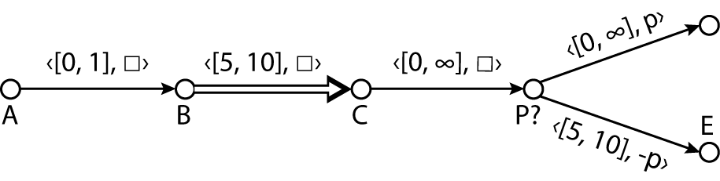
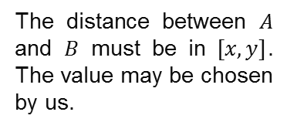
Conditional Simple Temporal Network with Uncertainty
(CSTNU)*
A constraint is only relevant if it’s proposition evaluates to true.
timepoint variables
proposition
A CSTNU is called dynamically controllable if it is possible to execute it for any allowed durations of its contingent constraints and any possible execution scenario without violating any of the time constraints or requiring any a priori knowledge about the execution.
requirement constraint
contingent constraint
The distance between $A$ and $B$ must be in $[x, y]$. The value may be chosen by us.
Once B is executed, C is guaranteed to execute such that $C−B∈\left[x,y\right]$.
But the execution of C is out of our control!
observation timepoint
After the execution of P? the value of propositional letter p becomes known.
* [Hunsberger et al., 12]
Notes:
Weiter gibt es bei CSTNU noch ausgezeichnet Zeitpunkt Variablen, sogenannte observation timepoints, die angeben zu welchem Zeitpunkt der Wert eines aussagenlogischen Atoms bekannt wird.
Diese aussagenlogischen Atome werden dann in Form von Propositionen an den Constraints annotiert und beschreiben die möglichen Ausführungspfade des Netzes. D.h. es gilt, dass ein Constraint nur dann beachtet werden muss, wenn die zugehörige Proposition gültig ist. Ein Rechteck symbolisiert dabei die leere Proposition die immer gültig ist.

Slide 23
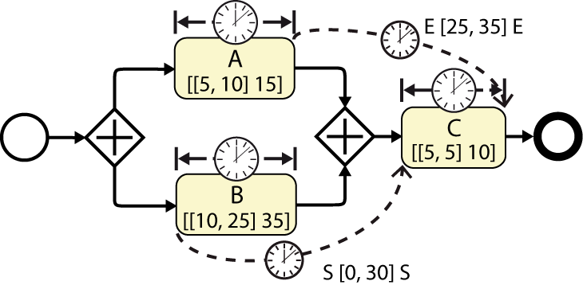
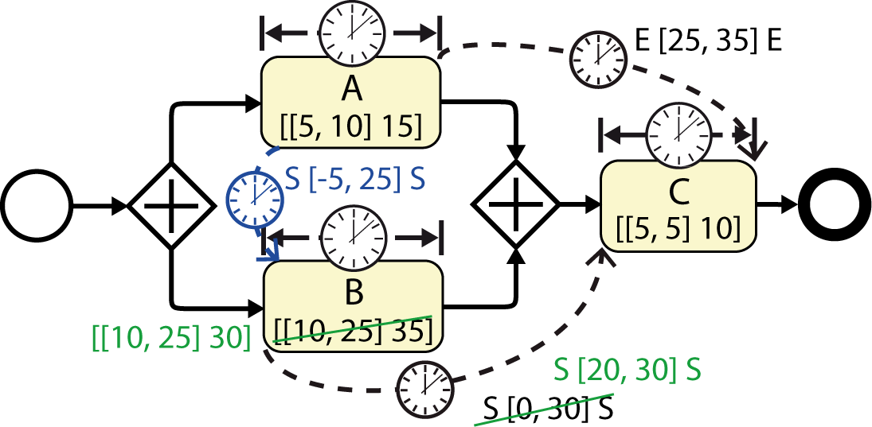
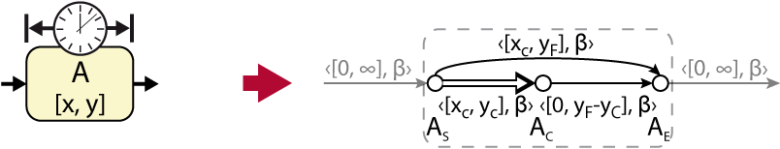

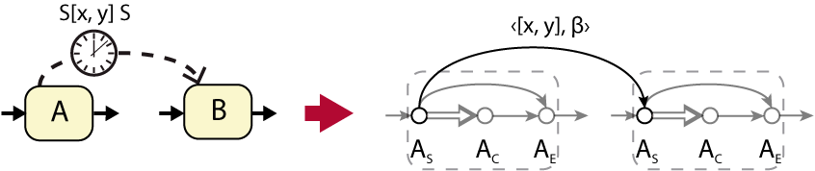






Process Time Model
Process Model
Mapping: Process Model → CSTNU [Hunsberger et al.]
Activity
A time-aware process model is executable iff the corresponding CSTNU time model is dynamically controllable.
Time Lags
Fixed Date
Restricted constraints
Derived interdependencies
Process Time Model
XOR Split
XOR Join
Andreas Lanz, Roberto Posenato, Carlo Combi, and Manfred Reichert. Controllability of time-aware processes at run time. In 21st International Conference on Cooperative Information Systems, CoopIS'13, pages 39--56. Springer, 2013.
Notes:
Using CSTNUs as basic formalism I developed a set of transformation rules in order to map the temporal behavior* of a time-aware process model to a corresponding CSTNU.
Based on this transformation I was, furthermore, able to show *that for each time-aware process model a corresponding CSTNU exists, that represents all temporal features of the process model.
In turn, based on the notion of dynamic controllability of CSTNU we can now say *that a process model is executable if the corresponding CSTNU is dynamically controllable.
Using algorithms developed for checking the dynamic controllability of CSTNUs , *this now enables us to verify the executability of time-aware process models.
Another benefit of using CSTNUs compared to other approaches is the fact that the algorithm for checking dynamic controllability, and in particular the constraint propagation rules used by it, enable us to derive *restricted constraints as well as *implicit dependencies between the timepoints of the CSTNU.
Using the developed mapping these can than be mapped *back to implicit or hidden interdependencies between the elements of the process model.

Slide 24







Enactment of Time-aware Processes
Question 3: How to monitor and re-check executability during run time?
Executing and monitoring time-aware process instances
Monitoring
Predicting execution times
Predicting and detecting critical situations
Ensuring efficiency
Notes:
Since it is now possible to verify the executability of a time-aware process model, we can start executing it.
In this context it’s necessary to continuously monitor the process instance and re-verify its executability during run-time.
For this purpose I developed algorithms which allow to ensure that all time constraints are satisfied during execution. Moreover, the time model used by these algorithms can be used to extract *predictions for the execution time of future activities. This allows us, for example, to *detect critical situation ahead of time and maybe avoid them.
However, problems can never be completely avoided. …

Slide 25



Dynamic Changes
Question 4: How can time-aware process instances be dynamically
adapted?
The patient has hypertension, we need to do an additional examination.
Dynamic changes of time-aware process instances
Structural and temporal changes
Ensuring correctness and executability
Ensuring efficiency
Andreas Lanz and Manfred Reichert. Dealing with changes of time-aware processes. In Proc BPM'14, pages 217-233. Springer, 2014..
Notes:
Damit ist es möglich zeitbehaftet Prozessinstanzen auszuführend und während der Ausführung zu überwachen, um kritische Situationen zu vermeiden.
Aktuell entwickle ich hier außerdem verschiedene Heuristiken um den Aufwand für die Aktualisierung des Zeitmodells während der Ausführung weiter zu reduzieren.
Probleme bei der Prozessausführung können dennoch nie ganz ausgeschlossen werden. Ferner muss es, wie Eingangs erwähnt, möglich sein Prozessinstanzen dynamisch zur Laufzeit an geänderte Kontextbedingungen anzupassen.
Insbesondere müssen Prozesse in der Lage sein flexibel auf unvorhergesehene Ereignisse zu reagieren.
Wird beispielsweise bei der Vorbereitung des Patienten festgestellt, dass dieser entgegen den Ergebnissen der Voruntersuchungen unter Bluthochdruck leidet, so muss vor der Behandlung dynamisch eine weitere Untersuchung durchgeführt werden, um abschließend entscheiden zu können ob der Patient behandlungsfähig ist.
Meine vierte Forschungsfrage war daher wie zeitbehaftet Prozessinstanzen dynamisch zur Laufzeit adaptiert werden können.

Slide 26





Dynamic Changes
$$δ=d_{min}−c_{min}$$
Notes:
Hierzu habe ich die dynamische Beherrschbarkeit und den zugehörigen Algorithmus genauer analysiert und konnte folgendes zeigen:
Wenn sich durch eine Änderung der Wert eines Constraint im Minimalen Zeitmodell um einen Wert delta verändert werden die Grenzen jedes anderen Constraints im Zeitmodell hierdurch maximal ebenfalls um Delta verändert.
Damit ist es möglich die Constraints des aktualisierten minimalen Zeitmodell so zu approximieren, das sichergestellt ist, das eine Änderung die auf dem approximierten Zeitmodell angewendet werden kann auch auf dem tatsächlichen Zeitmodell angewendet werden kann.

Slide 27




Proof of Concept Implementation
Modeling Time-Aware Processes
Verifying Executability
Analyzing the Time Model
Executing Time-Aware Processes
Andreas Lanz and Manfred Reichert. Enabling time-aware process support with the ATAPIS toolset. In Proc. BPM'14 Demo Track, 2014.
Notes:
My prototype is based on the AristaFlow BPM Suite, a fully-fledge process management system originally developed at our institute.
First my prototype allows us to model time-aware processes using a comprehensive number of time patterns.*
Resulting process models can be checked for their executability* and the resulting time model can be analyzed in detail.
*Finally, it’s possible to simulate the execution of processes in a test environment to test the behavior of the execution strategy.

Slide 28




Summary
Dynamic Changes
Approximation of Effects
Time Patterns &
Formal Semantics
Executability
Run Time Model
Execution Strategy
Notes:
At the beginning of my thesis stood the question, what kinds of temporal aspects are actually relevant in the context of business processes. *To answer this question, I developed a set of time patterns and later provided a formal semantics for each of them.
Based on this first step, I developed methods and algorithms for verifying the executability of respective time-aware process models based on Conditional Simple Temporal Network with Uncertainty.
*In the context of the execution of time-aware processes, I developed a comprehensive execution model, which allows to execute and monitor a time-aware process instance in order to ensure error-free execution.
*For the dynamic adaptation of processes, I have developed corresponding time-aware change operations. Furthermore, I was able to show how an approximation based technique can be used to perform multiple change operations efficiently.
Altogether, the concepts, techniques, and algorithms introduced by me provide a significant contribution to the development of Time-Aware BPM Systems.
Thank you very much.

Slide 29


Thanks to Andreas Lanz!

