Slide 1

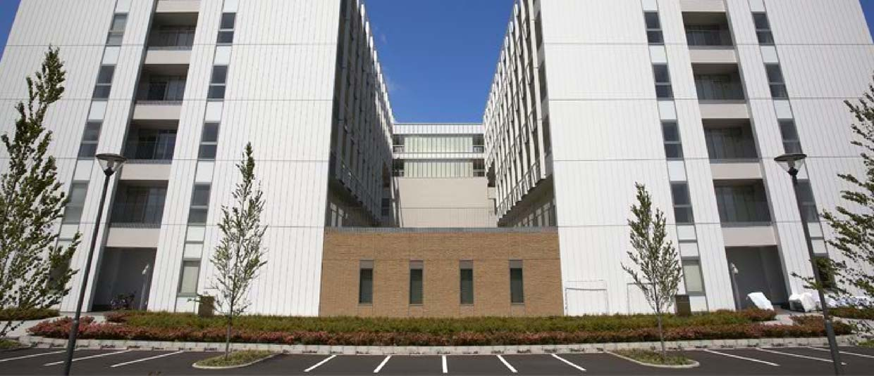
Overview of
the ISM

Slide 2
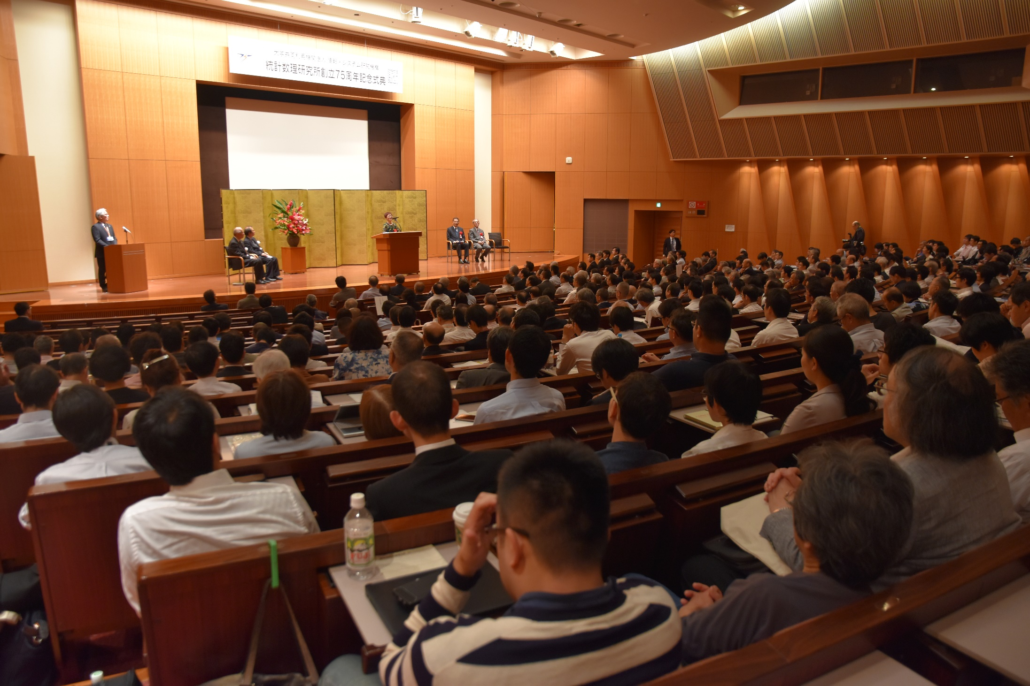
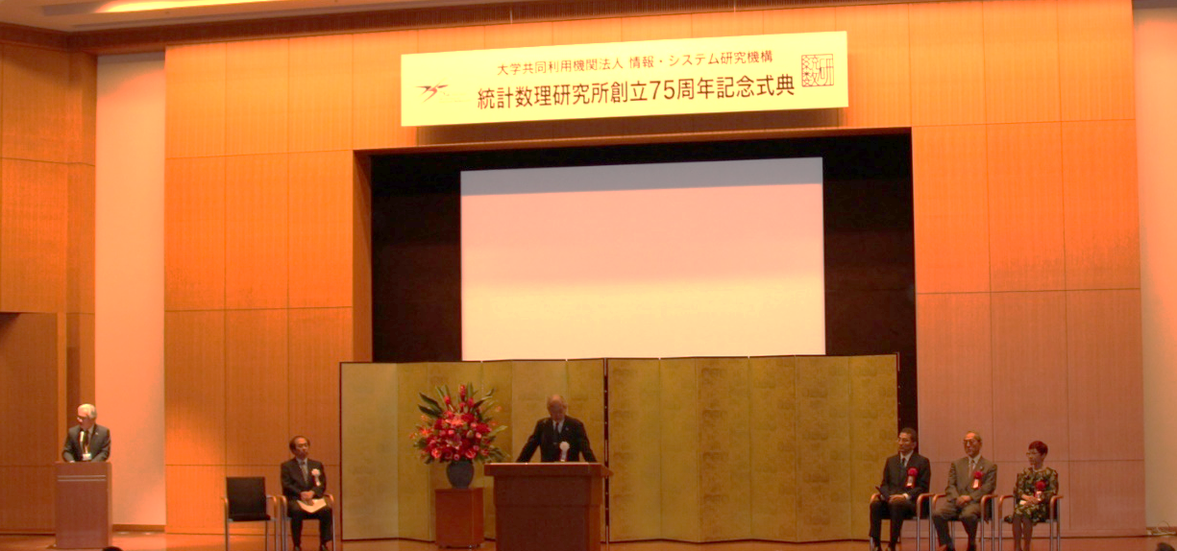
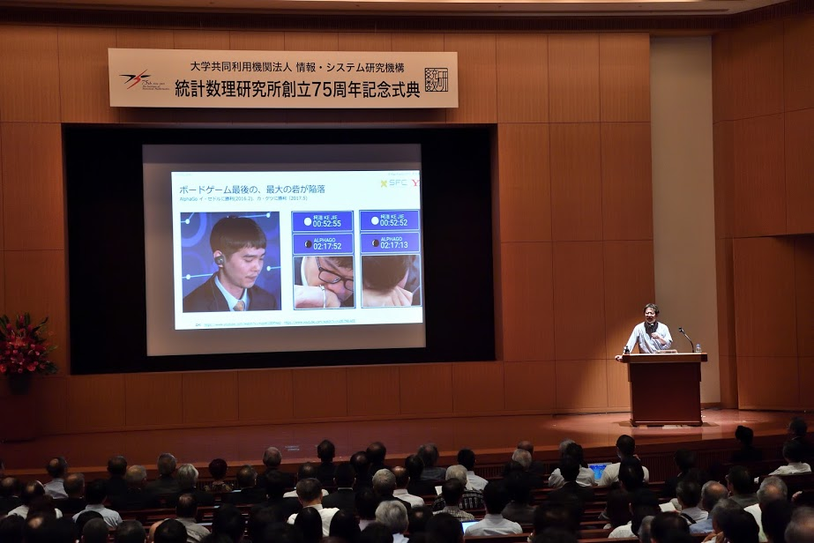
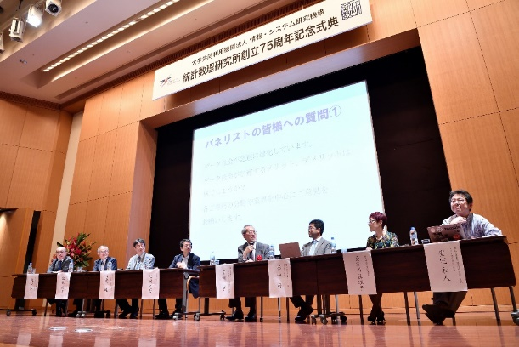
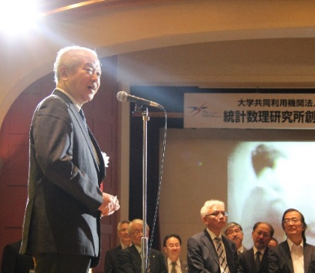
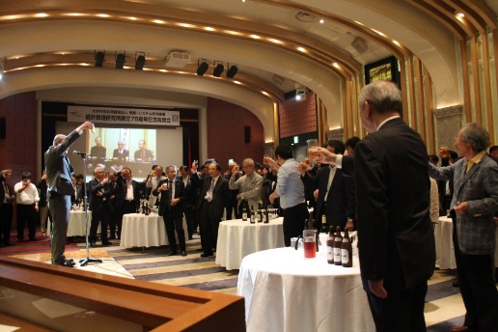
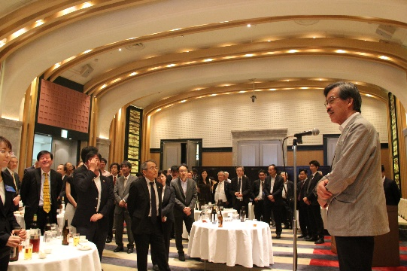
75th anniversary of ISM - 5 June 2019

Slide 3
Inter-University Research Institutes
Inter-University Research Institutes
Universities/College
National Institutes for Humanities
National
Universities
86
National Institutes of Natural Sciences
High-Energy Accelerator Research Organization
Research Organization of Information and Systems
Private
Universities
597
Junior College
453
National Institute of Polar Research
National Institute of Informatics
Institute of Statistical Mathematics
National Institute of Genetics
Refer form HP of MEXT of Japan.(http://www.mext.go.jp/a_menu/koutou/shiritsu/ )
May 1st, 2014

Slide 4
Objective, History and Activities
Objective
Research on statistical theory, methodologies
and their applications to real-world problems
Main Activities
○ Research Activities
・The only research institute of statistical science in Japan
・Cutting-edge research
○ Joint Research and Joint Usage
・Cooperative research programs with diverse
research fields
・Supercomputers with physical random number generators
・NOE (Network Of Excellence) Project
○ Graduate Education and Professional Development
・The only graduate program of statistical science in Japan
・Projects for Fostering and Promoting Statistical Thinking
History
1944：Foundation of ISM
1985：Inter-University Research Institute
1988：Graduate Univ. for Advanced Studies
2004：Independent Agency, Research Organization
2009：Moved to the current location (Tachikawa Campus)
2010：Joint Administrative Department
w/ National Institute of Polar Research
Foundation of Akaike Guest House
2014：Staffed URAs (University Research Administrators)
2018：Reorganized Administration Department to
Tachikawa Administration Department of ROIS
Foundation
Inter-Univ. Res.Inst.
Graduate Univ.
Independent Agency
Moved to Tachikawa
Tachikawa
Admin. Dept.
Joint Admin. Dept.／Found. Akaike Guest House
URAs
1944
1985
1988
2004
2009
2010
2014
2018

Slide 5

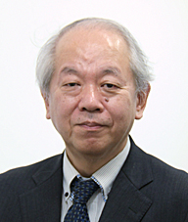
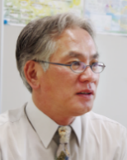
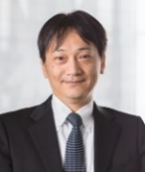
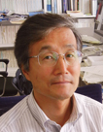
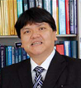
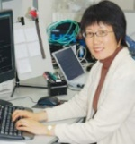
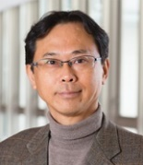
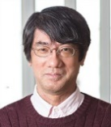
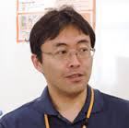
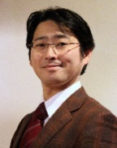
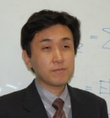
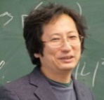
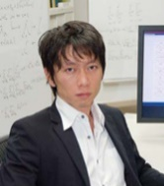
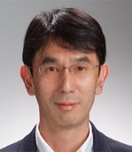
Introduction of Directors in 2019-2020
■Director-General
Prof. Hiroe Tsubaki
■Vice Director-General
Prof. Satoshi ITO（Research Planning, Personnel and Public Relations)
Prof. Satoshi YAMASHITA (Financial and Intellectual Property)
Prof. Yoshihiko MIYSASATO (Evaluation)
■Directors of the Departments
Prof. Tomoko Matsui (Statistical Modeling)
Prof. Koji KANEFUJI (Statistical Data Science)
Prof. Satoshi KURIKI (Statistical Inference and Mathematics)
H. Tsubaki
S. Ito
S. Yamashita
Y. Miyasato
■Directors
・School of Statistical Thinking
Prof. Yoshinori KAWASAKI
・Center for Eng. And Tec. Support
Prof. Genta Ueno
Y. Kawasaki
T. Matsui
K. Kanefuji
S. Kuriki
■ Directors of the NOE Centers
Prof. Satoshi YAMASHITA
(Risk Analysis Research Center)
Prof. Kenji FUKUMIZU
(Research Center for Statistical Machine Learning)
Prof. Ryo YOSHIDA
（DS Center for Creative Design and Manufacturing)
Prof. Yoichi ITO
(Research Center for Medical Health Data Science)
G. Ueno
◆Vice Director of School of Statistical Thinking
Prof. Yukito IBA
◆Vice Director of Center for Eng. And Tec. Support
Assoc. Prof. Kazuhiro Minami
Y. Ito
K. Fukumizu
Y. Iba
R. Yoshida
K. Minami

Slide 6
Number of Staff and Fund
職員数
As of Apr., 1 in each year
Annual expenditure
 | 2010 | 2011 | 2012 | 2013 | 2014 | 2015 | 2016 | 2017 | 2018 | 2019
Prof. | 16 | 18 | 17 | 16 | 18 | 18 | 21 | 17 | 19 | 18
Assoc. Prof. | 18 | 19 | 20 | 19 | 18 | 19 | 18 | 18 | 18 | 18
Assist. Prof | 14 | 11 | 12 | 10 | 9 | 8 | 6 | 9 | 10 | 8
Tech. Staff | 10 | 10 | 10 | 11 | 11 | 11 | 11 | 11 | 11 | 11
Admin. Staff | 13 | 13 | 13 | 12 | 13 | 13 | 14 | 16 | 15 | 16
Visiting Researcher in Japan | 48 | 54 | 69 | 76 | 71 | 87 | 85 | 98 | 88 | 95
Foreign Visiting Researcher | 10 | 6 | 10 | 15 | 11 | 10 | 11 | 7 | 9 | 6
Project Staff | 74 | 85 | 57 | 72 | 80 | 83 | 82 | 74 | 83 | 66
million yen
 | 2010 | 2011 | 2012 | 2016 | 2014 | 2015 | 2016 | 2017 | 2018
 | 769 | 765 | 691 | 604 | 663 | 702 | 729 | 705 | 666
 | 853 | 881 | 938 | 1005 | 958 | 861 | 864 | 926 | 953
 | 1622 | 1647 | 1629 | 1609 | 1621 | 1563 | 1594 | 1631 | 1619
Personnel
Others
＊
Amount
＊
＊Including 28 Project Professors/Researchers
14 Million Euro
1st mid-term
2nd mid-term
(present) 3rd mid-term
1st mid-term
2nd mid-term
(present) 3rd mid-term
Notes:
職員数について：170417メモ：常勤職員は本部DS基盤施設兼務職員数込 非常勤職員は兼務除く数として記載（人事TL森田さんに確認・相談の上決定）
H29決算額の方は要覧の原稿で確認したものを仮入れ
※過去（H27年度）7/10時点で新井さんに確認したところ機構本部からの財務諸表でも割り出せないため，要覧・年報掲載額も毎年見込みだそう
4/1付け人事は新年度前にわかっている限りで人事担当TLに依頼
決算については年報掲載と同情報を5月中旬以降で財務担当TLに依頼

Slide 7
Change of number and funds of Joint Research with private enterprises
Number
Thousand Yen
350 Thousand Euro
(3.6% of the budget)
33 Projects
in 2018
Notes:
2018/11/1 URA作成
2018/11/2 Rev
2018/12/25
2019/8/13rev

Slide 8
Organization of the ISM
April 1, 2018
Cooperative
Research
Committee
Department of Statistical Modeling
Prediction and Control Group
Complex System Modeling Group
Data Assimilation Group
Department of Statistical Data Science
Survey Science Group
Council
Metric Science Group
Department of Statistical Inference and Mathematics
Structure Exploration Group
Advisory
Board
Mathematical Statistics Group
Risk Analysis Research Center
Learning and Inference Group
Mathematical Optimization Group
Research Center for Statistical Machine Learning
Director-
General
Data Science Center for Creative Design and Manufacturing
Research Center for Medical and Health Data Science
Vice Director-
General
School of Statistical Thinking
Computing Facilities Unit
Networking Unit
Center for Engineering and Technical Support
Information Resources Unit
Media Development Unit
Planning Unit
General Administration Unit
URA Station
Administration
Planning and
Coordination
Section
Library
General Affairs Section
Specialist for Evaluation and Legal Affairs
Evaluation Unit
Personnel Unit
Information and
Public Relations Unit
Finance Section
Labor Unit
Tachikawa Administration
Department of ROIS
General Affairs and Auditing Unit
Industry-Academia Collabo
-ration and Intellectual
Property Unit
Accounting Section
1st and 2nd Finance Settlement of Accounts Unit
Asset Management and Acceptance Inspector Unit
NOE Promotion Unit
Research Promotion Section
1st and 2nd Contract Unit
Facility Unit
Gender Equality Unit
Research Promotion Unit
International Affairs Unit
Cooperative Research Unit
*This Unit is charge of the international affairs.
Graduate School Unit
Notes:
Made on 2018/2/8
Revised on 2018/3/6

Slide 9
Biaxial Structure for Research Activities in ISM
Center for Eng. and Tec. Support
（Research Support）
NOE-Type
Research Centers
Professional Development
Risk Analysis
Statistical Machine Learning
Data Science for Creative Design and
Manufacturing
Medical Health Data Science
School of Statistical Thinking
Dept. of Statistical Modeling
Prediction and Control Group
Complex System Modeling Group
Data Assimilation Group
Dept. of Statistical Data Science
Basic Research
Departments
Survey Science Group
Metric Science Group
Structure Exploration Group
Dept. of Statistical Analysis
and Mathematics
Mathematical Statistics Group
Learning and Inference Group
Mathematical Optimization Group
Notes:
2017/7/1現在
2017/12/17
2018/4/1
2019/4/1現在

Slide 10
Dept. of Statistical Modeling
The Department of Statistical Modeling works on structural modeling of physical phenomena related to numerous factors, and also conducts research on model-based statistical inference methodologies. By means of model-based prediction and control, modeling of complex systems, and data assimilation, the department aims to contribute to the development of modeling intelligence in many fields.
Prediction and Control Group
The Prediction and Control Group works on the development and evaluation of statistical models, which function effectively in terms of prediction and control of phenomena, decision making, and scientific discoveries. These efforts involve data analysis and modeling related to phenomena that vary across time and space.
Complex System Modeling Group
The Complex System Modeling Group conducts studies aimed at discovering the structures of complex systems, such as nonlinear systems and hierarchical networks, through statistical modeling. For these purposes, the group also considers Monte Carlo simulations, discrete mathematics, and software development.
Data Assimilation Group
The Data Assimilation group works on the development of data assimilation techniques, which are procedures aimed at combining information derived from large amounts of observations and a numerical simulation model. By developing computational algorithms and high-performance parallel computing systems, the group aims to build a next-generation simulation model that can predict the future in real time.
The probability that temperature could rise more than 2 degree in the latter half of this century
Inspiratiory neurons searched by Time
-space analysis
Tree Structures by the Gene expression of cell data
Notes:
2014/11/5(from outline)
2018/7/3rev

Slide 11
Dept. of Statistical Data Science
The Department of Statistical Data Science conducts research on data design methods aimed at managing uncertainty and incompleteness of information, quantitative methods for evidence-based practice, and related data analysis methods. Moreover, the department investigates methods for inferring the latent structures in target phenomena from observation data.
Survey Science Group
The Survey Science Group promotes research on the design of statistical surveys, development of statistical analysis methods on survey data, and applications. By exploring complex phenomena in various fields, the group also aims to contribute to practical applications in academia and policy-making through social surveys.
Metric Science Group
The Metric Science Group conducts research aimed at identifying and evaluating statistical evidence through quantification of phenomena that have not been measured thus far, as well as efficient information extraction from large databases. The group investigates related methods and develops methods for analyzing the collected data. By working on applied research in various fields of real science, the group aims to advance practical, applied, statistical mathematical research based on evidence.
Structure Exploration Group
The Structure Exploration Group conducts research on statistical science aimed at inferring the latent “structure” behind various target phenomena in biology, physics, and social science, based on observational data. The group focuses on machine learning, Bayesian reasoning, experimental design methods, and spatial-temporal analysis methods to investigate micro/meso/macroscopic and spatial-temporal dynamic structures in target phenomena.
The difference of awareness of disaster prevention in each area and inference method in Tachikawa City
Data clustering of real estates in Tokyo
Material search technic by integrated method of the Bayesian inference and the first-principles calculation
Notes:
2014/11/5(from outline)
2018/7/3rev

Slide 12
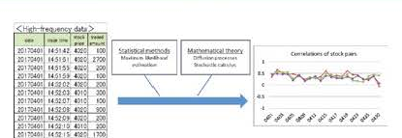
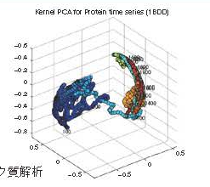
Dept. of Department of
Statistical Inference and Mathematics
The Department of Statistical Inference and Mathematics carries out research into general statistical theory, statistical learning theory, optimization, and algorithms in statistical inference.
Mathematical Statistics Group
The Mathematical Statistics Group is concerned with aspects of statistical inference theory, modeling of uncertain phenomena, stochastic processes and their application to inference, probability and distribution theory, and the related mathematics.
Learning and Inference Group
The Learning and Inference Group develops statistical methodologies to describe the stochastic structure of data mathematically and clarify the potential and the limitations of the data theoretically.
Mathematical Optimization Group
The Mathematical Optimization Group focuses on mathematical theory and practical applications of optimization and computational algorithms together with underlying numerical or functional analysis and discrete mathematics.
Regularization term which is applied to sparse optimization
Kernel PCA for Protein time series
Statistical analysis to high-frequently financial data
Notes:
2014/11/5(from outline)
2018/7/3rev

Slide 13
Biaxial Structure for Research Activities in ISM
Center for Eng. and Tec. Support
（Research Support）
NOE-Type
Research Centers
Professional Development
Risk Analysis
Statistical Machine Learning
Data Science for Creative Design and
Manufacturing
Medical Health Data Science
School of Statistical Thinking
Dept. of Statistical Modeling
Prediction and Control Group
Complex System Modeling Group
Data Assimilation Group
Dept. of Statistical Data Science
Basic Research
Departments
Survey Science Group
Metric Science Group
Structure Exploration Group
Dept. of Statistical Analysis
and Mathematics
Mathematical Statistics Group
Learning and Inference Group
Mathematical Optimization Group
Notes:
2017/7/1現在
2017/12/17
2018/4/1
2019/4/1現在

Slide 14
Transition diagram of the NOE Project
First Period of
the mid-term plan
（2006-2012）
Second Period of the mid-team plan
（2010-2015）
Third Period of the mid-term Plan
（2016-2021）
Start
Promotion
Development
Risk Research NOE
Medical Health Data Science NOE
ISM
（including Risk
Research Network）
Research Center for Medical Health Data Science
Set up: Apr., 2018
Risk Analysis Research Center
Reorganized: 2010
Statistical Machine Leaning NOE
Forming Risk
Research Network
Research Center for Statistical Machine Learning
Set up : Jan., 2012
Set up : Risk Analysis Research Center
2007
Next-Generation Simulation NOE
New
NOE
R&D Center for Data Assimilation
Set up :Jan., 2011
Closed: Mar., 2019
New Special Unit for new NOE
Data Science for Creative Design and Manufacturing NOE
Survey Science
NOE
Service Science NOE
Service Science Research Center
Jan., 2012
Closed: Feb., 2017
Data Science Center for Creative Design and Manufacturing
Set up: Jul., 2017
Survey Science Center
Set up : Jan., 2011
Closed: Feb., 2017
ROIS
Joint-support Center for
Data Science Research
Notes:
2019/8/13

Slide 15
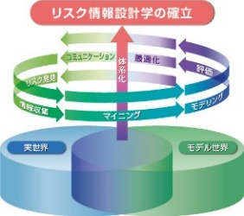
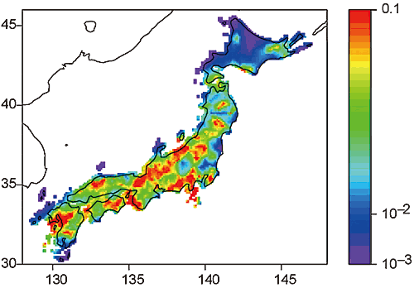

Risk Analysis Research Center
-Aims of risk analysis research are to develop a system and method for the scientific management of risks
in various social and natural fields by establishing quantitative risk evaluation methods.
Aims
Projects
Creating trans-disciplinary methodology for risk evaluation and management in various fields.
Implementing “risk research network” activity as an NOE (Network Of Excellence) consisting of researchers who support the creation of a new information science to be called “quantitative risk science.”
Integrating knowledge on risks in various fields as a research center that plays a key role in the information, statistics, and mathematics aspects of risk management in a social environment of increasing uncertainty and complexity.
    Data-centric risk science foundation development project
    Risk foundation mathematics project
    Risk evaluation project in medical and health science field
    *This project developed and ISM launch the RCMHDS.
    Statistical analysis method development project for environmental information
    Risk analysis project of resource management
    *This project will be developed a special unit in 2020
    Quantification and strategic control of financial risks
    Earthquake prediction analysis project
Designing Planning of
Risk Information
Earthquakes prediction more than M4
Center organization
Parent body
Risk Science NOE
今後の
協定機関
今後の
協定機関
Other affiliated organizations
Director, Prof. S. Yamashita
Established in April 2005
Risk Analysis Research Center
- Food and Drug Safety Research Group
- Environmental Risk Research Group
- Financial Risk and Insurance Research Group
Members
Shift to project system
・ Director 1 *
・ Vice Director 1 *
・ Center Professor 6 *
Assoc. prof. 3 *
Assist. prof. 3 *
* Holds joint appointment with
other department or center
Project Assist. prof. 4
・ Visiting Researchers
・ Research Assistants, etc.
Risk Analysis Research Center
Reorganization for
further development
Department of Risk Engineering,
Faculty of Systems and Information Engineering,
Uni. of Tsukuba
Prediction and Knowledge Discovery Research Center
- Earthquake prediction analysis group
- Genome analysis group
リスク研究ﾈｯﾄﾜｰｸ40機関
リスク研究ﾈｯﾄﾜｰｸ40機関
Integration
40 organizations in the risk research network
The Department of Ecoinformatics, Biometrics and Forest Growth of the Georg-August University of Goettingen (Germany)
Department of Probability and Mathematical Statistics, Charles University (Czech Republic)
Notes:
As of April 1, 2018
As of April 1, 2019

Slide 16
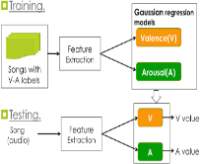
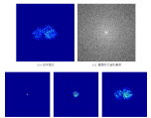
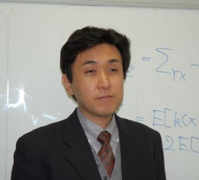
Research Center for Statistical Machine Learning
The aim of this center as a cooperative research institute is to enhance activities of Japan’s machine learning community, and to establish an international reputation through promoting domestic and overseas collaborations. The center conducts research on machine learning, from the viewpoints of both statistical science for inference, and of computer science for algorithms.
Aims
Machine learning is a field of research on systems that can automatically execute learning based on data or experience. It has a wide range of applications, including internet services, audio and video information processing, brain science, and robotics.
Promoting research on theory and methodology of machine learning from a statistical mathematics perspective, as well as applied research on machine learning in audio, video, natural languages, etc.
Promoting basic research on new data science by integrating optimization and statistical inference.
Developing research of high originality, such as information geometry and kernel methods.
Promoting the activities of the machine learning community in Japan.
Promoting international collaborations and establishing our positions in the international research community.
Space of all distributions
statistical model
Information geometry and Machine learning
Statistical analysis of media data
Approach by sparse modeling
Center organization
Statistical Machine Learning NOE
Parent body
今後の
協定機関
Center for Computational Statistics and Machine Learning, University College London
今後の
協定機関
Members
Research Innovation Center
- Functional Analytic Inference
Research Group
- Optimization-based Inference
Research Group
- Speech and Music Information
Research Group
Other affiliated organizations
Director, Prof. K. Fukumizu
- Director 1 *
- Vice Director 1 *
- Center Professor 6*
Assoc. Prof. 4 *
Assist. Prof. 4*
- Project Assist. prof. 1
Project Researcher 4
* Holds joint appointment with
other department or center
Visiting Researchers 14
- Research Assistants, etc.
Integration
Research Center for Statistical Machine Learning
Reorganization for
further development
Prediction and Knowledge Discovery Research Center
- Gene diversity analysis group [Please confirm the English name.]
Department of Communication Systems, SINTEF Information and Communication Technology
Department of Electronics and Telecommunications, Norwegian University of Science and Technology (NTNU)
Department of Empirical Inference, Max Planck Institute for Biological Cybernetics
Other academic staff in related fields
Notes:
As of April 1, 2018

Slide 17
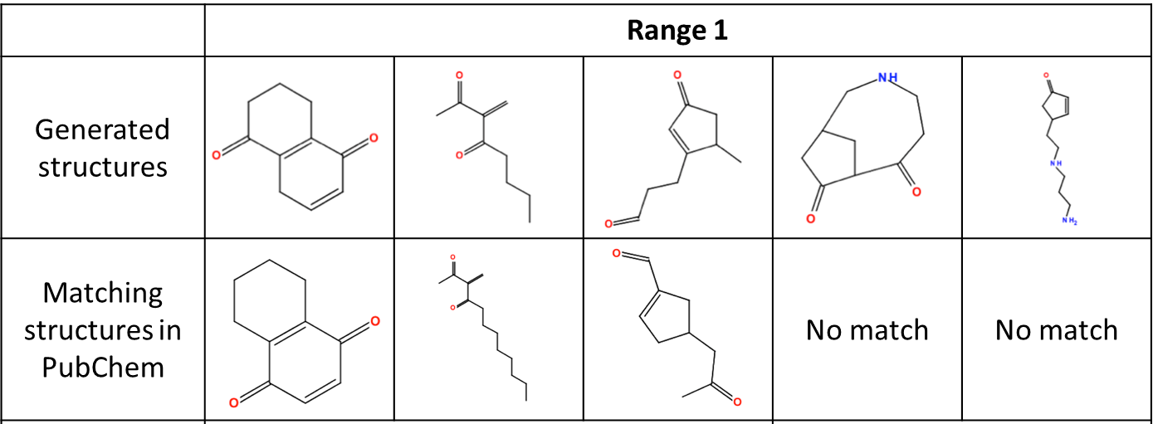
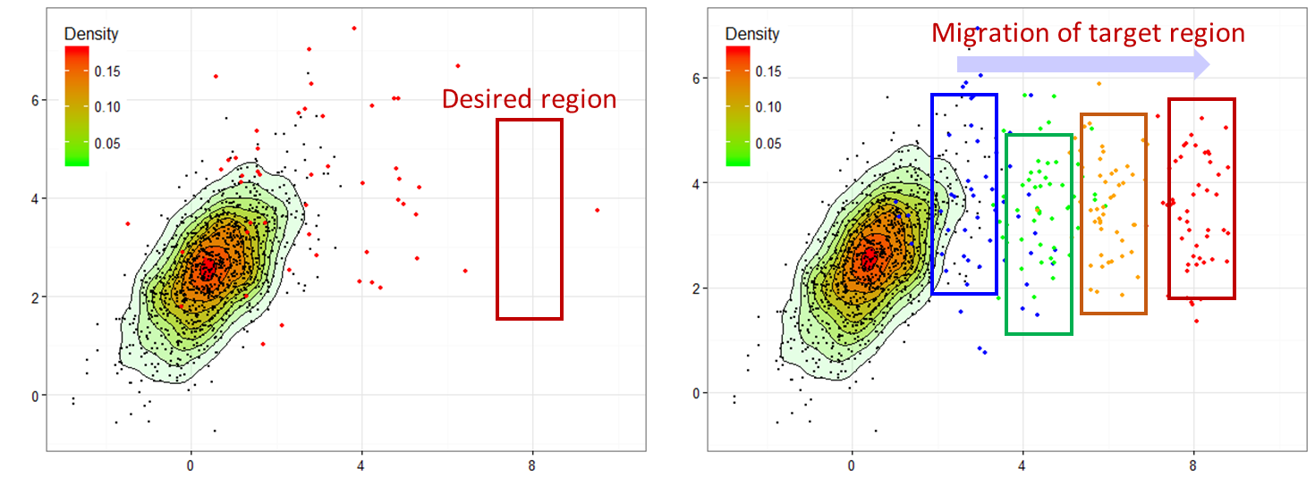
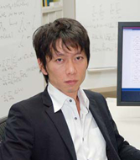
Data Science Center for Creative Design and Manufacturing
With advanced technologies in data science, we aim to create scientific methodologies for innovative design and manufacturing. We promote the development and widespread use of “data science driven smart design and manufacturing technologies”
AIMS
Creation of innovative algorithms for creative design and smart manufacturing
Promotion of projects for the grand challenge studies and open innovation
New definition of “the next generation design and manufacturing” from a unique perspective of data science
Promotion of advanced data science technologies to various industrial applications
Establishment of co-created values through industry-academia collaboration
Data Science Driven Smart Design and Manufacturing
Strategic fields: manufacturing, biotechnology, material, chemistry, etc.
Core technologies: machine learning, data assimilation, simulation, optimization, system control, high-performance computing, etc.
Material Design using Machine Learning
The opening symposium was held on June 15th, 2017
ORGANIZATION
NOE for Creative Design and Manufacturing
Members
Research and Development Center for Data Assimilation
Research Center for Statistical Machine Learning
Service Science Research Center, etc.
National University, etc
・Director 1 (Affiliated)
・Vice Director 1 (Affiliated)
・Professor 1
Assoc. Prof. 2
Assist. Prof. 1
Project Assist. Prof. 1
・Visiting Researcher 1
・Research technicians
Enterprise
Director, Prof. R. Yoshida
Data Science Center for Creative Design and Manufacturing
International Institute
Academic Association
Notes:
As of April 1, 2019

Slide 18

Research Center for Medical and Health Data Science
The opening symposium was held on May 28, 2018
Set up on April 1st,2018
Gathering intelligence of Data Science in Japan and supporting cutting-edge research for Data Science Research and high-level specific statistical education in the field of Medical and Health Data Science.
Aims
Education for Specific Data Analyzing in much higher level 【Development educational materials 】
Joint-use materials in cloud system, Systematic Educational Course,
OJT(On-the-Job) Program
【Educational Courses】 Health Science Mathematics, Public health/Epidemiology, Clinical Study，Cutting-edge Medical Data Analysis, Sports Science, and so on.
Supporting and promoting the development cutting-edge research and high-level specific education in the field of Medical and Health Data Science
Establishment “Health Science Research Network” as the educational research consortium for the industry-academia-government throughout all Japan
Forming the core sole academic base in the field of Medical and Health Data Science in Japan
As the gole for the development of the specific education in much higher level, applying and improvement of research literacy in various research areas
ORGANIZATION
Medical and Health Data Science NOE
Academic associations
Health Science Research Network
Universities in Japan
Members
Parent body
・ Director 1（Affiliated）
・ Vice director 1 （Affiliated）
・ Professor 2
Assoc. Prof. 3
Project Assoc. Prof. 1
Project Assis. Prof. 2
Project Researcher 1
・ Visiting Prof. 18
・ Assistant staff
Medical and Health Project in the Risk Analysis Research Center
Risk Research Network
Director,
Prof. Y. Ito
Planning
&Managing
Base Hospitals in Japan
Research Center for Medical and Health Data Science
（Affiliated）
（Affiliated）
Foreign research organizations
Enterprises
Notes:
As of April 1, 2019

Slide 19
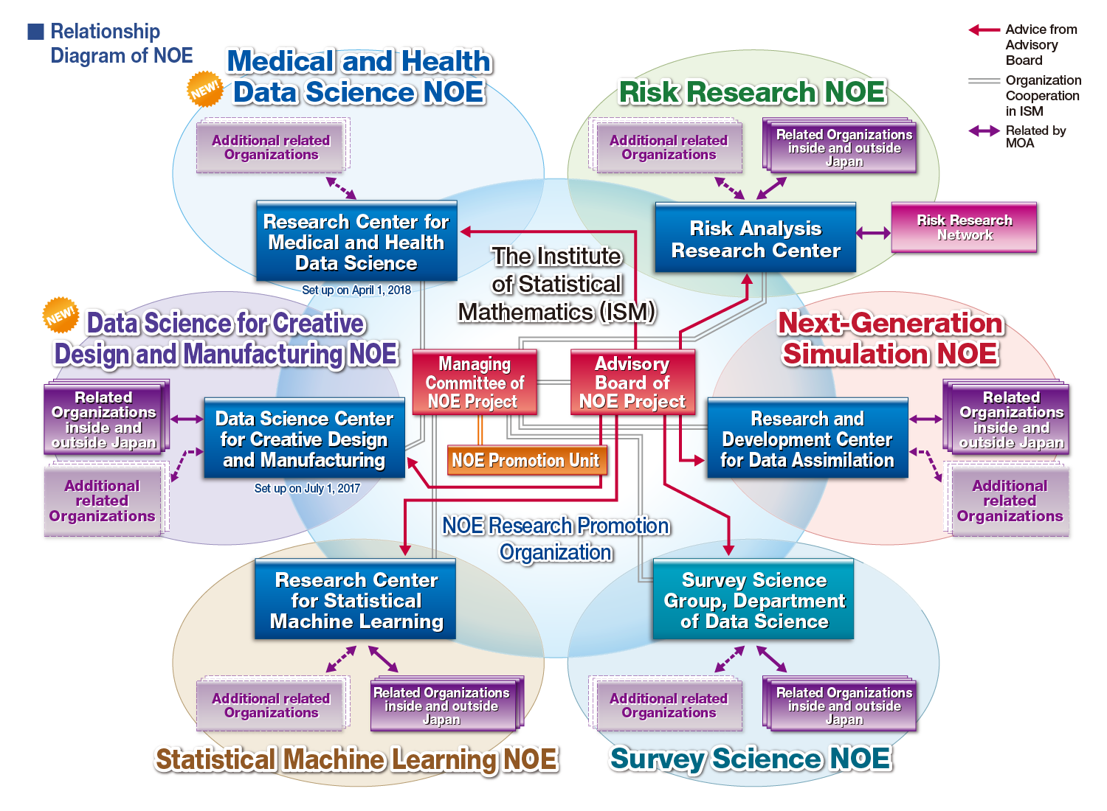
NOE (Network Of Excellence) Project
Supported by the community, reflecting the needs of universities as cooperative research institute..
- To solve the complex problems of modern society, it is essential to make use of large-scale data and to merge research from multiple fields.
- It is necessary to construct trans-disciplinary NOEs focused on statistical mathematics, a fast emerging tool for using large-scale data.
- Synergy effect is expected through comprehensively promoting these formation of NOEs.
Medical Health Data Science Research Network
Data Assimilation Group, Department of Statistical Modeling
Survey Science Group, Department of Statistical Data Science
Notes:
2017/9/16
→2018/5/22
2019/8/6

Slide 20
Changes in the Number of MOUs
numbers
MOUs signed before 2006
Asia
Europe
South
America
North
America
Pacific
2007
2008
2009
2010
2011
2012
2013
2014
2015
2016
2017
2018
Notes:
2017/1/11rev2018/2/9
Rev2018/5/22
2019/8/13

Slide 21
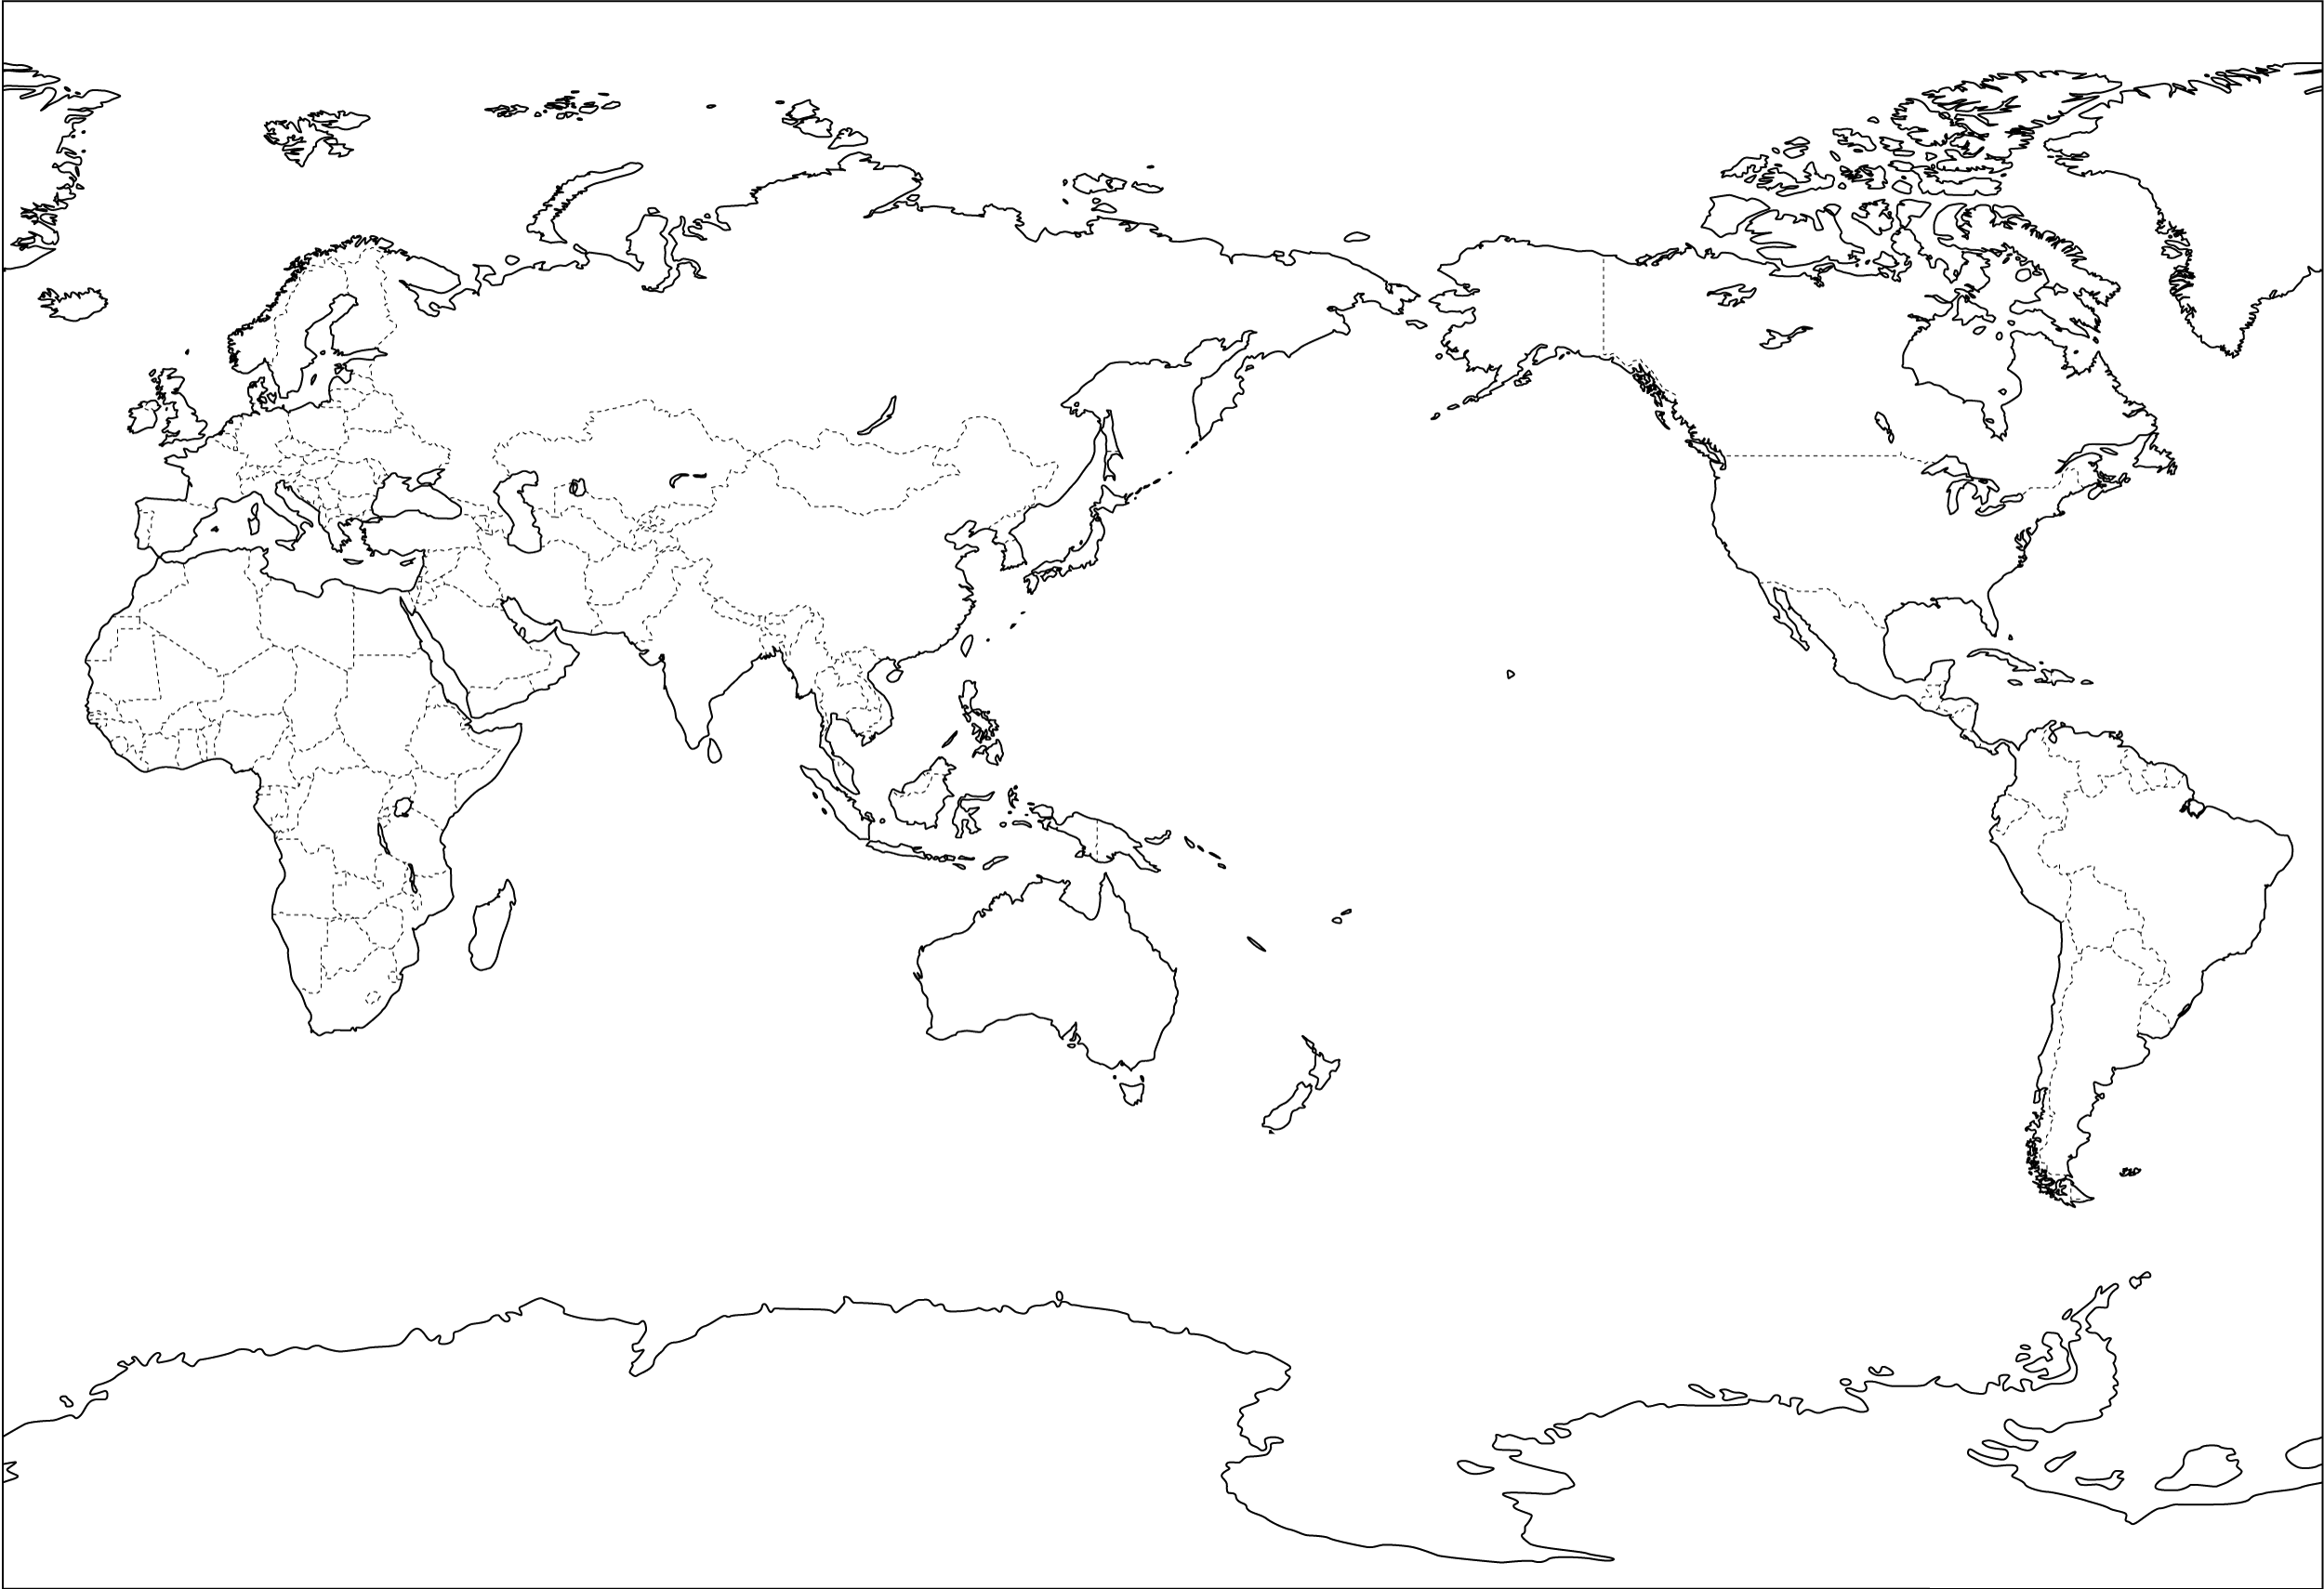
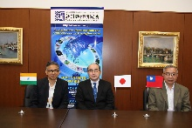
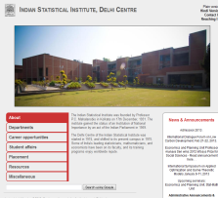
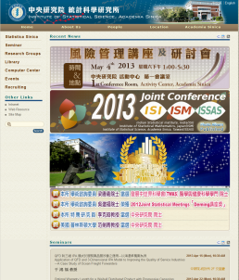
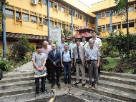
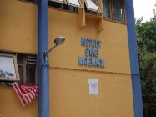
Foreign Organizations with Concluded MOUs
NOE-type MOU: 26
General-type MOU: 18 (including LOI)
NORWAY;
SINTEF Information and Communication Technology
NORWAY；Department of Electronics and Telecommunications, Norwegian University of Science and Technology(NTNU)
GERMANY；Institute for Statistics and Econometrics, Humboldt University of Berlin
GERMANY；ＺＩＢ
GERMANY;
ULM University
UK；University of Warwick
GERMANY ； Department of Empirical Inference, Max Planck Institute for Biological Cybernetics
UK;Big Data Institue, University College London
GERMANY；The Department of Ecoinformatics, Biometrics and Forest Growth of the Georg-August University of Goettingen
Korea; Korean Association for Survey Research
RUSSIA；The Steklov Mathematical Institute
Korea; Korean Statistical Society
The Korean Association for Survey Research
China; Dept. of Earth and Space Sciences, Southern University of Science and Technology
NETHERLAND；
Stichting Mathematisch Centrum
USA： Geaogie State University
UK；
Jean Golding Institute for data-intensive research, the University of Bristol.
Korea; Soongsil University
USA：San Jose State University
Nepal; Institute of Forestry, Pokhara of Tribhuvan University
CHINA；Inst. of Geophysics, China Earthquake Admin.
Korea; Survey Research Center, Sungkyunkwan University
USA：The Statistical Research Division of the U.S. Bureau of the Census
ＩＳＭ
USA: Toyota Technological Institute at Chicago（TTIC）
CHINA；
Faculty of Science HKBU
CHINA；
Central South Universityｖ
UK；Centre for Computational Statistics and Machine Learning, University College London
TAIWANG；Institute of Statistical Science, Academia Sinica
ISM - ISI – ISSAS Joint Conference is held every year
CZECH ；
Department of Probability and Mathematical Statistics, Charles University in Prague
INDIA；Indian Statistical Institute
Laos:
National Univ. of Laos
Indonesia;
University of Lampung
France; IRCICA
Vietnam:
Forest Inventory and Planning Institute.
France; BLAISE PASCAL UNIVERSITY
Cambodia: The Institute of Forest and Wildlife Research and Development of F.A.
Indonesia;
University of Lampun
France; University of South Brittany
France; CRIStAL
UK; Oxford University
Schweizerische;
RiskLab ETH Zurich
Malaysia；
University of Malaya
Australia; Schweizerische
Mathematical Science Institute, Australian National University
Portugal;
University of Port
Notes:
20190819

Slide 22



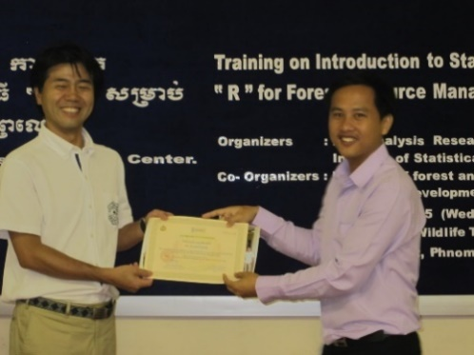
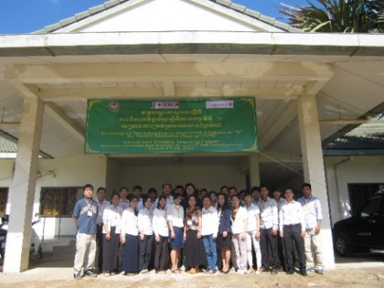

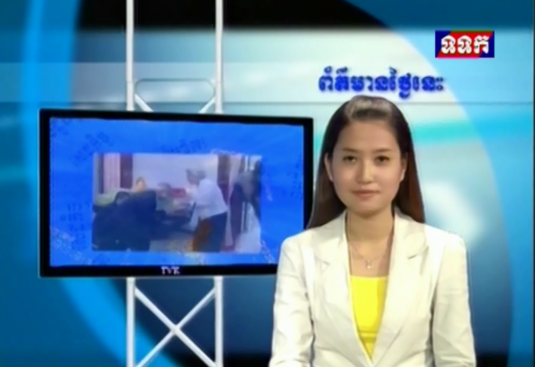
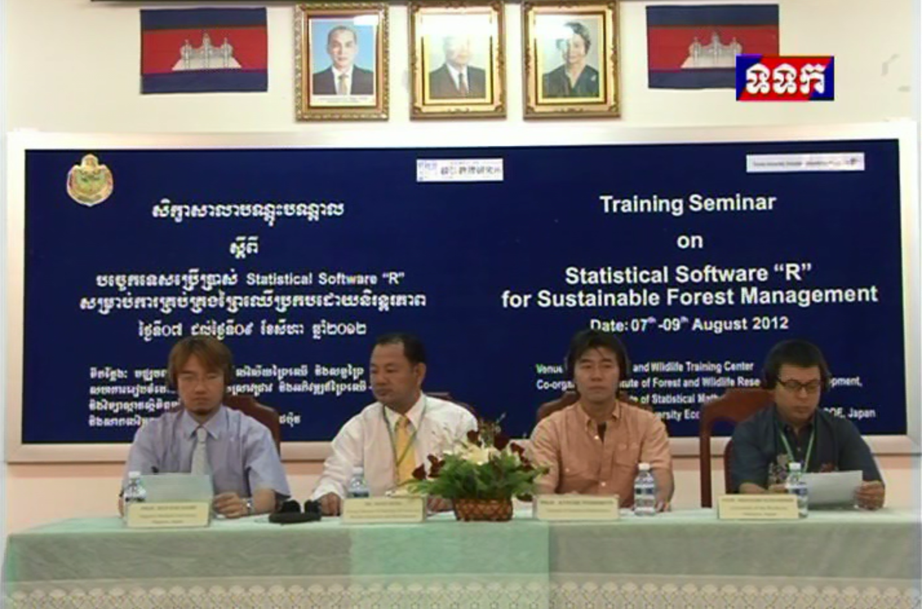

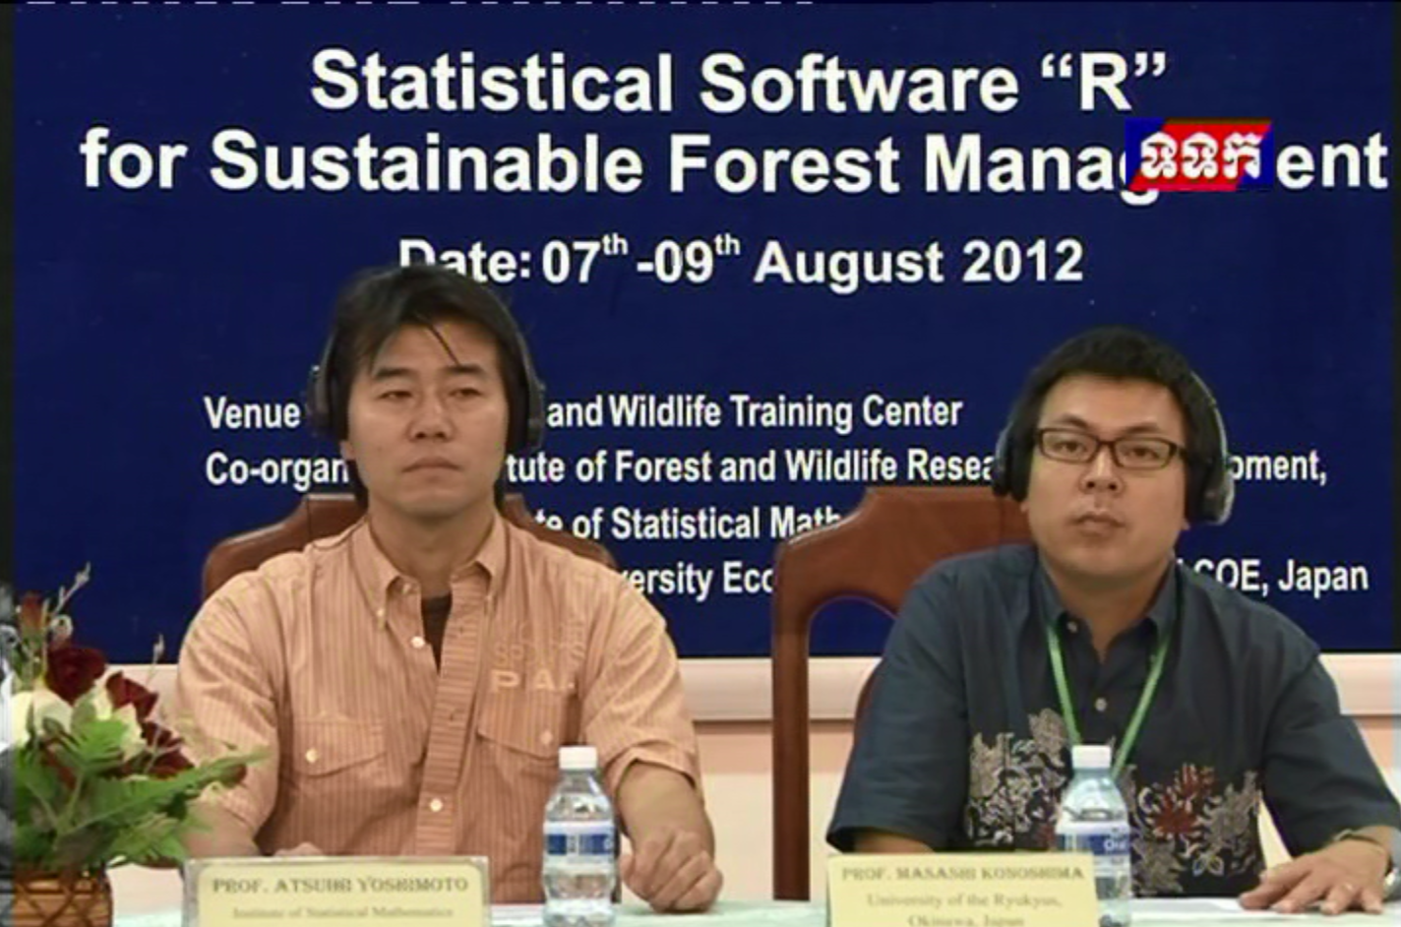
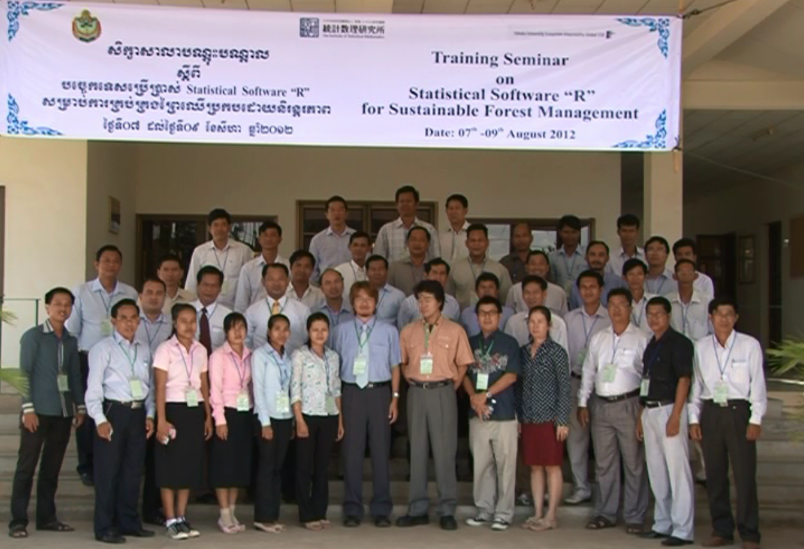
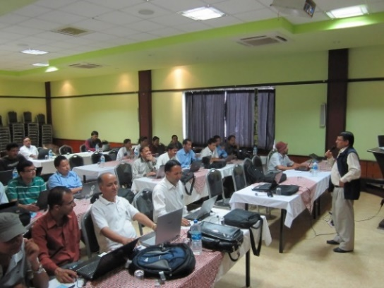
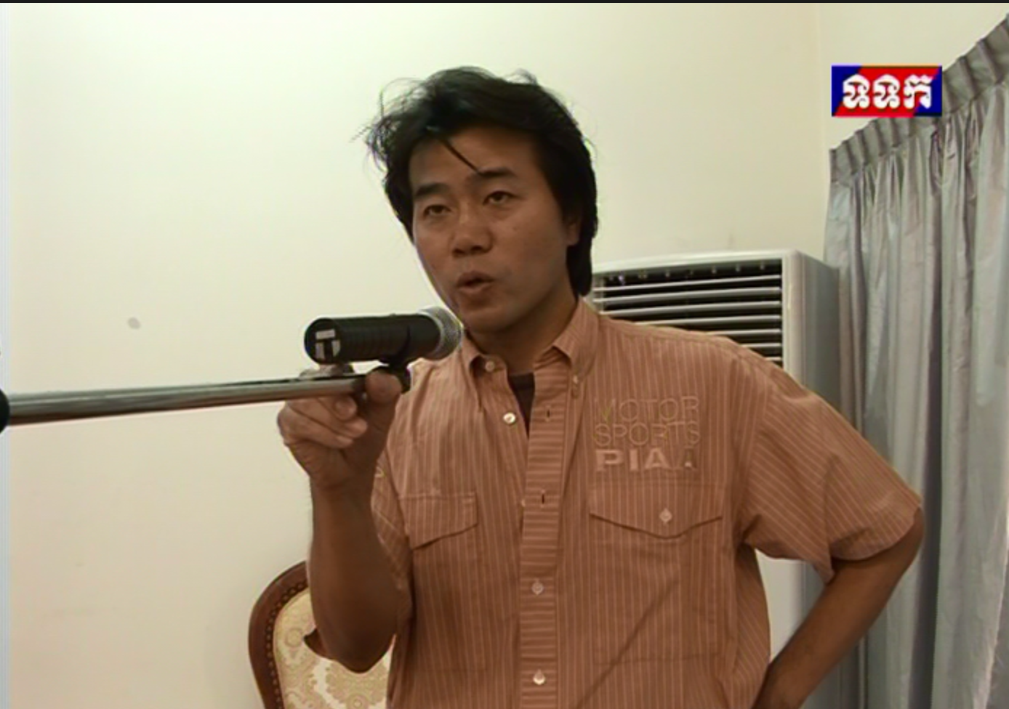
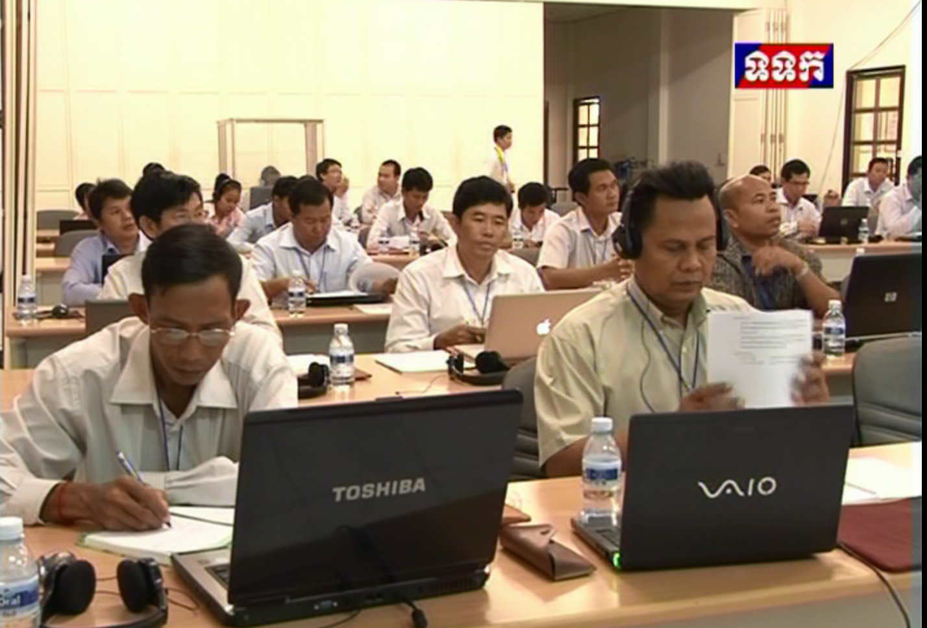
Research and Educational Activities
in ASEAN
“Training on Introduction to Statistical Analysis in “R” for Forest Resource Management”
(from Sep.25th to Sep.27th, 2013／ From Aug.27th to 29th, 2014 in Cambodia)
Statistical Software “R” for Sustainable Forest Management
(from Aug.7th to 9th,2012)
TV news on air in Cambodia.
“Training Seminar on Applied Statistical Analysis with R for Forestry Studies-Series II 2014” in Pokhara, Nepal
(From Sep.19th to 21st,2014)
(Nov.8-9, 2015 in Vietnam）
“Training on Advanced Statistical Analysis in "R" for Forest Resource
Management 2016”
(From Dec., 13th to 14st,2016)
Training seminars like “Training on Introduction to Statistical Analysis in “R” for Forest Resource Management”
are held every year since 2012.
Notes:
2016/3/25⇒2017/8/17
欄外１行追加・吉本先生に確認
基本的に毎年開催
> > はい、それで結構です。
> > 実績は下記かと。
> > 継続中：カンボジア：2012-2017、年に１～２回（定期）
> > 継続中：ネパール：2013-14、年に１回（不定期、今年度予定）
> > 継続中：ベトナム：2014-2017、年に１回（定期）
> > 継続中：ラオス：2015、年に１回（不定期、今年度予定）
> > 中断中：フィリピン：2014、年に１回（現在中断中）
> > 新規：インドネシア：2017、年に１回（今年度から予定）
> >
> > 吉本

Slide 23
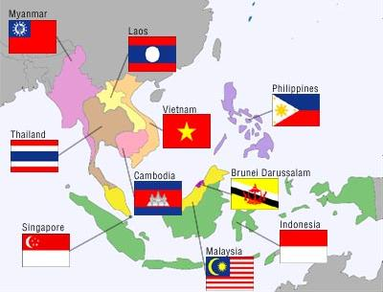

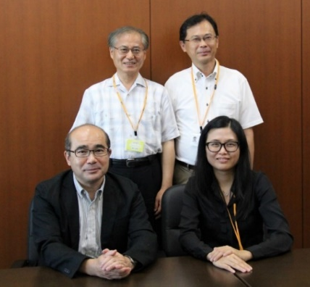








Academic Exchange
with ASEAN Countries
Dr. Fam Pei Shan,
Visiting Researcher in ISM from
Universitit Sains Malaysia
(Aug.18th, 2014)
Six statisticians from Indonesia, Sri Lanka and Vietnam, who visited to Japan for the 6th International Workshop on Analysis of Micro Data of Official Statistics (from Dec. 17th to 22nd at ISM) paid a visit to Prof. Higuchi, Director-General of ISM (on Dec. 22nd, 2014.)
Front (left to right); Prof. T. Higuchi(Director-General of ISM)
Dr. Fam Pei Shan Visiting Researcher
Back (left to right); Adjunct Prof. K. Shimizu, Prof. K.Kanefuji
Front ; 6 statisticians and Prof. T. Higuchi(Director-General of ISM)
Back; Staff of ISM and Sinfonica
MOU Signing Ceremony on March 6th , 2015 at ISM
The Institute of Forest and Wildlife Research and Development of the Forestry Administration of Cambodia
The Institute of Forestry, Pokhara of Tribhuvan University, Nepal
MOU Signing Ceremony on June 2nd, 2015 at ISM
The Forest Inventory and Planning Institute of Vietnam
Commemorative Photo.
Facility Tour (in front of one of the supercomputing systems [C])
Director-Generals of Both organizations shake hands.
Discussion
Notes:
2015/6/2

Slide 24











ISI-ISM-ISSAS Joint Conference
The 7th Joint Conference was held at ISM Apr.2nd -4th ,2015
Since 2007, ISI(Indian Statistical Institute) of India , ISM(The Institute of Statistical Mathematics a) of Japan and ISSAS(Institute of Statistical Science Academia Sinica) of Taiwan have held the joint conference once a year.
The 3rd Conference was held at ISI in Jan., 2010
The 2nd Conference was held at ISSAS in Jun., 2008
The 1st Conference was held at ISM in Nov., 2007
The 11th Conference was held in ISSAS in Jan., 2019.
The 10th Conference was held in ISM in Nov., 2017.
The 9th Conference was held at ISI in Feb., 2017
The 8th Conference was held at ISSAS in Jan., 2016
The 7th Conference was held at ISM in Apr.,2015
The 6th Conference was held at ISI in Feb., 2014
The 5th Conference was held at ISSAS in Jan., 2013
The 4th Conference was held at ISM in Feb., 2012
2016(8th)
2013(5th)
2014(6th)
2012(4th)
2010(3rd )
2007(1st)
Notes:
2016/9/26作成⇒2016/8/16更新

Slide 25



MOA Signing Ceremony with
Zuse Institute Berlin(ZIB)
【Jun. 20, 2016】
By this MOA, ISM and ZIB agreed to promote joint research projects, to accept research staff from each other, and to maintain continuous and collaborative contact etc. in the field of applied or statistical mathematics and data-intensive high-performance computing.
Professor Dr. Thorsten Koch (left) visited ISM on behalf of Professor Dr. Christof Schütte, President of ZIB.
(left to right in front) Prof. Higuchi, Director-General, ISM and Prof. Dr. Thorsten Koch, ZIB
(left to right in back) Prof. Ito, Vice Director-General, ISM and Prof. Shinano, Visiting Professor of ISM who belongs to ZIB
Notes:
2019/5/8英文に変更＆レイアウトやや変更

Slide 26










ISM-ZIB-IMI Joint Workshop
on Optimization and Data-intensive High Performance Computing
【1st WS was held during Jan., 19-21,2017@ISM】 【2nd WS was held during Sep., 22-26, 2017@ZIB】
【3rd WS was held during Sep.26-Oct.1, 2018@GRIPS】 【4th WS was held during Mar.25-30,2019 @ISM】
Commemorative Photo on 19, Jan.,2017
Organizer, Prof. Ito of ISM
Presentation by the Prof. Higuchi, Director-General of ISM
Demonstration by 4K3D Monitor of ISM
Mr. Awatsuji of MEXT gets the question by Prof. Coch of ZIB
Enjoying Japanese style Lunchbox
Notes:
2017/1/23
2018/5/30rev
2019/5/8rev

Slide 27
Development of Professionals capable of Statistical Thinking and Qualitative Reasoning: Major driver of trans-disciplinary research
Each Research Field
T-type
Trans-disciplinary Field
Dramatic changes in the data environment
Key role for trans-disciplinary research
SM：Case１
Solving near-future problems
Aggressively cultivate user’s expectations, and voluntarily study the applicability of SM
Speech recognition
Life Science
Natural Language
Fields where SM has not been used before
Engineering
Earth Science
π-type
Economics
SM：Case２
Many different research fields in trans-disciplinary science
Communication, Information processing, Control, AI, Simulation, OR, Applied math, Quality Control
Transversely connect and integrate fragmented areas of science

Slide 28










School of Statistical Thinking
● The second mid-term period plan of The Institute of Statistical Mathematics includes the project to promote developing professionals capable of statistical thinking. With that in mind, we set up the School of Statistical Thinking. We hope the school will be a training ground for researchers or students of new statistical study field, and also for other people who need statistics in their own fields.
Our Goal and Expected Benefits
Target | Programs -Projects for Fostering and Promoting Statistical Thinking-
General Public (those with interest in statistical mathematics) | Open Lecture Once a year (November)
For people who want to study statistical mathematics | Tutorial Courses About 13 courses per year
For University and Graduate school students | Graduate School Linkage Program Lectures or seminars are held in collaboration at Graduate schools.
 | Special Collaboration with Graduate Students Professors in ISM guide students of other graduate schools.
 | Summer Short Course Special Lectures are held once a year.
 | Open-type Professional Development Program In order to foster and promote “statistical thinking”, the Institute of Statistical Mathematics invites proposals for research projects and workshops to develop young researchers.
For researchers who need statistical mathematics | Statistical Mathematics Seminar Series Seminars are held by researchers of ISM every Wednesday with no charge
For researchers in need of a solution for specific issues in statistical research | Research Collaboration Start-up Expert statisticians affiliated with the Institute give scientists and others advice on statistical modeling, data analysis, and research.
For young researchers who belong to other organizations | Researcher Exchange Promotion Program We support young researchers who belong to other organizations, and have sabbatical for research at The Institute of Statistical Mathematics. ＊This Program is held by The Research Organization of Information and System
Educators concerned with statistics | Statistical Training for Teachers Training seminars for math and science school teachers are held.
Cooperation with other organizations’ events | We cooperate with the examination system, the Japan Statistical Society Certificate. We co-hosted “Forum for the Science Technology Education” of The Japanese Society for Quality Control.
Private Companies | Data Science Research Plaza We accept people who need the research facilities from pri9ate companies, governmental organizations and academic organization.
For all | On line lectures by youtube, niconicomovie, and Ustream.
New Special System | Data-based lecture plan based on organizational collaboration Planning various lectures or Training Courses based MoU, Graduate School Linkage and so on .
Our goal is to develop Professional, Type-T human who are able: to do statistical thinking; to create modeling with large-scale data; to coordinate research in various fields, and so on. We expect to develop young researchers like above through the activities of various collaboration research.
We support young researchers who belong to other departments in The Institute of Statistical Mathematics. And We try to expand our outreach activities concerned with Statistical Mathematics.
Ultimately, our goal is to create new research field, which might be able to solve problems and phenomena that are so complicated and uncertain.
Members
Director*
1 Vice-Director*
3 Professors*
3 Assoc. Professors*
2 Assist. Professors*
2 Adjunct Professors
1 Project Professor
1 Project Associate Professor
2 Project Assistant Professors
Visiting Professor
Project Visiting Research fellows
* Affiliated
Director,
Prof. Y. Kawasaki
Notes:
Apr.1st, 2018
Apr.1st, 2019

Slide 29



Research Collaboration Start-Up
One-time free consultation service
Young project assistant professors handle particular problems together with experienced emeritus professors.
  Consultation for a client. OJT for young researchers.
  We accept about 40 cases per year.
  34% academic, 40% companies, 16% government/hospital
If it is from academia, this can be a good start-up of research collaboration.
If it is from industries, we expect they can proceed to paid consultation or funded research collaboration.
👆 Examples as the accomplishment of OJT. *Young Project Assistant Professors took part in editing the Newton Magazines.

Slide 30

Summer Short Course
Started in 2006.
From 2014, we have had consecutive 10 days boot camp on infectious disease modeling every summer.
Currently, all the lectures are given in English.
80 to 90 participants
25 lecturers and tutors including top researchers from overseas.
https://sites.google.com/site/modelinfection/home/shortcourse4
※Click the Picture or URL and you can see more detail

Slide 31





Education (on the cooperation with) SOKENDAI
Graduate University for Advanced Study
（SOSENDAI)
・Founded in 1988
・First graduate University in Japan
・6 schools 20 departments
・17 supporting national research institutes*
*Inter-University Research Institutes
Department of Statistical Science
Sole statistical department in Japan since 1988
Annual capacity 5 *
          2 for a five-year Ph. D. course
          3 for a three-year Ph.D. course
Enrollment 35* as of April 1, 2019
      9 in the five-year Ph. D. course
      26 in the three-year Ph. D. course
Ph.D. degree Awardees 136 (by end of Mar. 2019)
Prof. Hironori Fujisawa,
Chair of the Dept. of Statistical Science
FY2019-2020
A commemorative Special lecture for 100 doctors in Statistical Science of SOKENDAI on Jun.14,2013
Notes:
2019/8/14rev

Slide 32
Department of Statistical Science
The Department of Statistical Science of Sokendai is only one department in Japan that provides graduate-level courses in statistical science. The Department provides two courses:
a three-year Ph. D. course for students and working people who have master's degrees
And
a five-year Ph. D. course for students and working people who have bachelor's degrees.
Reflecting the diversity of statistical science, students from a wide variety of academic backgrounds from statistics, life science, information science, physics, engineering, to the social sciences have enrolled in the Department.
After earning their degrees have gone to work in various academic and professional fields.
Student enrollment and Degrees Awarded
Notes:
The ISM currently has four research departments, namely department of fundamental statistical theory, statistical methodology, prediction and control, and interdisciplinary statistics. We also have two centers for statistical computing and information on statistical sciences.
Currently we have 66 faculties on various fields of statistical sciences.
2017/5/12
2019/8/14rev
和文の内容を少し追加しレイアウト等を変更

Slide 33
After earning Ph.D. of Statistical Science
Degrees Awarded：１３６ (in 30 years)
National and Public Universities | Univ. of Tsukuba, ，Univ. of Tokyo,＊Prof. Director, Obihiro Univ. of Agriculture and Veterinary Medicine, Univ. of Electro-Communications , Univ. of Hyogo, Future Univ. Hakodate, Tohoku Univ., Saitama Univ., Yokohama National Univ.，Kyushu Univ.,Nagoya Univ.,, Univ. of the Ryukyu, National Defense Medical College, Osaka Pref. Univ., Hiroshima Univ.，Kyushu Univ., Univ.,of Tsukuba, Oita Unive，Tokyo Tech., Inst，Kyoto Univ., Kyushu Univ.
National and Public Intuitions | ISM, ISM, ROIS, Government Pension Investment Fund, Bank of Japan, JSPS, ISM
Private Universities | Doshisha Univ., Meiji Univ. ＊Chair，Sapporo Gakuin Univ., Tokyo Healthcare Univ., Nippon Institute of Tech.，Aich Univ., of Tech., Josai Univ., Sapporo Gakuin Univ., Komazawa Univ., Meiji Univ.，Tokyo Univ. of Information Science, Waseda Univ., Kurume Univ.,
Foreign Universities | UCLA, USC, Victoria U.
Private Companies | Hitachi, Mizuho Trust&Banking, QIAGEN, Mitsubishi-Tanabe Pharma, Railway Technical Research Institute, Daiichi Sankyo，ATR, Mitsubishi Tokyo Bank，Pfizer, Goldman Sachs, Sony, NHK, Bridgestone，Qualicaps，Doctoral Institute for Evidence Based Policy, Brainpad, PricewaterhouseCoopers Aarata LLC，Credit Risk Database，CPC Clinic
As of May,28,2019
Prof. Assoc. Prof. Assist. Prof/Lecturer PD URA
Notes:
2019/8/14
和文概要を英訳して追加

Slide 34









Computers of ISM
Supercomputing System
Exhibition of Statistical Science and Computers
Certificated by IPSJ Computer Museum in 2015
⇒IPSJ (Information Processing Society of Japan) a virtual museum where you can find information about historical Japanese computers and the people engaged in the development of those computers.
We provide two computing facilities; the Super Computer System* for Statistical Science for joint-use and the Communal Cloud Computing System with various applications.
*We renewed and replace the Super Computer System for Statistical Science in FY 2018.
Water Cooling System
Random number Generators
from 1950 to2000
Computer In 1950
↑Sole 4K-3D visualization system in Japan
Workstation in 1980
Mini-Computer In 1970
Mini computer in 1970

Slide 35





Library and Publications
Library
Our library has a large collection of books and journal related to
Statistical science, and provides several services using the Internet.
■Journals
200 leading scientific journals related to statistics, mathematics, computational science and information science.
■Online Access
・ Online Public Access Catalog is available to search materials in ISM Library.
・ A great variety of electronic journals, electronic books and databases can be used.
Books
72,381
Periodicals
2,218
28％
47％
Electric Books：about 137,000
Electric Journal ：about 2,000 titles
72％
53％
As of Apr.1st, 2018
Publications
We publish academic journals and reports and provide publications on our website.
■The ISM Survey Research Report
Technical reports on surveys mainly in Japanese
■Computer Science Monographs
Online technical report on computer programs and software for statistical science
■Annals of the institute of Statistical Mathematics
International journal edited by ISM and distributed by Springer
■Research Memorandum
Prompt academic technical reports
■Proceedings of the Institute of Statistical Mathematics
Biannual journal in Japanese with English summaries
■ISM Report on Research and Education
Archives on workshops and lectures
■Cooperative Research Reports
Reports for the record of the each Cooperative Research in Japanese.
■ISM Report on Statistical Computing
Archives about the Statistical Computing in ISM
Notes:
統数研における共同利用に関連した試みとしては，ソフトウェアのWeb化があり，これによって多くのユーザが最新の統計手法を簡単に利用できるようになりました．また，最近重要性を増した，シミュレーションを視野に物理乱数サーバーを開設して提供を開始しました．統数研の物理乱数は2003年にはJIS規格になり，現在はISO規格を目指しております．また，統計計算のための世界有数のスパコンも共同利用として提供し，広く利用されています．
統計数理研究所では，大きく分けて，統計科学スーパーコンピュータシステム，計算統計学支援システム，ブートストラップシステムを所員研究用及び共同利用のために設置しています。示しているグラフは，所員，共同利用研究員，それぞれの上位5名の利用時間（CPU時間）です。1.3TFLOPSの高速計算機でありますので，非常に大規模な計算が行われていることがわかると思います。WebDECOMPは季節調整，時系列解析の計算を研究所のWeb上で行うことができるようにしたシステムです。毎月約1000件を超えるような利用があります。物理乱数については研究所が40年以上前から世界に先駆けて開発してきております。日立との共同開発で昨年度には特許を取得しております。物理乱数サーバーは1998年度に研究所が協力して東芝が開発した乱数ボードの第２世代のものを搭載しており，オンデマンドでの乱数提供を可能にしています。セキュリティーのために若干，使いづらくなっているために，平成17年度中にシステムを見直し，利便性と安全性を両立させる予定です。
2019.04.01

Slide 36

Akaike Guest House
Akaike Guest House holds 23 guest rooms.
Single Room １8（２１㎡）
Twin Room 4 （４３㎡）
Impediment Removal Room 1 （４３㎡）
A single room and a twin room can be connected and expanded.
S
S
S
S
S
S
S
S
S
T
S
S
T
S
S
T
S
Impediment Removal
S
S
The construction of the new rooms was completed in September 2015.
T
S
S
Notes:
2016/4/1

Slide 37


The Institute of Statistical Mathematics(ISM)
【Photo（As of Apr.1, 2019）】

