Slide 1

7
Cluster-based discrimination of foreshocks for earthquake prediction
Shunichi Nomura and Yosihiko Ogata
The Institute of Statistical Mathematics
Notes:
2019/10/8
1
First, thank you for giving me an opportunity of the talk in university of Ulm.
I’d like to talk about earthquake prediction.
I am afraid that because earthquakes seldom occur in Ulm and some of you may have never experienced earthquakes.
But Most Japanese are often suffered from earthquakes and some of them have experienced large one.
This picture shows that Japanese traditional belief that earthquakes are induced by big catfish quaking under the ground.
Earthquakes often occurs in swarm.
Here the size of catfish represents magnitudes of earthquakes.
The largest earthquake is called mainshock and often accompanies foreshocks and aftershocks before and after the mainshock, respectively.
The foreshocks are of my research interest and I’d like to present our work on Short-term forecasts by foreshock discrimination.
This is joint work with professor emeritus Ogata in ISM.

Slide 2

My Profile
Fellow of the Institute of Actuary of Japan since 2010
Ph.D, The Graduate University for Advanced Studies, 2012
2010-2013: Reserving actuary in non-life insurance (SOMPO)
2013-2017: Assistant professor, Tokyo Institute of Technology
2017-present: Assistant professor, ISM
Research theme:
  Earthquake forecasting (main)
  Sparse modeling
  Mortality modeling (recently started)
Notes:
Before my research presentation, let me introduce myself.
Among the participant of this workshop, I am the only one belonging to the Institute of Actuary of Japan.
I used to work in non-life insurance company as a reserving actuary from 2010 to 2013.
The company group is named “SOMPO”. Maybe you haven’t heard about this company but it has a Germany branch in Deuceldolf and I’ve been there once.
Then I obtained Ph.D degree at ISM in the Graduate University for Advanced Studies.
and changed my job into assistant professor in Tokyo Institute of Technology.
And I moved to ISM two years ago.
I think there are a lot of academic actuaries in Germany such as the previous speaker Dr. Chen.
But There are only several academic actuary belonging to university or research institute in Japan.
My main research interest is in earthquake forecast, but I am also working on sparse modelling and mortality modelling.
If I have next opportunity, I’d like to talk about those works.

Slide 3
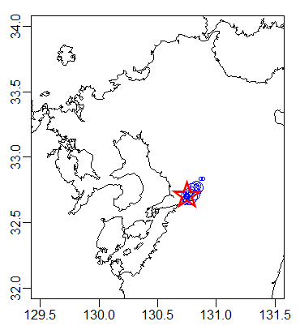
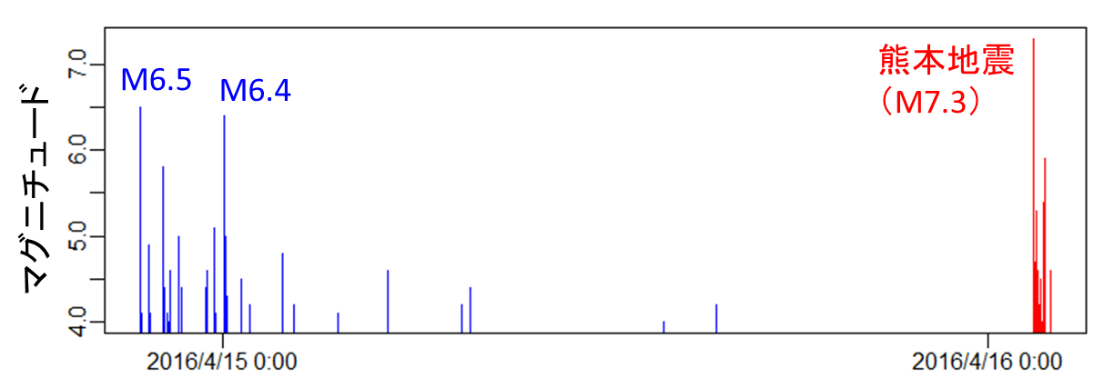
Introduction
Foreshocks are promising clues for short-term forecasting of large earthquakes.
Many of large mainshocks have foreshock activities.
Foreshock activities have characteristic trends in magnitude distribution, spatial and temporal concentration.
M7.3 (2016
Kumamoto
earthquake)
Magnitude
Time
Notes:
This figure shows magnitudes and occurrence times of foreshocks of 2016 Kumamoto earthquake of M7.3.
The blue bars are foreshocks.
Their frequency is high and they are spatially concentrated around the mainshock shown in a red star.
And magnitude gap between two largest foreshocks is only 0.1, quite small.
Foreshocks often have all or a part of such trends.

Slide 4
Introduction
Ogata et al. (1996) proposed a logistic regression model to discriminate foreshocks from growing earthquake clusters.
Toward operational forecasting, we modified some aspects of the foreshock discrimination model proposed by Ogata et al. (1996). Specificlly, we set
  Forecasting time horizon at 30 days from the last event,
  Targets of forecast at events whose magnitudes are over the largest foreshock magnitude,
  Evaluating probability for magnitudes of target events.
Notes:
It means that we want to discriminate foreshocks before mainshock occurs.
In this study, we tried to modify Ogata’s model toward more realistic and operational forecasts in 3 points.
First, we explicitly define the forecasting period by 30 days from the last event.
Second, we define targets of forecast as events whose magnitudes are over the largest foreshock magnitude. This is not necessarily the mainshock in a cluster.
And third we evaluate magnitudes of target events by assuming exponential distribution for magnitude gap between the largest foreshock and mainshock.
Hereafter we’d like to introduce this model and results.

Slide 5
Contents
We analyzed two earthquake catalogues:
  Japan Meteorological Agency (JMA) catalogue of Magnitude 4+ observed from 1926 to 1999 in the region E128–148°, N30–46°at a depth shallower than 100 km.
  International Seismological Centre (ISC) catalogue of Magnitude 4.7+ observed from 1960 to 1999 in all over the world at a depth shallower than 100 km.
Notes:
The first one is Japan Meteorological Agency catalogue of Magnitude 4 or larger observed in that region around Japan.
The second one is international catalog of magnitude 4.7 or larger.
We train our model by those catalog before 2000 and validate it by those after 2000.
Then I’d like to begin with Japanese catalog.

Slide 6
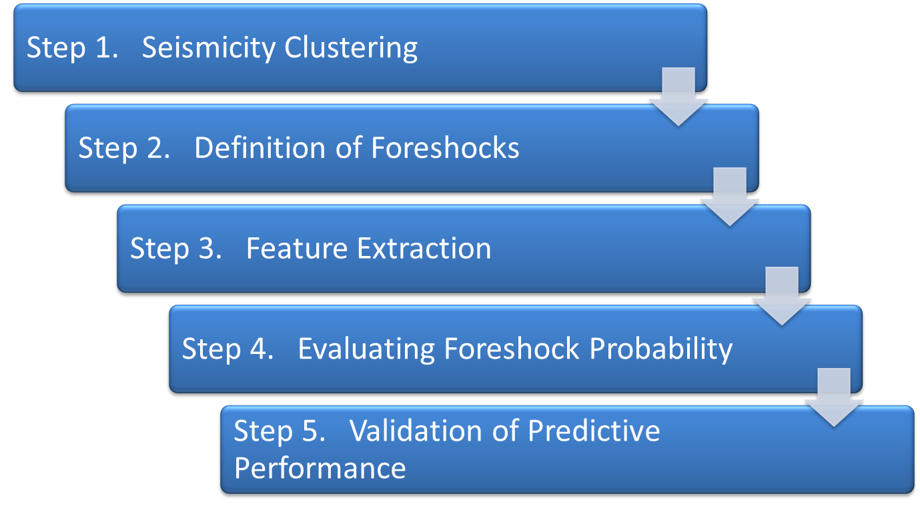
Cluster-based Foreshock Discrimination
Notes:
Then I’d like to explain the model along the 5 steps in turn.

Slide 7
Step 1. Seismicity Clustering
Clustering is necessary to define foreshocks to be discriminated.
Many algorithms:
  Window methods (Gardner & Knopoff, 1972)
  Link methods (Reasenberg, 1985; Frohlich & Davis, 1990; Zaliapin et al., 2008)
  Stochastic methods (Zhuang et al., 2002; Marsan & Lengline, 2010)
Clusters should be recognized before mainshocks to be forecasted (window methods are not applicable).
Once clusters are constructed, foreshocks can be defined.
Notes:
The first clustering step is necessary and important to define foreshocks to be discriminated.
There are so many clustering methods for seismicity, but most of them can be classified in 3 types, window, link and stochastic methods.
But because clusters should be made before mainshocks to be forecasted, window method that makes a window using mainshock information cannot be applied
Once clusters are made, we can define mainshocks, aftershocks and foreshocks within clusters.

Slide 8
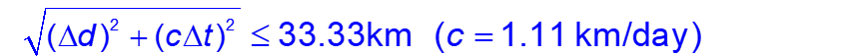
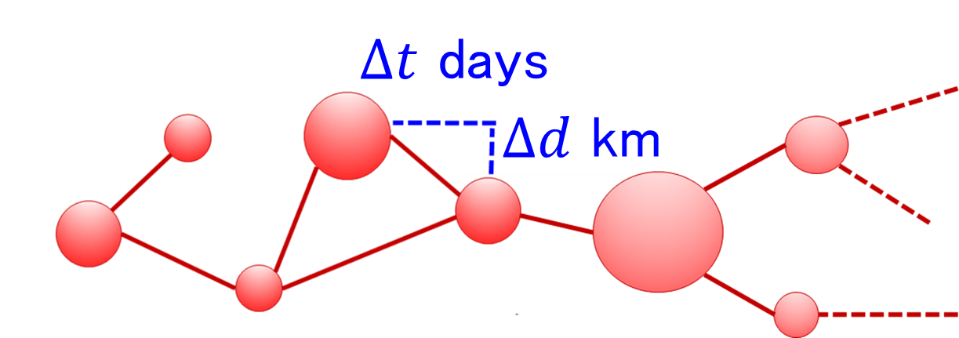
Step 1．Seismicity Clustering
First, we construct seismic clusters from JMA catalog by single-link method by Frohlich & Davis (1990) which connects pairs of earthquakes within certain space-time distance.
The threshold of link is determined to obtain clusters consistent with other methods by Ogata et al. (1995).
Notes:
In our study,
We define space-time distance by this formula with the exchange rate c.
The threshold of link is 33.33km corresponding to 0.3 degree in latitude

Slide 9
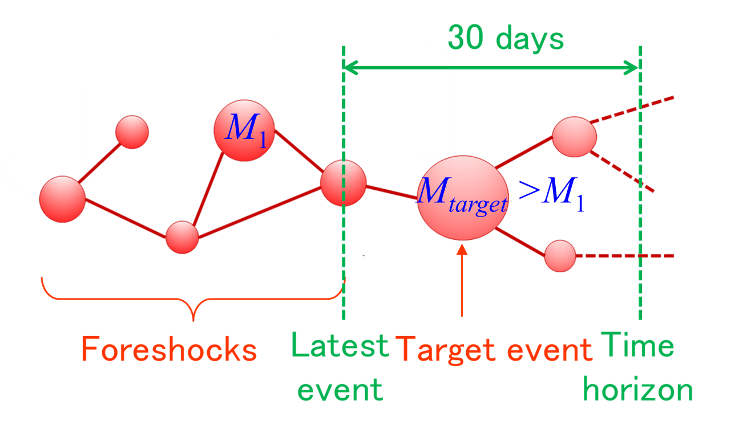
Step 2．Definition of Targets and Foreshocks
For each growing seismic cluster, we define the target events of forecast by earthquakes after the latest event larger than the largest event before the latest event.
We define foreshocks by the growing cluster that a target event occurs within 30 days after the latest event.
Notes:
After clusters are made, we define Targets of Forecast and Foreshocks
for each growing cluster, it means this is whole cluster but at this time we observed only these events and the cluster is still growing.
We should note that the target event is not necessary to be the largest event in the whole cluster because further large event may occur after the target event within a cluster.

Slide 10
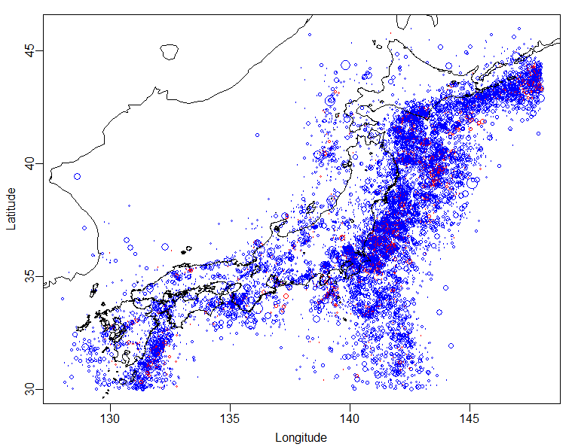
Step 3．Feature Extraction (First Event)
When the first event of a cluster appears, extract the following features to evaluate its foreshock probability.
  Magnitude：M₁
  Location in longitude and latitude ：X, Y （deg）
foreshock
non foreshock
Notes:
Then, In the next step, we extract the feature of clusters for discriminating foreshocks.
In this study, we separate our modeling into 2 cases.
One case is that the first event of a cluster appeared
and the other case is that the cluster size is more than 2, we call that cluster a multiplet.
Then, for the first case, when~
This map shows the distribution of the first events of clusters.
The red plots represent foreshocks and blue ones non-foreshocks.
The ratio of foreshocks seems to depend on region.

Slide 11
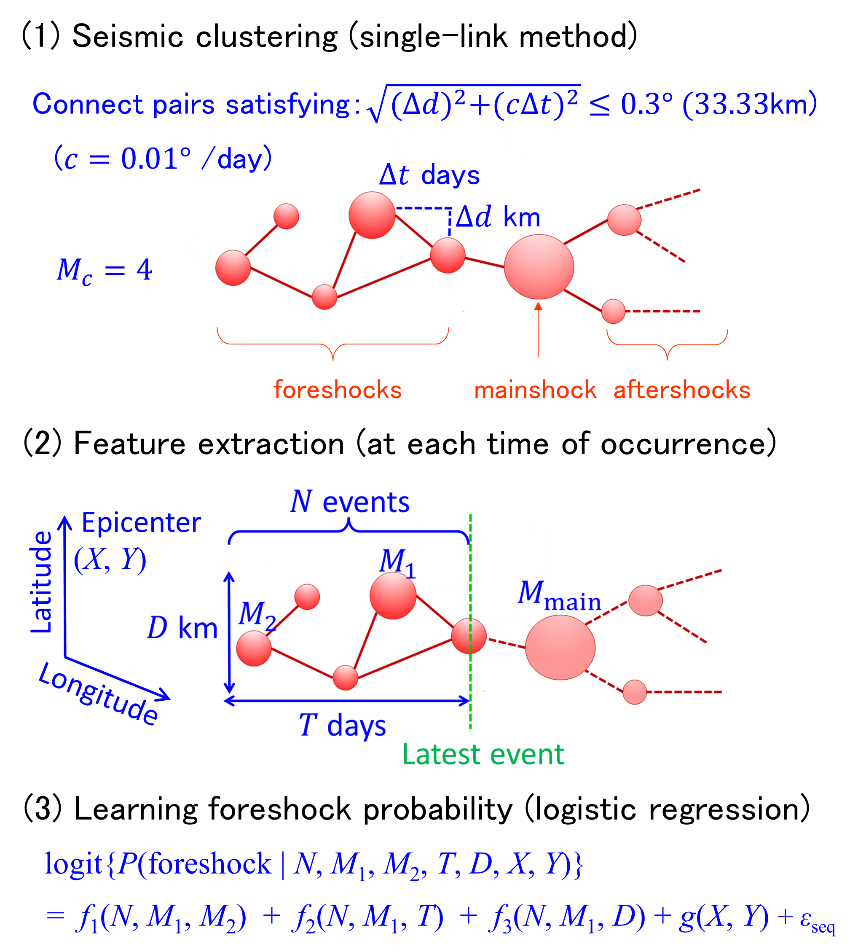
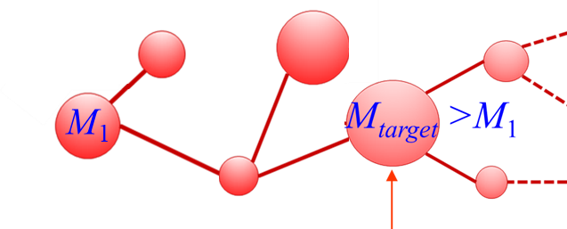
Step 4．Modeling Foreshock Probability (First Event)
Estimate the following non-linear logistic regression.
logit P(foreshock| N=1, M₁, X, Y) = g(X, Y) + f (M₁)
  P(foreshock| N=1, M₁, X, Y)： foreshock probability
  logit p = log{p/(1－p)}： logit function (0 < p <1)
g(X, Y)： log odds ratio for location (thin plate spline)
f (M₁) ： log odds ratio for magnitude (cubic regression spline)
30 days
First event
Target event
Time horizon
Notes:
After feature extraction, we evaluate the foreshock probability that a target event occurs within 30 days after the first event by the following non-linear logistic regression model .
The left hand side is logit function of foreshock probability.
The right hand side is composed of 2 terms of log odds ratio between foreshocks and non-foreshocks.
The first term is~
The second term is~ with 3 knots.
Then, We estimated the model from JMA catalog before 2000.

Slide 12
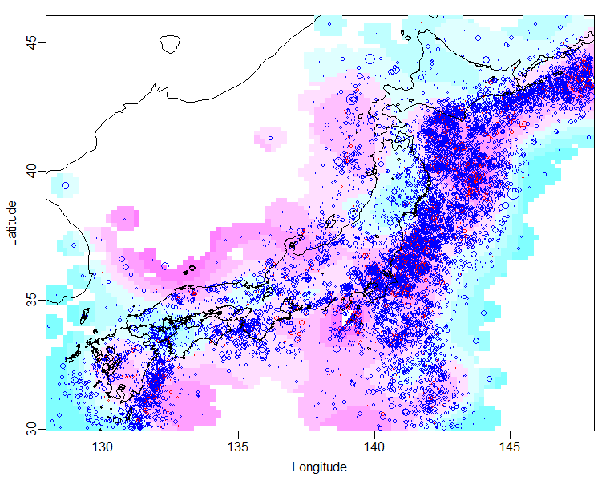
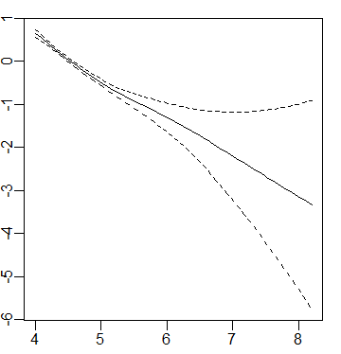
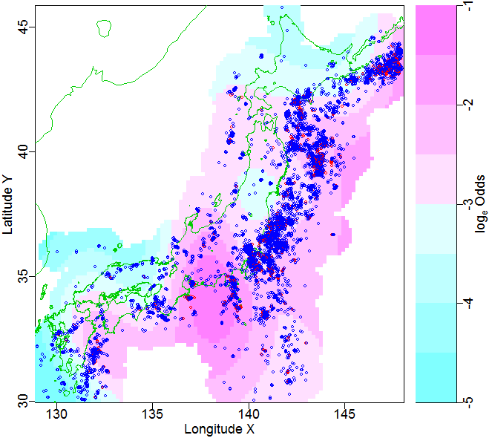
Step 4．Estimated Log Odds Ratio (First Event)
The smaller M₁ gives the higher log odds ratio because M₁ is the lower bound of magnitude of the target event M_{target} > M₁.
g(X, Y) f (M₁)
Latitude Y
log_{e} odds ratio
Longitude X
  Magnitude M₁
log_{e} odds ratio
Notes:
Here shows the estimated log odds ratio.
The log odds ratio for location is shown in color scale in this map.
The log odds ratio is higher in offshore region and lower in inland of Japan.
The log odds ratio for magnitude is shown in this curve with its confidence interval.
The log odds ratio is higher for the smaller magnitude of first event M1.
This is because M1 is the lower bound of magnitude of target event
and so small M1 gives wide range of magnitude for target event.

Slide 13
Step 3．Feature Extraction (Multiplets)
For a multiplet, extract the following features and update them whenever the multiplet grows by linking an new event.
  Number of earthquakes：N（ ≥ 2）
  Largest magnitude：M₁
  Magnitude gap between two largest events: ΔM = M₁ − M₂
  Duration time：T （days）
  Mean pairwise distance：D （km）
  Central location in longitude and latitude ：X, Y （deg）
Notes:
Next, for multiplets, that is growing clusters with multiple member,
We update those features by every occurrence of an new event in the growing cluster to update evaluation of foreshock probability.

Slide 14
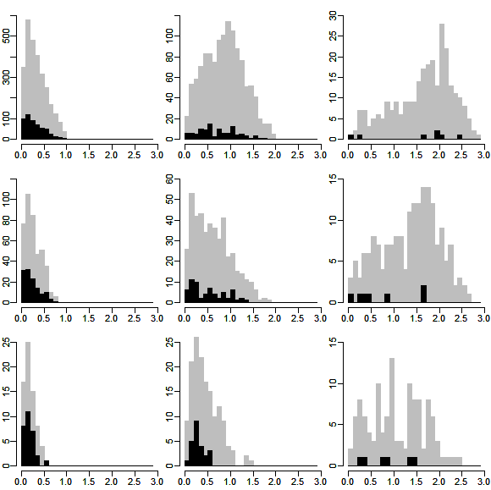
Step 3．Distribution of Features
4≦M1＜5
5≦M1＜6
6≦M1＜7
Foreshocks
N=2
Non-foreshocks
N=4
N=8
ΔM=M1-M2
ΔM=M1-M2
ΔM=M1-M2
Notes:
We’d like to see the difference of feature distribution between foreshock clusters and other clusters.
These figures show histograms of magnitude gap between two largest events.
9 histograms are arranged for different cluster size N in rows and different largest magnitudes in columns.
We can see that distribution of magnitude gap depends on cluster size and largest magnitude, and whether the cluster is foreshocks or not.
Magnitude gaps of foreshocks tends to be smaller than non-foreshocks.

Slide 15
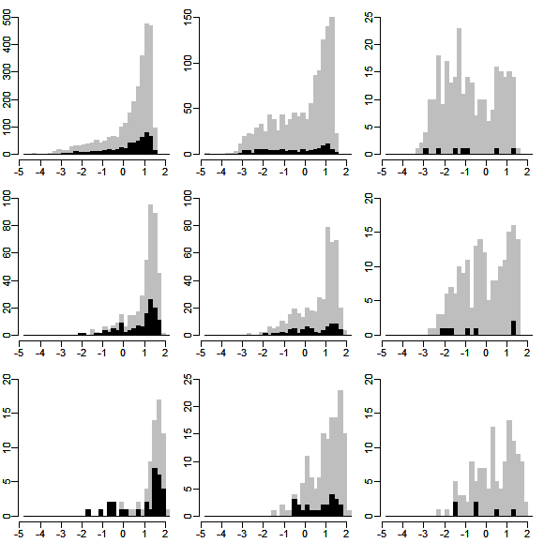
Step 3．Distribution of Features
4≦M1＜5
5≦M1＜6
6≦M1＜7
Foreshocks
N=2
Non-foreshocks
N=4
N=8
log₁₀T (day)
log₁₀T (day)
log₁₀T (day)
Notes:
We can also see the similar trends in duration time of clusters.
Here we show histograms of duration times.
Distribution of duration time also depends on cluster size and largest magnitude, and whether the cluster is foreshocks or not.
Duration time of foreshocks tends to be shorter than non-foreshocks.

Slide 16
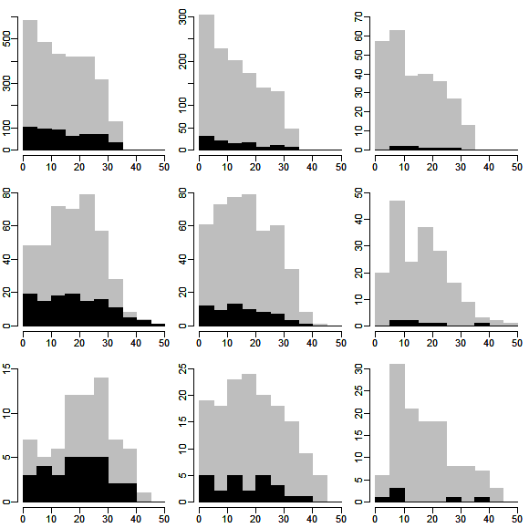
Step 3．Distribution of Features
4≦M1＜5
5≦M1＜6
6≦M1＜7
Foreshocks
N=2
Non-foreshocks
N=4
N=8
D (km)
D (km)
D (km)
Notes:
In contrast, distribution of mean pairwise distance within a cluster does not change so much by cluster size and largest magnitude.
We cannot see clear trend between foreshocks and non-foreshocks.

Slide 17
Step 4．Modeling Foreshock Probability (Multiplet)
Estimate the following non-linear logistic regression model from training dataset observed during 1926-1999.
logit P(foreshock| N, M₁, ΔM, T, D, X, Y)
= g(X, Y) + f₁(N, M₁, ΔM) + f₂(N, M₁, T) + f₃(N, M₁, D) + α_{s}
  P(foreshock| N, M₁, ΔM, T, D, X, Y)： Foreshock probability
  logit p = log{p/(1－p)}： Logit function (0 < p <1)
g(X, Y) ： log odds ratio for location (thin plate spline)
f₁(N, M₁, ΔM), f₂(N, M₁, T), f₃(N, M₁, D) ： log odds ratio
for combination of features (cubic regression spline)
α_{s}： Random effect for the s-th cluster
Notes:
Then, using those insight, we evaluate the foreshock probability by the following model
The right hand side is composed of 4 log odds ratio functions.
The first term means the location-dependent foreshock probability.
The second, third and fourth terms represent the effect of magnitude difference, time duration and mean pairwise distance, respectively.
We added interaction with cluster size and the largest magnitude, because distribution of those features depend on them.
In addition, we introduced random effects α for seismic clusters to obtain robust estimates under existence of outliers.
Then, We estimated the model from JMA catalog before 2000.

Slide 18
Step 4．Estimated Log Odds Ratio (Multiplet)
Estimated log odds ratio for location
g(X, Y)
Latitude Y
log_{e} odds ratio
Longitude X
Notes:
The log odds ratio for location is shown in color scale in this map.
The log odds ratio is higher in offshore region and lower in inland of Japan.
After clusters are made, we define Targets of Forecast and Foreshocks
We should note that the target event is not necessary to be the largest event in the eventual cluster because further large event may occur after the target event within a cluster.

Slide 19
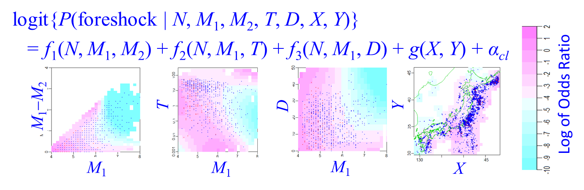
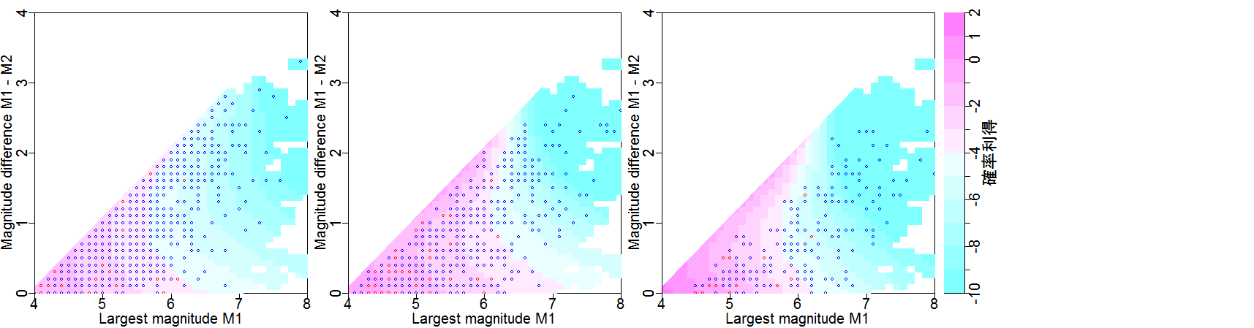
Step 4．Estimated Log Odds Ratio (Multiplet)
The smaller M₁ gives the higher log odds ratio because M₁ is the minimum magnitude of the target event M_{target} > M₁.
Within the same M₁ , log odds ratio is higher as the magnitude gap between the 2 largest events ΔM = M₁ − M₂ gets smaller.
f₁(N=2, M₁, ΔM) f₁(N=4, M₁, ΔM) f₁(N=8, M₁, ΔM)
foreshock
non foreshock
ΔM = M₁−M₂
ΔM = M₁−M₂
ΔM = M₁−M₂
log_{e} odds ratio
M₁
M₁
M₁
Notes:
Next we show the estimated log odds ratio for magnitude gap ΔM, cluster size N and largest magnitude M1.
We show them in 2d color scale map with fixed cluster sizes.
It is the same as the previous analysis for the first event that
the log odds ratio is higher for the smaller magnitude of first event M1.
When we see along the vertical axis of magnitude gap.
log odds ratio is higher as the magnitude gap between the 2 largest events ΔM = M₁ − M₂ gets smaller

Slide 20
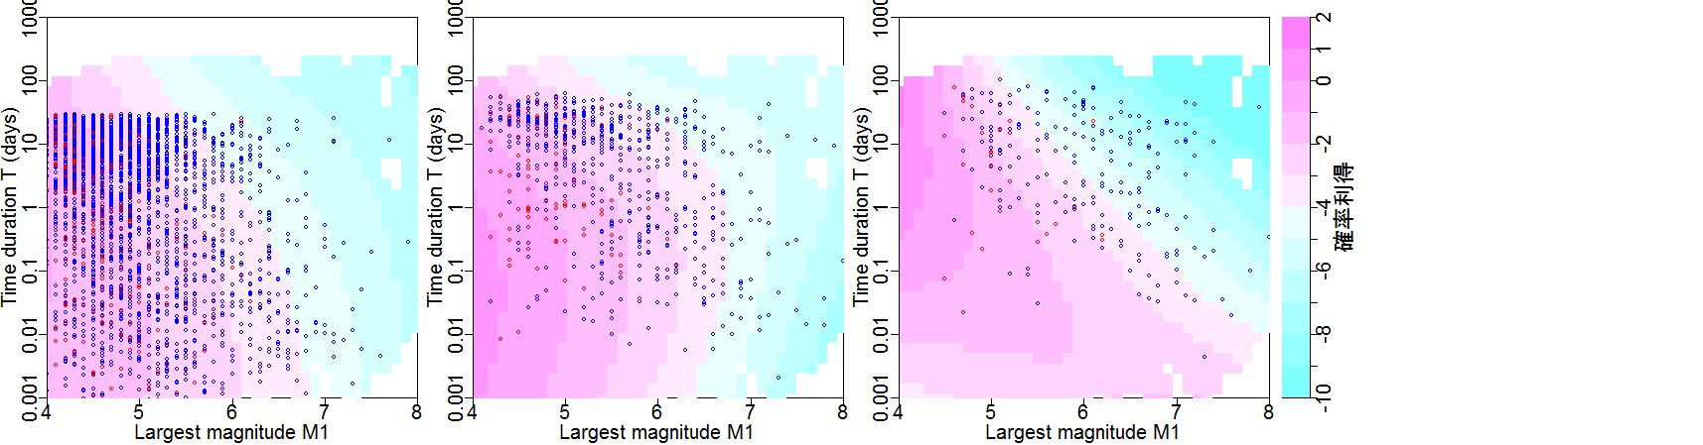
Step 4．Estimated Log Odds Ratio (Multiplet)
The smaller M₁ gives the higher log odds ratio because M₁ is the minimum magnitude of the target event M_{target} > M₁.
Within the same M₁ , log odds ratio is higher as the time duration T gets shorter.
f₂(N=2, M₁, T) f₂(N=4, M₁, T) f₂(N=8, M₁, T)
T (days)
T (days)
T (days)
log_{e} odds ratio
M₁
M₁
M₁
Notes:
The next one is for time duration of a cluster.
We also show them in 2d color scale map with fixed cluster sizes.
The time duration is transformed in log scale for our analysis.
The log odds ratio is also higher for the smaller magnitude of first event M1.
and When we see along the vertical axis of time duration,

Slide 21
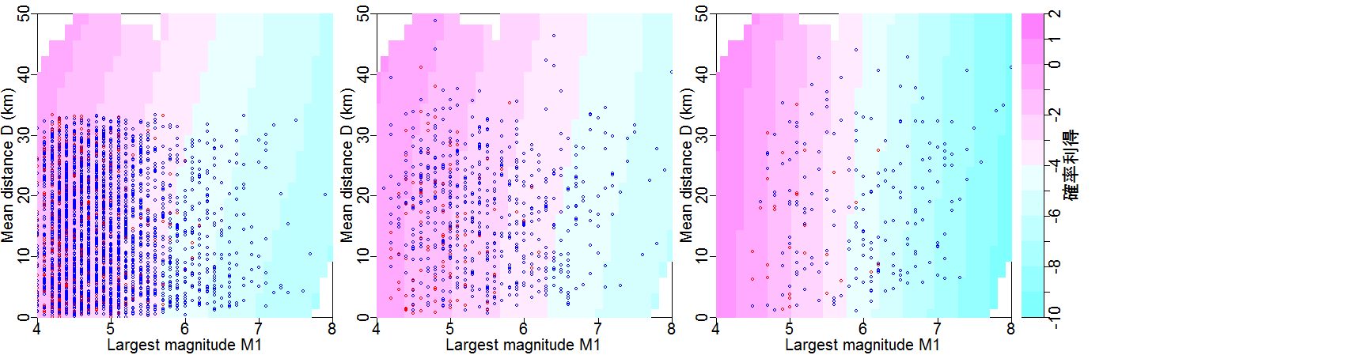
Step 4．Estimated Log Odds Ratio (Multiplet)
The smaller M₁ gives the higher log odds ratio because M₁ is the minimum magnitude of the target event M_{target} > M₁.
Within the same M₁ , log odds ratio is slightly higher as the mean distance D gets longer.
f₃(N=2, M₁, D) f₃(N=4, M₁, D) f₃(N=8, M₁, D)
D (km)
D (km)
D (km)
log_{e} odds ratio
M₁
M₁
M₁
Notes:
The last one is for mean pairwise distance within a cluster.
When we see along the vertical axis of mean distance,
That’s all the estimated log odds ratio functions in our model.

Slide 22
Step 5．Validation of Predictive Performance
We applied the model estimated from training dataset observed during 1926-1999 to validation dataset observed during 2000-2017.
The evaluated foreshock probabilities are approximately consistent with the actual portion of foreshocks in the validation dataset.
Notes:
In the last step, we validate predictive performance of our model by JMA catalog after 2000.
We compare the evaluated foreshock probability and actual portion of foreshocks in the validation dataset in this table.
The evaluated foreshock probabilities for growing seismic clusters of fixed cluster sizes N = 2, 5, 10 are tabulated in 10% intervals.
The foreshock probability reaches over 70% at maximum and they are actually foreshocks.
We count all clusters and foreshock clusters corresponding with each cell and calculate portion of foreshocks.
The evaluated foreshock probabilities seem to be approximately consistent with the actual portion of foreshocks.

Slide 23
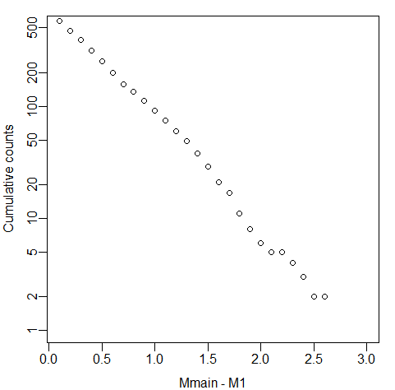
Step 4．Magnitude of Target Event
Given a foreshock cluster, we also predict magnitude of the target event by exponential distribution over the largest foreshock magnitude:
p(M_{target} > M₁+m | foreshock, M₁) = 10^{-0.80m}. m = 0.1, 0.2, …
  M_{target} ： Magnitudes of the target event
  M₁： Largest foreshock magnitude
Cumulative counts
M_{target} － M₁
Notes:
Here we add another element in forecast. that is magnitude of target event.
we predict magnitude of the target event by exponential distribution over the largest foreshock magnitude by this formula.
The coefficient 0.8 is estimated from the magnitude gaps between target events and the largest foreshocks in the dataset.

Slide 24
Step 5．Validation of Predictive Performance for M6+
When we limit magnitudes of target events to M6+, the evaluated foreshock probabilities get lower but are still valid for prediction.
Notes:
Then we evaluated foreshock probability again for target events of magnitude 6 or larger and compare them with actual portion of foreshocks.
The evaluated foreshock probabilities for events of M6 and larger did not exceed 20%.
The evaluated foreshock probabilities are not consistent with the actual portion of foreshocks.
But we can say that clusters with higher foreshock probability are indeed more likely to be foreshocks.

Slide 25
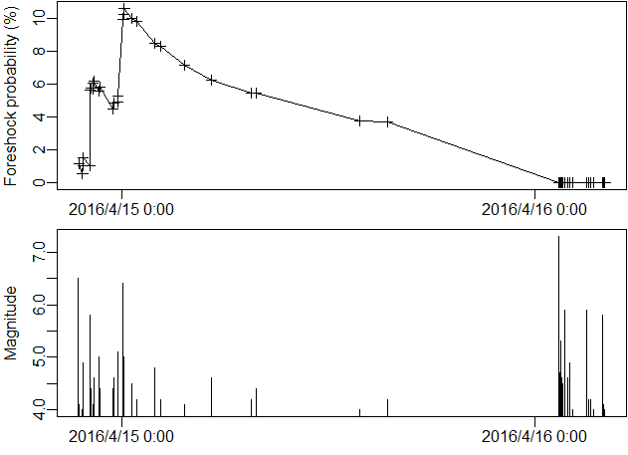
Evaluation for Major Foreshock Sequences
2016 Kumamoto (M7.3)
Target event M6.6+
M7.4+
Foreshock
probability (%)
M6.5
M7.3
M6.4
M5.8
Magnitude
Time
Notes:
At last, we’d like to show 2 examples of major foreshocks in Japan.
The first one is foreshock sequence of 2016 Kumamoto earthquake of M7.3.
The bottom figure shows magnitudes and occurrence times of foreshocks.
The foreshock sequence had started 2 days before the mainshock,
The first one is of M6.5 and 2 large events of M5.8 and 6.4 followed soon after that.
The upper figure shows the evaluated foreshock probability that target event of magnitude M6.6 or larger will occur within 30 days from the latest event.
The foreshock probability is reevaluated and updated as a new event occurs.
We can see that at first the foreshock probability was low below 1%.
But it had jumped twice when relatively large event of M5.8 and 6.4 occurred.
This is because the magnitude gap between 2 largest event got smaller and log odds ratio for the gap got higher.
the foreshock probability reached 10% at maximum, and after that decayed gradually into 4%, and then mainshock occurred.
the foreshock probability after the M7.3 mainshock fell down to near 0% which means further large earthquake over M7.3 would not occur.

Slide 26
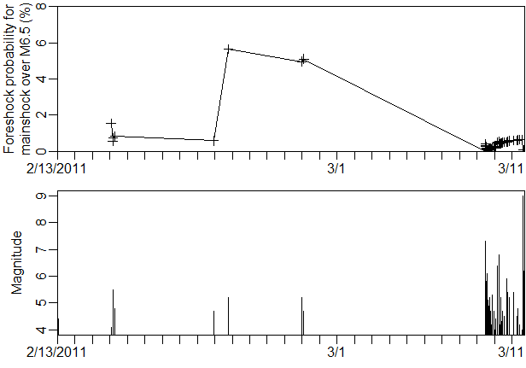
Evaluation for Major Foreshock Sequences
2011 Tohoku (M9.0)
Target event M5.6+
M7.4+
Foreshock
probability (%)
M9.0
M7.3
M6.8
Magnitude
M5.5
M5.2
Time
Notes:
The second example is foreshock sequence of 2011 Tohoku earthquake of M9, which is the largest event we have ever observed in Japan.
The first event is of magnitude 5.5 and target event is larger event than it for a while.
Then large earthquake of M7.3 occurred within a month.
After that event, the magnitude of target event rose to M7.4 or larger, and the foreshock probability fell into almost 0%.
But the foreshock probability gradually increased again to about 1% and then the largest event of M9 occurred.
Though the probability is low, but we can forecast such huge event we have never seen.

Slide 27
Contents
We analyzed two earthquake catalogues:
  Japan Meteorological Agency (JMA) catalogue of Magnitude 4+ observed from 1926 to 1999 in the region E128–148°, N30–46°at a depth shallower than 100 km.
  International Seismological Centre (ISC) catalogue of Magnitude 4.7+ observed from 1960 to 1999 in all over the world at a depth shallower than 100 km.
Notes:
We analyzed the JMA catalog in that region observed from 1926 to October 2017.

Slide 28
Cluster-based Foreshock Discrimination
Notes:
Again, we take the following 5 steps in turn.

Slide 29
Step 1．Seismicity Clustering
First, we construct seismic clusters from ISC catalog by single-link method by Frohlich & Davis (1990) which connects pairs of earthquakes within certain space-time distance.
The threshold of link is determined to obtain clusters consistent with those in previous analysis from JMA catalog.
55.55km
Notes:
We construct seismic clusters from ISC catalog in the same way as JMA catalog
except for the threshold of link set at 55.55km corresponding to 0.5 degree in latitude

Slide 30
Step 2．Definition of Targets and Foreshocks
For each growing seismic cluster, we define the target events of forecast by earthquakes after the latest event larger than the largest event before the latest event.
We define foreshocks by the growing cluster that a target event occurs within 50 days after the latest event.
50 days
Notes:
The definition of foreshocks is also the same except for the time horizon of forecast set at 50 days.

Slide 31
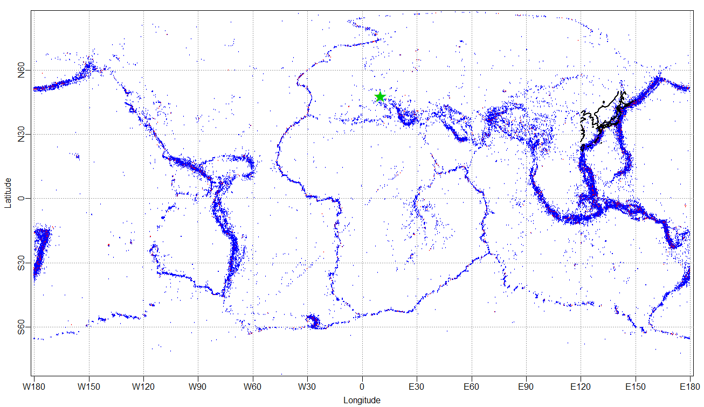
Step 3．Feature Extraction (First Event)
When the first event of a cluster appears, extract the following features to evaluate its foreshock probability.
  Magnitude：M₁
  Location in longitude and latitude ：X, Y （deg）
Latitude Y
Longitude X
Notes:
Then, In the same as the previous analysis, we extract == from the first events of clusters
Here’s the map of earthquake locations.
I’m afraid that I couldn’t add the map of lands, but you can see coast of continents where earthquakes are distributed.
Here is the western coast of Africa continent, here is the western coast of America continent.
this is Japan and this green star represents the location of Ulm.
Fortunately,there are only several earthquakes in Southern Germany and no earthquake in Ulm

Slide 32
Step 4．Modeling Foreshock Probability (First Event)
Estimate the following non-linear logistic regression.
logit P(foreshock| N=1, M₁, X, Y) = g(X, Y) + f (M₁)
  P(foreshock| N=1, M₁, X, Y)： foreshock probability
  logit p = log{p/(1－p)}： logit function (0 < p <1)
g(X, Y)： log odds ratio for location (thin plate spline on sphere)
f (M₁) ： log odds ratio for magnitude (cubic regression spline)
50 days
First event
Target event
Time horizon
Notes:
Then I evaluate the foreshock probability by following logistic regression

Slide 33
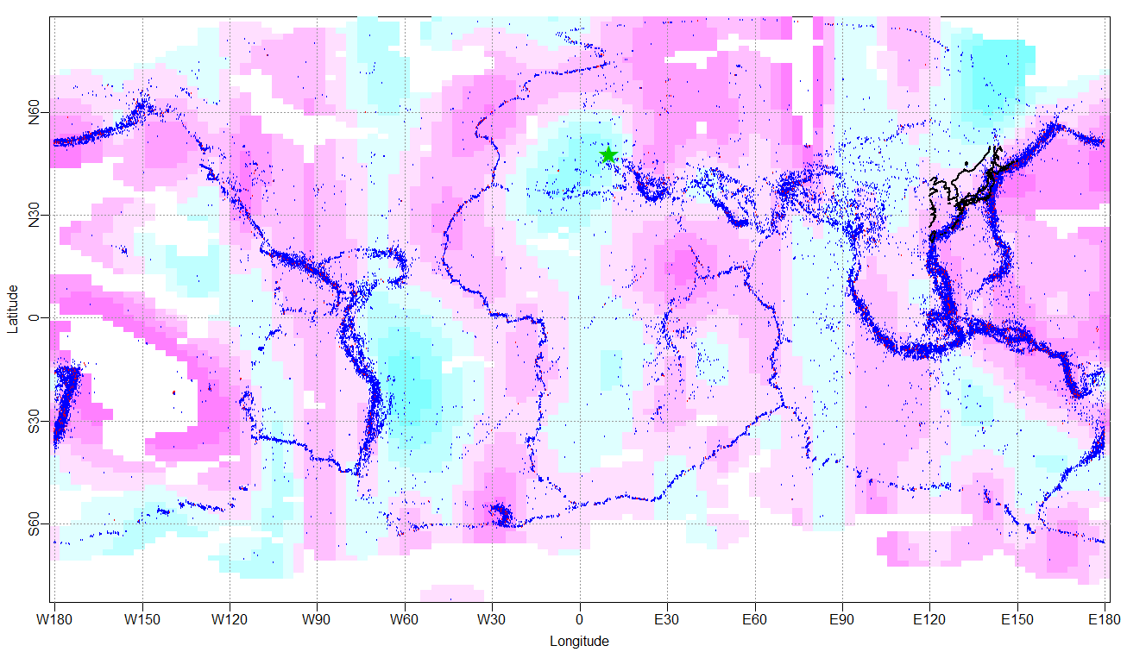
Step 4．Estimated Log Odds Ratio (First Event)
Log odds ratio for location over the world is rough.
g(X, Y)
Latitude Y
Longitude X
log_{e} odds ratio
Notes:
This map shows the estimated log odds ratio for location in color scale all over the world
The foreshock probability tends to be higher in offshore region and lower in inland region.
The foreshock probability is low in Ulm.
But we should note that this is very rough estimate that it is all red around Japan.

Slide 34
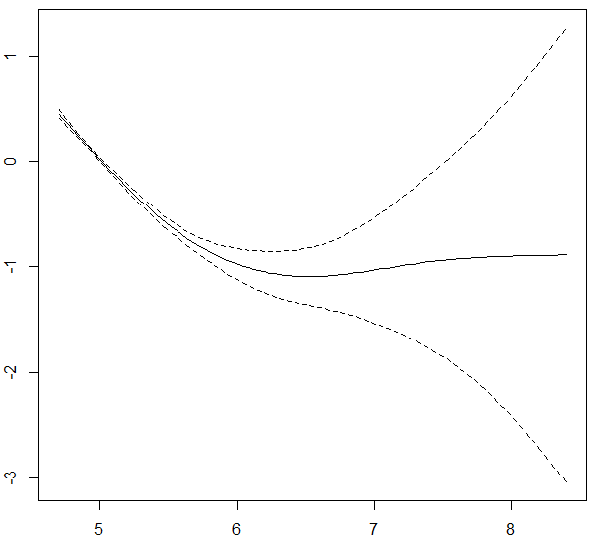
Step 4．Estimated Log Odds Ratio (First Event)
The curve of log odds ratio for magnitude gets flat over M6+
f (M₁)
log_{e} odds ratio
  Magnitude M₁
Notes:
This is the Estimated Log Odds Ratio for magnitude of first event.
We should note that The curve gets flat over M6+ which is different from the previous analysis.

Slide 35
Step 3．Feature Extraction (Multiplets)
For a multiplet, add the following features and update them whenever the multiplet grows by linking an new event.
  Number of earthquakes：N（ ≥ 2）
  Largest magnitude：M₁
  Magnitude gap between two largest events: ΔM = M₁ − M₂
  Duration time：T （days）
  Mean pairwise distance：D （km） (excluded)
  Central location in longitude and latitude ：X, Y （deg）
Notes:
Then, In the next step, we extract the following features from multiplets.
In this analysis we excluded one of the feature, mean pairwise distance because when we add it AIC of the model and predictive performance for validation dataset get worse.
The rest feature is the same as the previous analysis.

Slide 36
Step 4．Modeling Foreshock Probability (Multiplet)
Estimate the following non-linear logistic regression model from training dataset observed during 1926-1999.
logit P(foreshock| N, M₁, ΔM, T, D, X, Y)
= g(X, Y) + f₁(N, M₁, ΔM) + f₂(N, M₁, T) + f₃(N, M₁, D) + α_{s}
  P(foreshock| N, M₁, ΔM, T, D, X, Y)： foreshock probability
  logit p = log{p/(1－p)}： logit function (0 < p <1)
g(X, Y) ： log odds ratio for location (thin plate spline on
sphere)
f₁(N, M₁, ΔM), f₂(N, M₁, T) ： log odds ratio
for combination of features (cubic regression spline)
α_{s}： random effect for the s-th cluster
  (excluded)
Notes:
And this is the formula of logistic regression.
We also omitted the term including mean distance D.
The rest is the same as in the previous analysis.

Slide 37
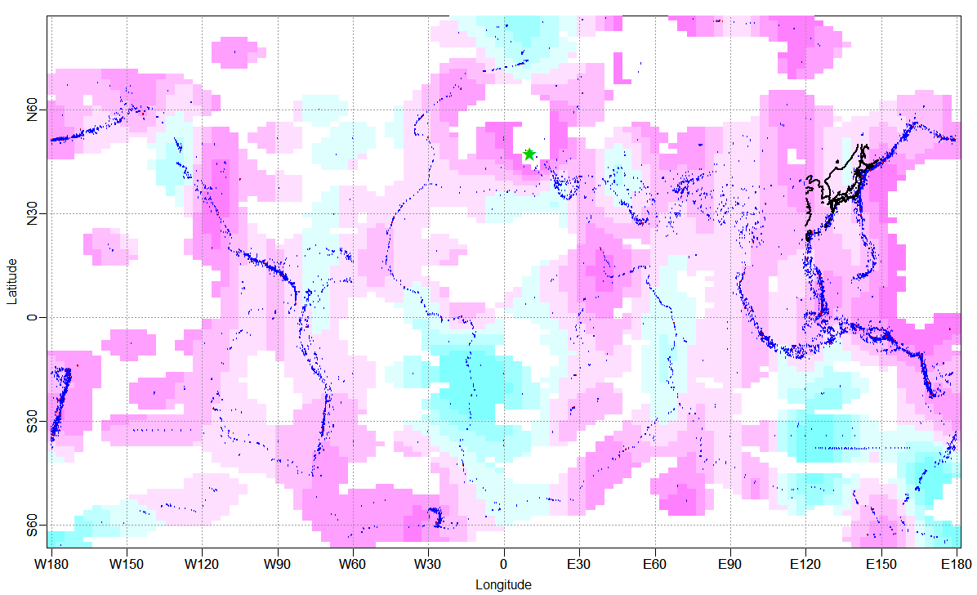
Step 4．Estimated Log Odds Ratio (Multiplet)
g(X, Y)
Latitude Y
Longitude X
log_{e} odds ratio
Notes:
This map shows the estimated log odds ratio for multiplet’s location which is similar with that for the first events location.

Slide 38
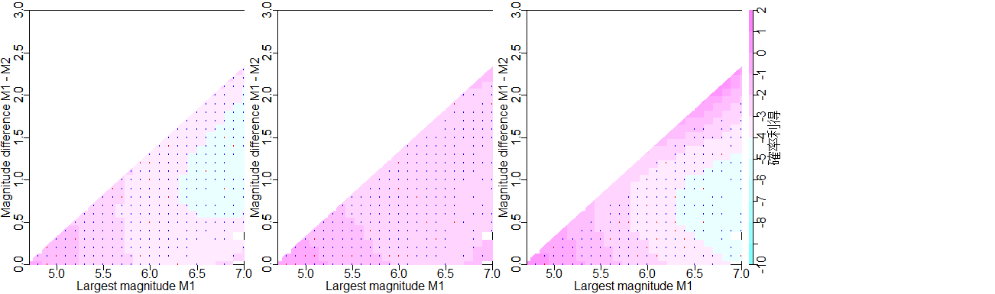
Step 4．Estimated Log Odds Ratio (Multiplet)
The smaller M₁ gives the higher log odds ratio because M₁ is the minimum magnitude of the target event M_{target} > M₁.
Within the same M₁ , log odds ratio is higher as magnitude gap between the 2 largest events ΔM = M₁ − M₂ gets smaller.
f₁(N=2, M₁, ΔM) f₁(N=4, M₁, ΔM) f₁(N=8, M₁, ΔM)
foreshock
non foreshock
ΔM = M₁−M₂
ΔM = M₁−M₂
ΔM = M₁−M₂
log_{e} odds ratio
M₁
M₁
M₁
Notes:
Next we show the estimated log odds ratio for magnitude gap ΔM, largest magnitude M1 in 2d color scale map with fixed cluster sizes N.
These result show the same trends that within~

Slide 39
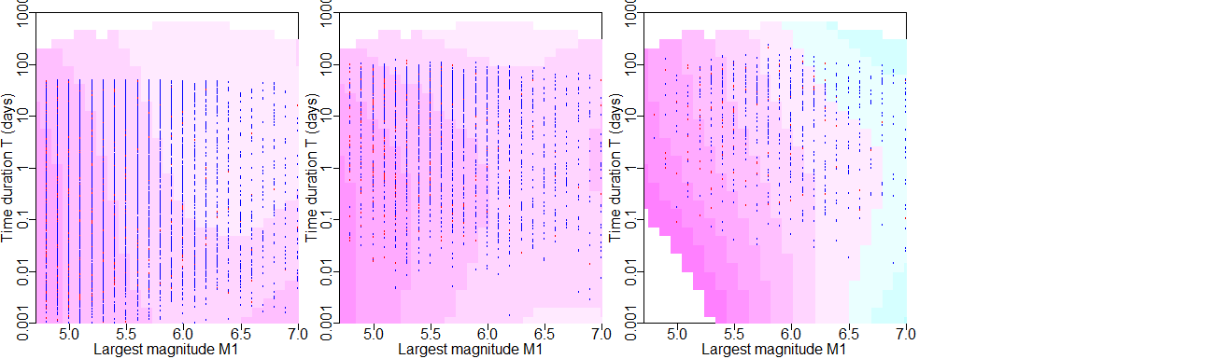
Step 4．Estimated Log Odds Ratio (Multiplet)
The smaller M₁ gives the higher log odds ratio because M₁ is the minimum magnitude of the target event M_{target} > M₁.
Within the same M₁ , log odds ratio is higher as time duration T gets shorter.
f₂(N=2, M₁, T) f₂(N=4, M₁, T) f₂(N=8, M₁, T)
T (days)
T (days)
T (days)
log_{e} odds ratio
M₁
M₁
M₁
Notes:
And these 2d color scale maps show the log odds ratio for time duration.
We can also see the same trend as the previous analysis that within~

Slide 40
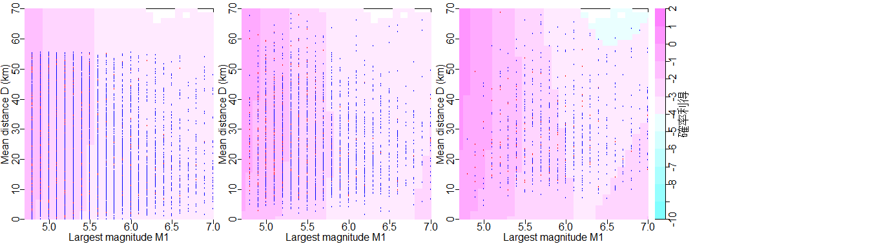
Step 4．Estimated Log Odds Ratio (not used)
If we add the mean distance D in a cluster to the feature set, AIC of the model and predictive performance for validation dataset get worse.
Within the same M₁ , log odds ratio is not so different among mean distance D .
f₃(N=2, M₁, D) f₃(N=4, M₁, D) f₃(N=8, M₁, D)
D (km)
D (km)
D (km)
log_{e} odds ratio
M₁
M₁
M₁
Notes:
These maps show the log odds ratio for mean distance D, which is omitted in our analysis.
But if we add this term, we obtain following results.
The log odds ratio seems almost independent on mean distance D and so it is no use to add this term in our model.

Slide 41
Step 5．Validation of Predictive Performance
We applied the model estimated from training dataset observed during 1926-1999 to validation dataset observed during 2000-October 5th 2019.
The evaluated foreshock probabilities are approximately consistent with the actual portion of foreshocks in the validation dataset.
Notes:
Then, we validate predictive performance of our model by the validation dataset from 2000 to 3 days ago.
As in the same manner as the previous analysis,
We compare the evaluated foreshock probability and actual portion of foreshocks in the validation dataset in this table.
The evaluated foreshock probabilities for growing seismic clusters of fixed cluster sizes N = 2, 5, 10 are tabulated in 10% intervals.
The foreshock probability reaches over 80% at maximum and it was actually foreshock.
We count all clusters and foreshock clusters corresponding with each cell and calculate portion of foreshocks.

Slide 42
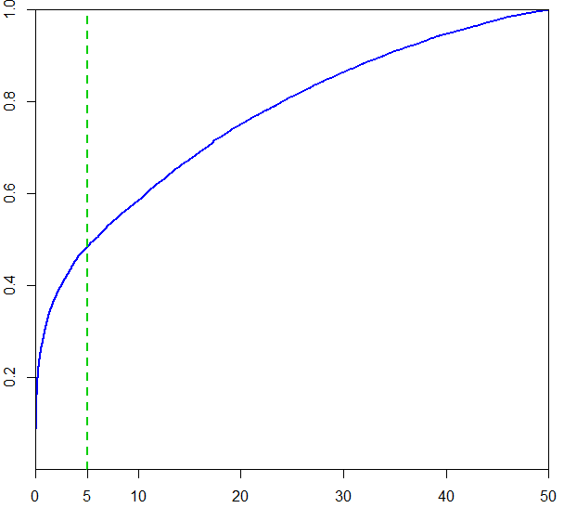
How soon the target events occur?
About a half of target events occur within 5 days from foreshock occurrences.
Cumulative portion
Time interval between foreshock and target event (days)
Notes:
At last, we’d like to give an answer for a natural question “How soon the target events occur?”
Because forecasting time horizon at 50 days is a bit long,
we might want to know the risk of large earthquakes in shorter period.
here we show the cumulative distribution of time interval between foreshocks and target events.
According to this curve, about~
We should note that this is only a rough estimate because it may depend on some features of clusters.

Slide 43
Summary
We proposed cluster-based foreshock discrimination models using information of magnitudes, space, and time in seismic clusters.
Our models can provide real-time forecast of larger earthquake for 30/50 days from the latest event in each cluster.
The actual portion of foreshocks was consistent with the evaluated foreshock probabilities in validation datasets.
We will try to develop an ensemble model of our forecasts with aftershock forecasts given by e.g. ETAS models and submit that model to prospective earthquake forecasting tests (CSEP Japan Testing Center).
Notes:
This is the summary.

Slide 44
7
Thank you
Notes:
2019/10/6
44

